Slide 1

Golf Merit Badge
Option 2
Disc Golf
Troop 344 and 9344
Pemberville, OH

Slide 2
Golf Merit Badge Requirements
Discuss safety on the golf course. Show that you know first aid for injuries or illnesses that could occur while golfing, including lightning, heat reactions, dehydration, blisters, sprains, and strains.
Complete Option 2: Disc Golf

Slide 3
Golf Merit Badge Requirements
Discuss safety on the golf course. Show that you know first aid for injuries or illnesses that could occur while golfing, including lightning, heat reactions, dehydration, blisters, sprains, and strains.
Complete Option 2: Disc Golf
Study the "PDGA Official Rules of Disc Golf" now in use.
  Tell about the six areas of Courtesy (812).
  Describe the seven areas of Scoring (808).

Slide 4
Golf Merit Badge Requirements
Tell about your understanding of the "PDGA Disc Golfer's Code."
Do the following:
  Tell about the history of disc golf and why it is an inclusive game.
  Discuss with your counselor the contributions Ed Headrick made to the sport of disc golf.
  Describe the evolution of disc design.
  Tell about the accomplishments of a top disc golfer of your choice.
    Do the following:
    Tell how disc golf can contribute to a healthy lifestyle, mentally and physically.
    Tell how a disc golf exercise plan can help you play better. Show two exercises that would help improve your game.

Slide 5
Golf Merit Badge Requirements
Show the following:
  A good throwing grip
  A good run-up (X-step) when throwing a disc
  Backhand shot
  Forehand shot
  Overhand shot
  Rolling shot
  A good (in-line) putting stance
  A good straddle putting stance
  A good putting grip
  A good putting motion and follow through
  The proper use of a mini-marking disc

Slide 6
Golf Merit Badge Requirements
Play a minimum of 18-holes of disc golf with another disc golfer about your age and with your counselor, or an adult approved by your counselor. Do the following:
  Follow the "PDGA Official Rules of Disc Golf."
  Practice good disc golf etiquette.
  Show respect to fellow disc golfers and other people in the park along with any wildlife, trees, and plants on the property.
Find out about three careers related to disc golf. Pick one and identify the education, training, and experience required for this profession. Discuss this with your counselor, and explain why this interests you.

Slide 7
Requirement #1
Discuss safety on the golf course. Show that you know first aid for injuries or illnesses that could occur while golfing, including lightning, heat reactions, dehydration, blisters, sprains, and strains.

Slide 8

1 Lightning Dangers
How to stay safe from lightning on the disc golf course.
Check the forecast and check it often.
Download a reliable radar app.
Check the courses policy on lightning and if they have a lightning detection/prediction system.
Seek Shelter Immediately.
  Do not stand under tall trees.
  Do not stand under a lone tree, even a small one.
  Stay away from the metal baskets
  Stay away from water.
  If stranded in the open, go to a low place such as a ravine or valley, or the lowest spot you can find.

Slide 9
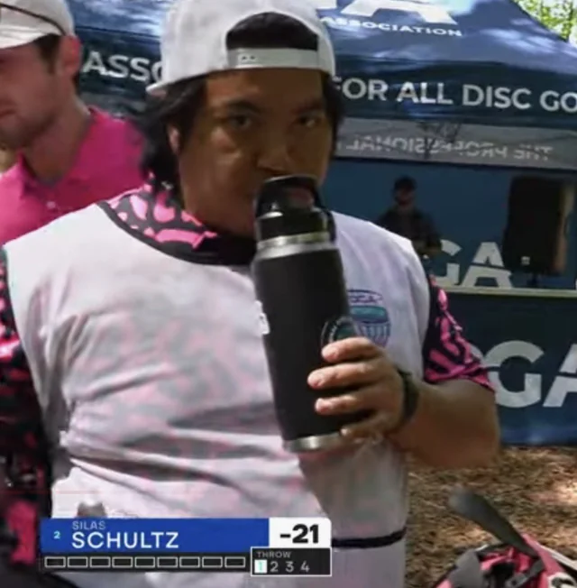
1 Dehydration
When the body puts out more liquid than it is taking in.
Ways we lose fluids:
  Sweating.
  Urination.
  Vomiting.
Signs of dehydration:
  Thirst.
  Yellow or dark urine.
  Dry mouth.
  Lightheadedness.
  Nausea and vomiting.
  Dry skin.
  Cease sweating.
Treatment:
  Drink fluids (water, Gatorade).
  Avoid physical activity.
  Get inside air conditioned or cool area.

Slide 10
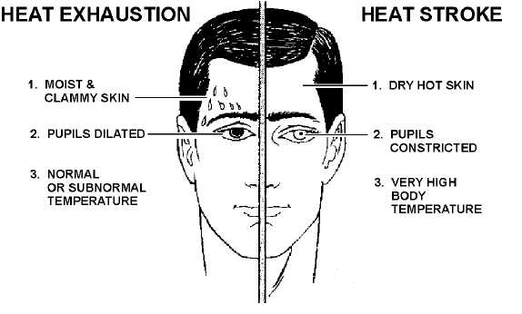
1 Heat Emergencies

Slide 11

1 Heat Exhaustion
Heat exhaustion symptoms:
  Heavy sweating
  Thirst
  Fatigue
  Heat cramps
  Headache
  Dizziness
  Nausea
  Vomiting

Slide 12
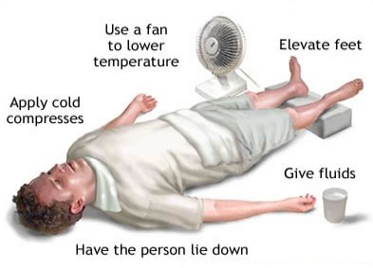
1 Heat Exhaustion
First aid for heat exhaustion:
  Move victim from heat to rest in a cool place.
  Loosen or remove unnecessary clothing.
  Give water or a sports drink.
  Raise feet 8-12 inches.
  Put cool, wet cloths on forehead and body – spray skin with water.
  Seek medical care if victim’s condition worsens or does not improve within 30 minutes.

Slide 13
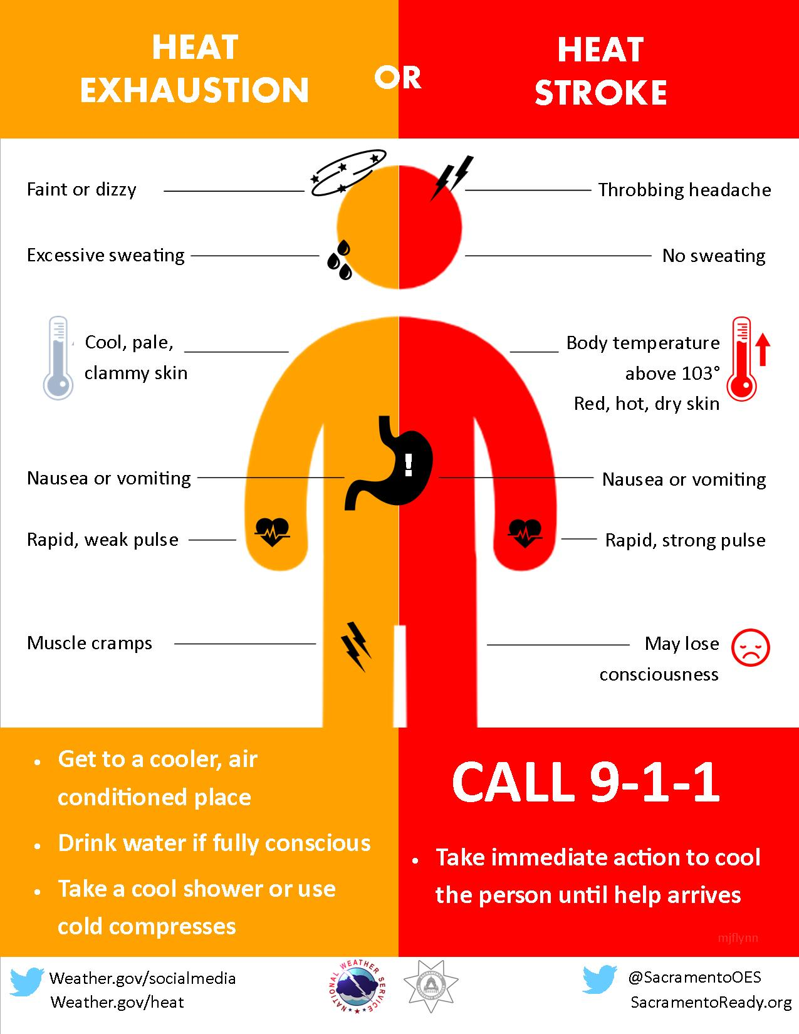
1 Heatstroke
First aid for heat stroke.
  Call 911.
  Move victim to cool place.
  Remove outer clothing.
  Cool victim quickly.
  Apply cold compresses or spray skin with water.
  Put ice bags or cold packs beside neck, armpits, and groin.

Slide 14
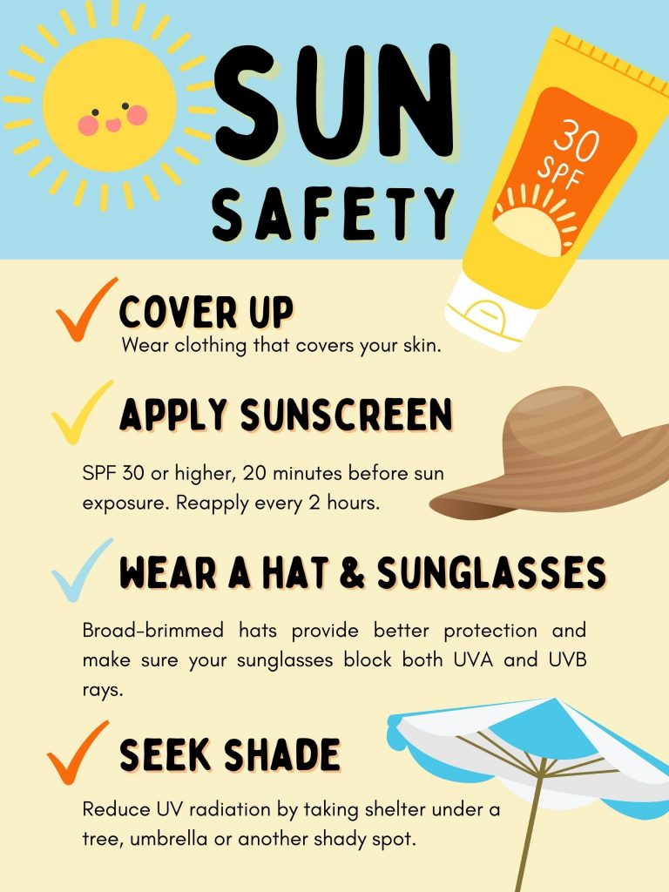
1 Sunburn
Severe sunburn can be a significant first aid situation.
Sunburn is preventable with protective ointments, clothing, or staying out of the sun.
Long term effects of sunburn has been linked to skin cancers.

Slide 15


1 Sunburn
Symptoms:
  Redness.
  Minor inflammation, or swelling.
  Pain.
  Dry, peeling skin occurs as the burn heals.
Treatment:
  Soak the wound in cool water for five minutes or longer.
  Take acetaminophen or ibuprofen for pain relief.
  Apply lidocaine (an anesthetic) with Aloe Vera to soothe the skin.
  Use an antibiotic ointment and loose gauze to protect the affected area.
  Make sure you don’t use ice, as this may make the damage worse.

Slide 16
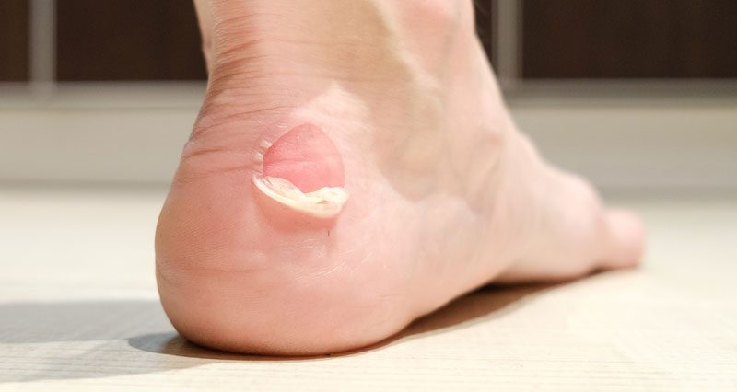
1 Blisters
A blister is skin injury that is usually filled with water.
Blisters commonly occur on the feet or hands.
They are most often caused by the hands or feet rubbing against something (such as wearing new shoes).

Slide 17
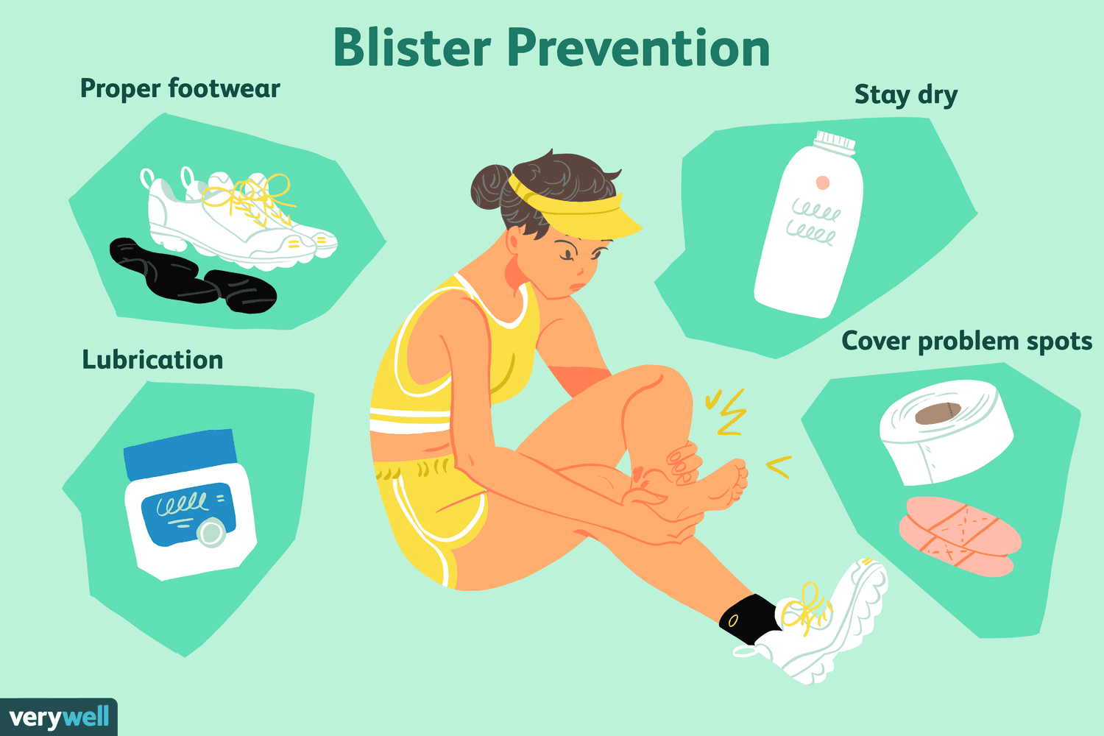
1 Treatment for Blisters
Do not open the blisters, since this increases the possibility of infection.
Clean the skin around it.
Take the pressure off the area by placing a Band-Aid over the blister or Moleskin with a hole cut in the center.
If the blister accidentally breaks open, trim off the loose skin.
Keep the surface clean by washing it twice a day with an antibacterial soap (such as Dial or Safeguard).
Apply an antibiotic ointment and a Band-Aid to help with healing.

Slide 18
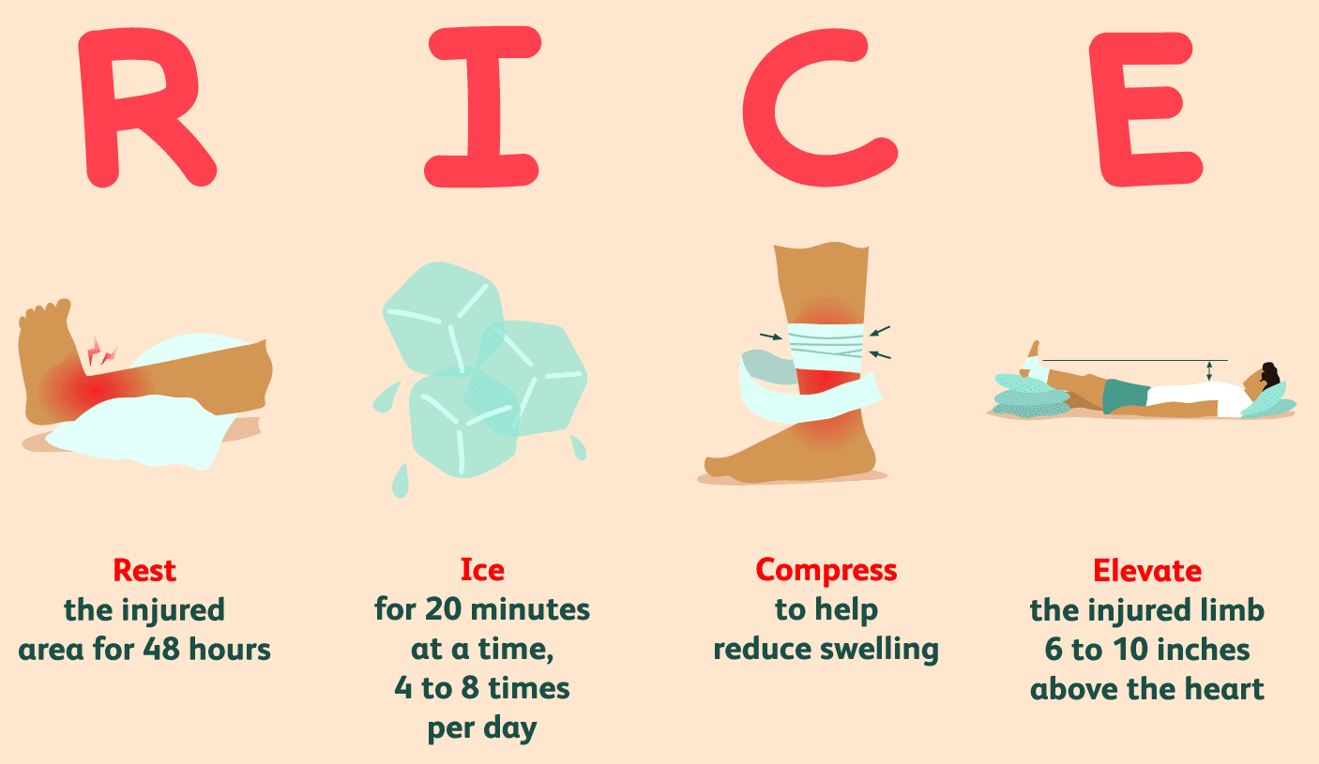
1 Sprains and Strains
Treat both sprains and strains with RICE.
  Helps to relieve pain and swelling.
  Promotes healing and flexibility.
RICE stands for:
  Rest and protect the injured or sore area.
  Ice or a cold pack used as soon as possible.
  Compression, or wrapping the injured or sore area with an elastic bandage.
  Elevation (propping up) the injured or sore area.
  Aspirin or ibuprofen can help with pain and swelling.
  Seek medical attention if appropriate.

Slide 19
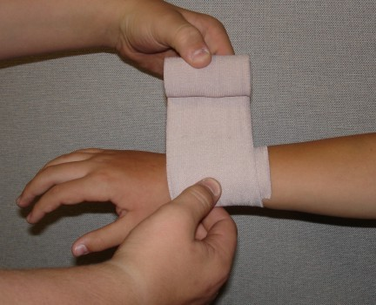
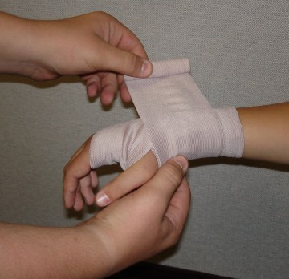
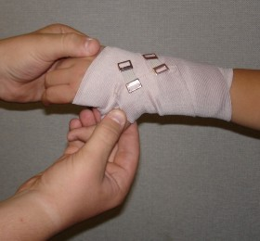
1 Sprains and Strains
Wrapping a Sprain with an Elastic Bandage
1. Hold end in place for first turn of bandage
2. Continue with overlapping turns (overlap by about 3/4 of previous turn
3. Fasten end of bandage with clips, tape, or safety pins
88

Slide 20

Requirement #2 A
Study the "PDGA Official Rules of Disc Golf" now in use.
  Tell about the six areas of Courtesy (812).
  Describe the seven areas of Scoring (808).

Slide 21
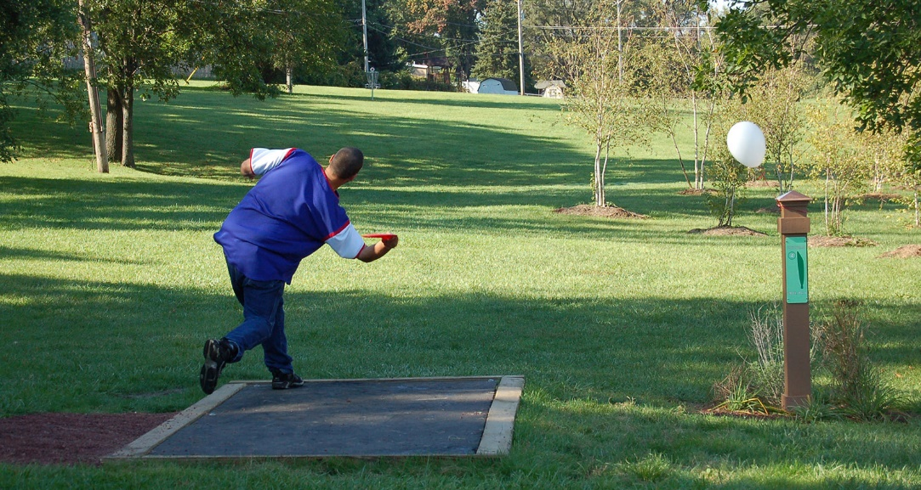
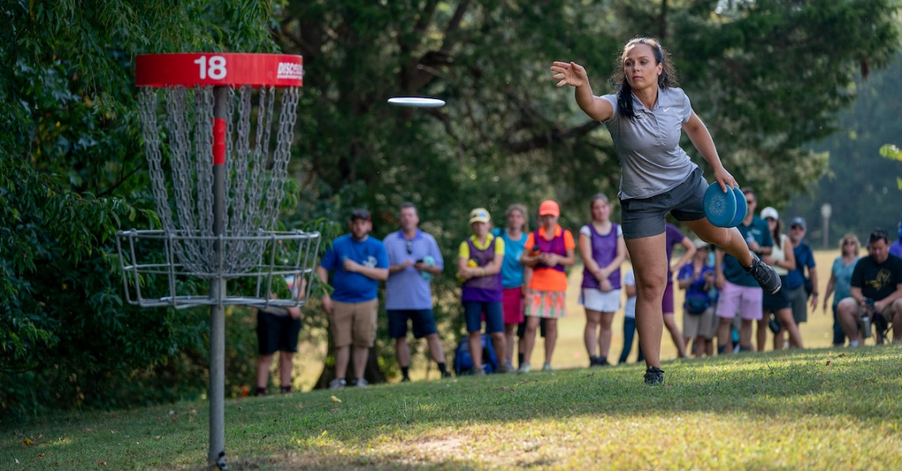
Introduction to Disc Golf
Disc golf is similar to regular golf; however, instead of using golf clubs and balls aiming for a hole, Disc Golf players use golf discs and aim for a Disc Pole Hole, a pole extending up from the ground with chains and a basket where the disc lands.
The object of the game is to complete each hole in the fewest number of throws, starting from a tee area and finishing at the Disc Pole Hole.
Generally, a course is 9 or 18 Disc Pole Holes long.
Players start at hole one and complete the course in order, playing through to the last hole.
The player with lowest total cumulative score wins.

Slide 22
Basic Rules of Play for Disc Golf
The object of disc golf is to have fun and complete the course in the fewest throws. Safety and courtesy are important. Be careful of plants, animals and other visitors. Throw only when the landing area is clear of people including other players.
Start from the teeing area. The player must throw from behind the front of the teeing area.
Subsequent shots are played from behind the spot where the previous shot came to rest. This spot is known as the "lie". If your disc comes to rest in a tree or a bush, the lie is the spot on the ground directly below.
A run-up and follow through are allowed, but the player must release the disc before stepping past the lie.
A putt is a throw from within 10 meters (32.8 ft.) of the target. When putting, you may not step past your lie until the disc comes to rest.
The hole is completed when the disc comes to rest in the basket or chains. The hole is not completed if the disc is resting on the top of the target.
If a shot goes out-of-bounds: play from either the last in-bounds location with a 1-stroke penalty or retee with a 1-stroke penalty.
A mandatory, or mando, is one or more designated trees or other obstacles in the fairway that must be passed on the correct side as indicated on the tee sign. If your disc passes to the wrong side of the mando, either play from the previous lie or from a marked drop zone area if applicable and add a one throw penalty to your score.
The player with the least amount of strokes on the previous hole is the first to tee off on the next hole. After all players have teed off, the player whose disc is farthest from the hole always throws first.

Slide 23
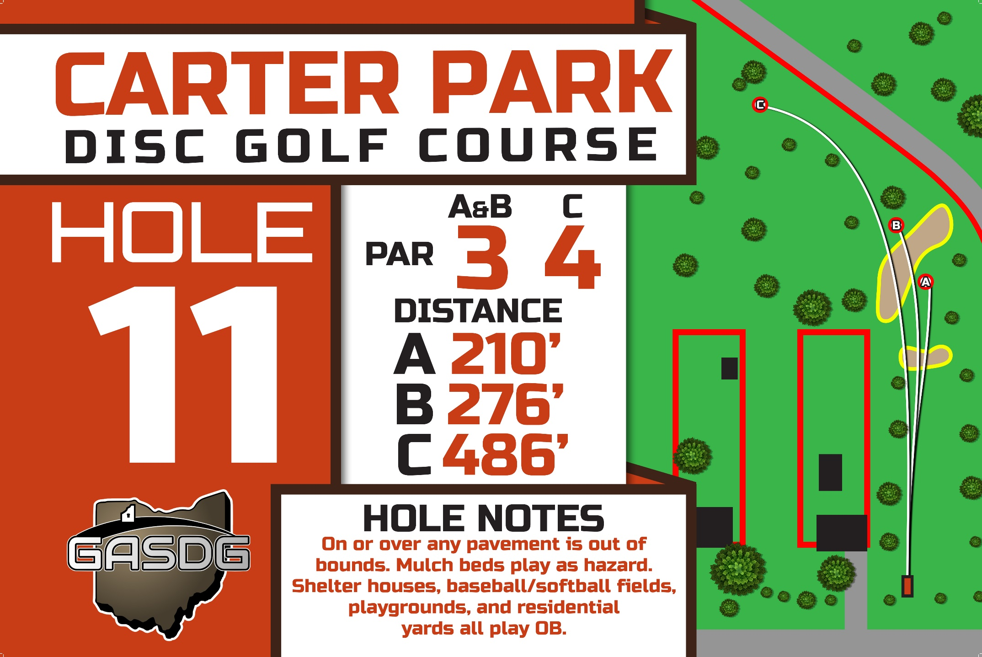

Slide 24
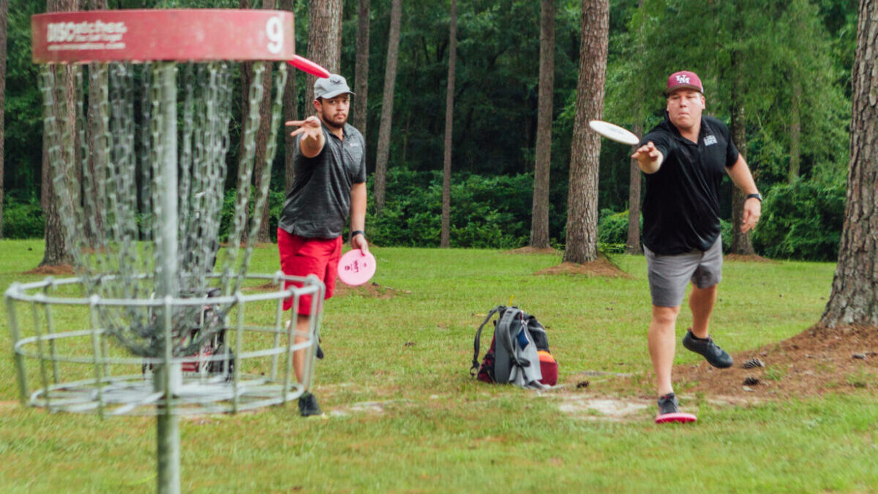
812 Courtesy
A player must not:
  Throw if the throw might injure someone or distract another player; or,
  Throw out of order without consent or when it would impact another player; or,
  Engage in distracting or unsportsmanlike actions such as:
    Shouting (unless warning someone at risk of being struck by a disc),
    Cursing,
    Striking, kicking, or throwing park, course, or player equipment,
    Moving or talking while another player is throwing,
    Advancing beyond the away player; or,
  Leave equipment where it may distract other players or interfere with a thrown disc; or,
  Litter, including cigarette butts; or,
  Allow their smoke to disturb other players.

Slide 25
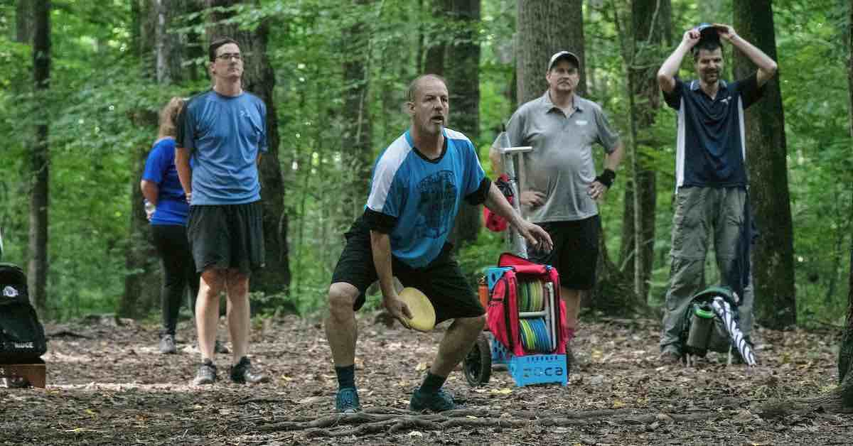
812 Courtesy
A player must:
  Perform actions expected by the rules, including:
    Helping to find a lost disc; and,
    Moving equipment when asked; and,
    Keeping score properly.
  Watch the other members of the group throw in order to ensure rules compliance and to help find discs.

Slide 26
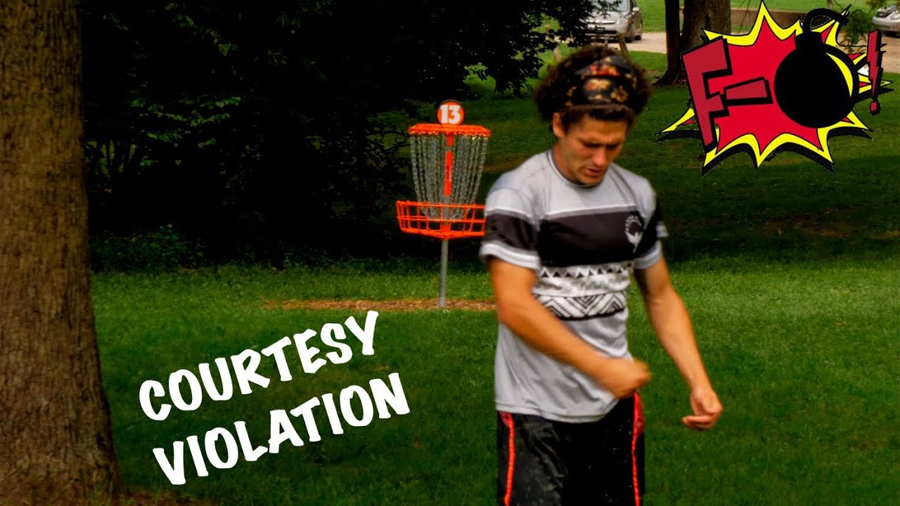
812 Courtesy
A player receives a warning for the first violation of any courtesy rule. Each subsequent violation of any courtesy rule by that player in the same round incurs one penalty throw. A courtesy violation may be called or confirmed by any affected player, or by an Official. Repeated courtesy violations may result in disqualification by the Director.
#$!&@

Slide 27
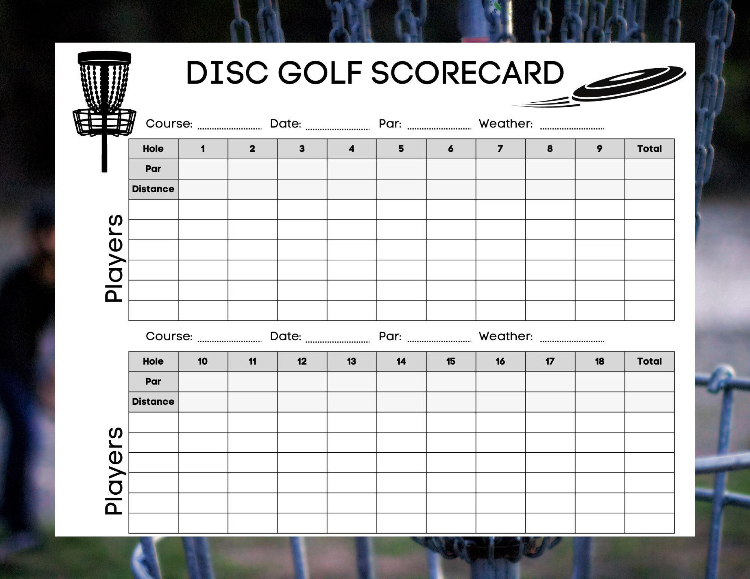
808 Scoring
Each player must keep an independent scorecard recording scores after each hole for the entire group. A player who refuses to keep score may be subject to disqualification.
Players may delegate scorekeeping duties only to their designated caddie.

Slide 28
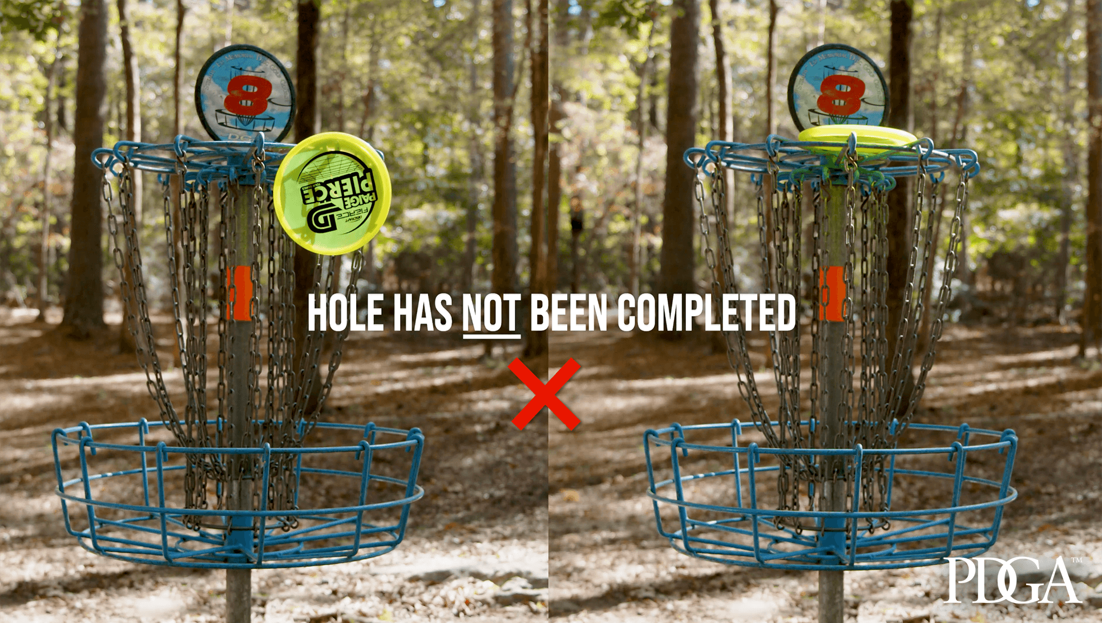
808 Scoring
After each hole has been completed, each player records the score for every player in the group in a manner that makes each score clear to every player in the group. Any warnings or penalty throws are to be noted along with the score for the hole.
The score for a player on a hole is the total number of throws, including penalty throws. The total score for the round is the sum of all hole scores, plus any additional penalty throws. The use of anything other than a number as a score (including the lack of a score) is subject to penalty as described in 808.G.2.

Slide 29
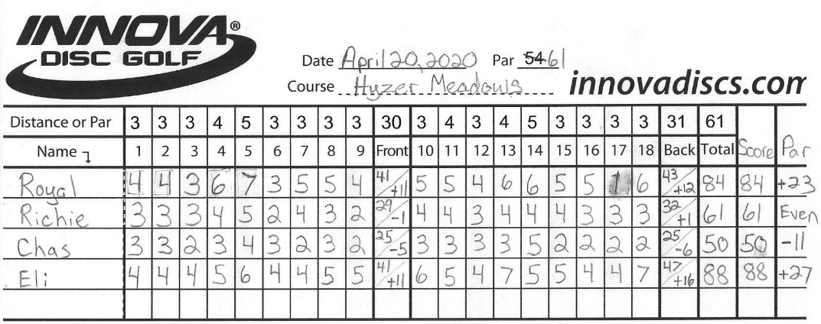
808 Scoring
If there is disagreement about the score a player reports, the group reviews the hole and attempts to arrive at the correct score. If the group cannot reach consensus on the player's score, they seek the help of an Official or the Director as soon as is practical. If all players in the group agree that a score is incorrect, the score may be corrected before the scorecard is submitted.
All players are responsible for reconciling and submitting their copy of the scorecard within 30 minutes of when their group finishes their round. A player who has not submitted their scorecard on time receives two penalty throws.

Slide 30
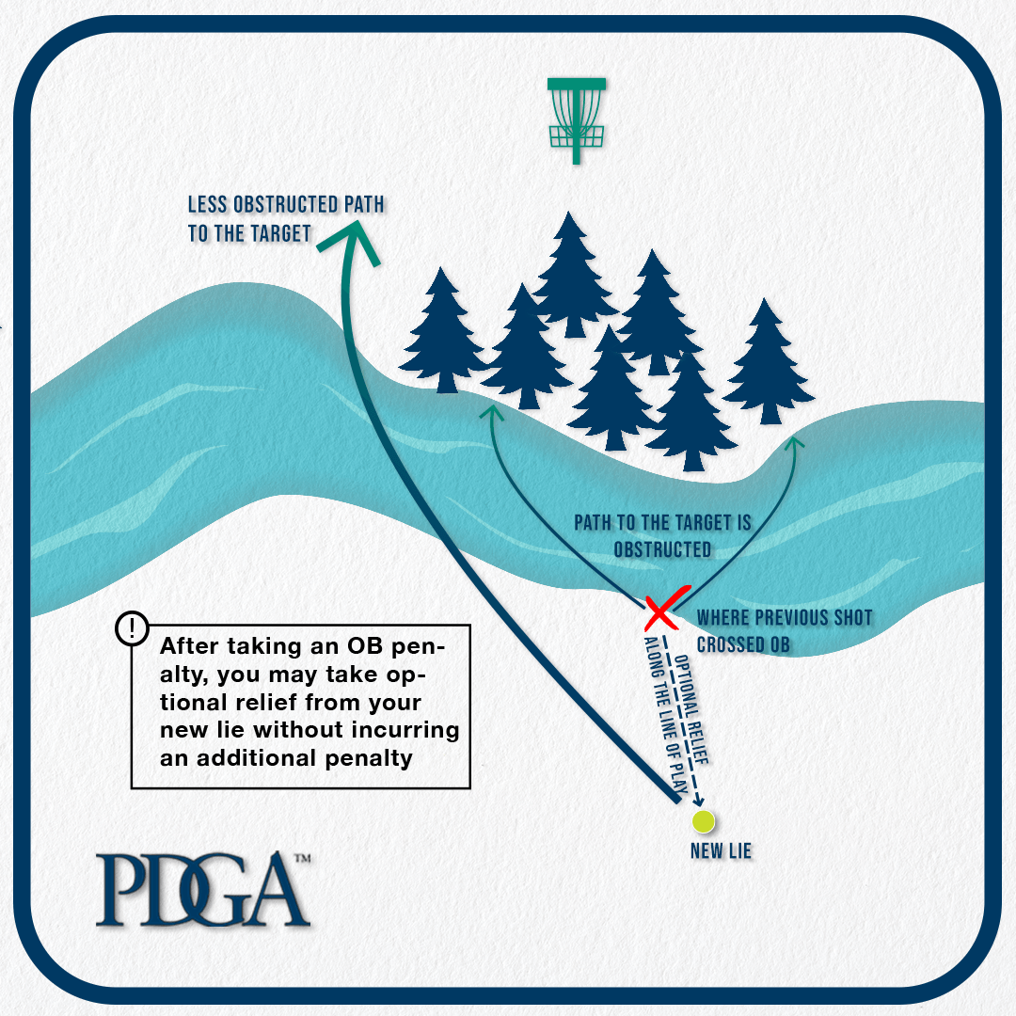
808 Scoring
After the scorecard has been submitted, the total score as recorded is final, except for the following circumstances:
  Penalty throws may be added or removed by the Director up until the Director declares the tournament over, or all awards have been distributed.
  If a player submits a scorecard where their total score or hole scores are incorrect, improperly recorded, or missing, two penalty throws are added to the correct total score. Those penalty throws are not added when the score has been adjusted for other violations determined after the player had submitted an otherwise correct scorecard.
  A player is not penalized if another member of their group submits an incorrect scorecard.

Slide 31

Requirement #2 B
Tell about your understanding of the "PDGA Disc Golfer's Code."

Slide 32
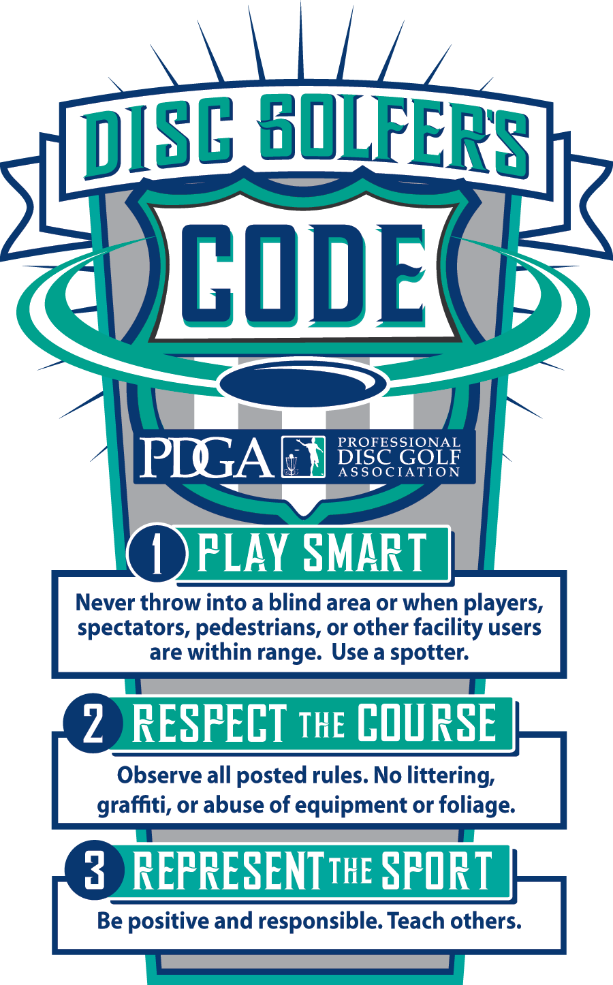

Slide 33
Requirement #2 C
Do the following:
  Tell about the history of disc golf and why it is an inclusive game.
  Discuss with your counselor the contributions Ed Headrick made to the sport of disc golf.
  Describe the evolution of disc design.
  Tell about the accomplishments of a top disc golfer of your choice.

Slide 34
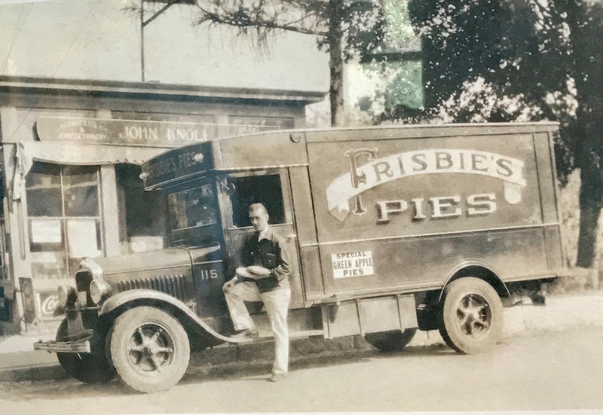
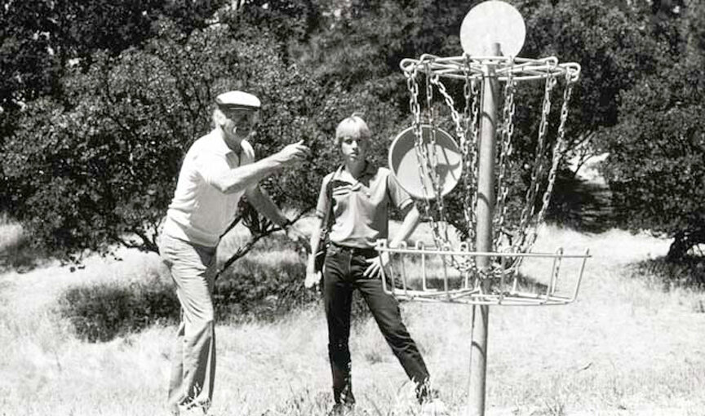
History of Disc Golf
1926 – In Saskatchewan, Canada a group of elementary school friends played a game called 'Tin Lid Golf'.
  Throwing tin lids into 4-ft wide circles made around the school grounds.
1940’s – The tossing of the Frisbie Pie Company's pie tins by college students at Yale and Dartmouth led to Frisbie becoming a well known term for flying disc play in the Northeast.
1966 – First Frisbee was patented by "Steady" Ed Headrick, aka the Father of Disc Golf.
1974 – Disc golf became an organized sport.
1975 – Headrick patented the Disc Golf Pole Hole and installed the first official disc golf course at Oak Grove Park in Pasadena, CA.
1983 – David Dunipace invented the modern beveled-edge golf disc.
Today it is one of the fastest-growing sports in the world with courses on every continent, even Antarctica.
Disc golf is inclusive in that all ages and skill levels can play this game.

Slide 35
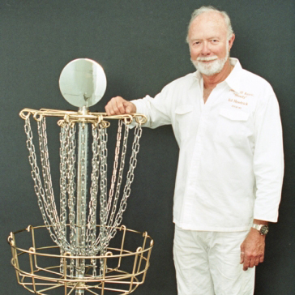
Ed Headrick
Ed Headrick is considered the Father of Disc Golf.
Of his dozens of patented inventions, two of them hold infinite importance to our sport.
The first was the Frisbee in 1966 as an employee at Wham-O.
The second was the basis of all disc golf targets today, the Disc Golf Pole Hole in 1975.

Slide 36
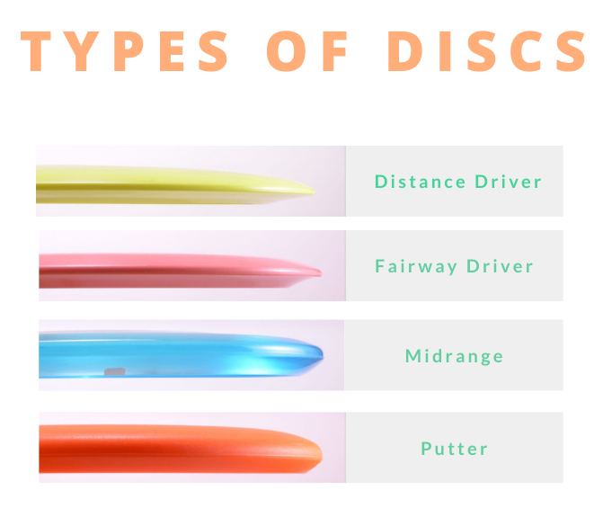
Evolution of Disc Design
In 1983 a company called Champion Discs, now known as Innova debuted its first Disc Golf specific Disc, The Eagle, designed by Dave Dunipace.
Following the introduction of the Eagle, the disc golf industry saw a rapid expansion in the variety of discs available, catering to different throwing styles, skill levels, and flight characteristics.
Disc manufacturers began experimenting with various plastic types, leading to the development of durable, high-performance materials that could withstand the rigors of disc golf.
Discs evolved to include various categories, such as distance drivers, fairway drivers, mid-range discs, and putters, each designed for specific shots and situations on the course.

Slide 37
Top 10 Disc Golfers in 2024
Men
Women
Eagle McMahon
Calvin Heimburg
Paul McBeth
Simon Lizotte
Ricky Wysocki
Kyle Klein
Gannon Buhr
Isaac Robinson
Matthew Orum
Bradley Williams
Kristin Tattar
Ohn Scoggins
Holyn Handley
Hailey King
Missy Gannon
Henna Blomroos
Eveliina Salonen
Paige Pierce
Ella Hansen
Kat Mertsch

Slide 38
Requirement #2 D
    Do the following:
    Tell how disc golf can contribute to a healthy lifestyle, mentally and physically.
    Tell how a disc golf exercise plan can help you play better. Show two exercises that would help improve your game.

Slide 39

Healthy Lifestyle with Disc Golf
Disc golf can be good for your health and your heart.
  On short, nine-hole disc golf courses, players walk about a mile/1.6 kilometers on average.
  They tend to cover just under three miles/4.8 kilometers on very long, 18-hole courses.
Playing 18 holes will add over 5000 steps to your step total.
  Increasing your step count by 1,000 steps per day (over a baseline median step count of ~4000) can lead to a 15% decrease in all-cause mortality..
Playing disc golf regularly can help you:
  Stay fit.
  Improve muscle tone and endurance.
  Lose weight and body fat.
  Reduce stress.

Slide 40

Healthy Lifestyle with Disc Golf
Other benefits of disc golf:
  Reduces stress due to physical activity and the joy of being close to nature.
  Is an excellent way to stay in touch with friends.
  Improves social interactions by bringing together people who have a shared interest.
  Develops a sense of bonding with your community.
  Helps you retain a sense of achievement by becoming better at something that you enjoy doing.
  Actively engages your body and mind.

Slide 41
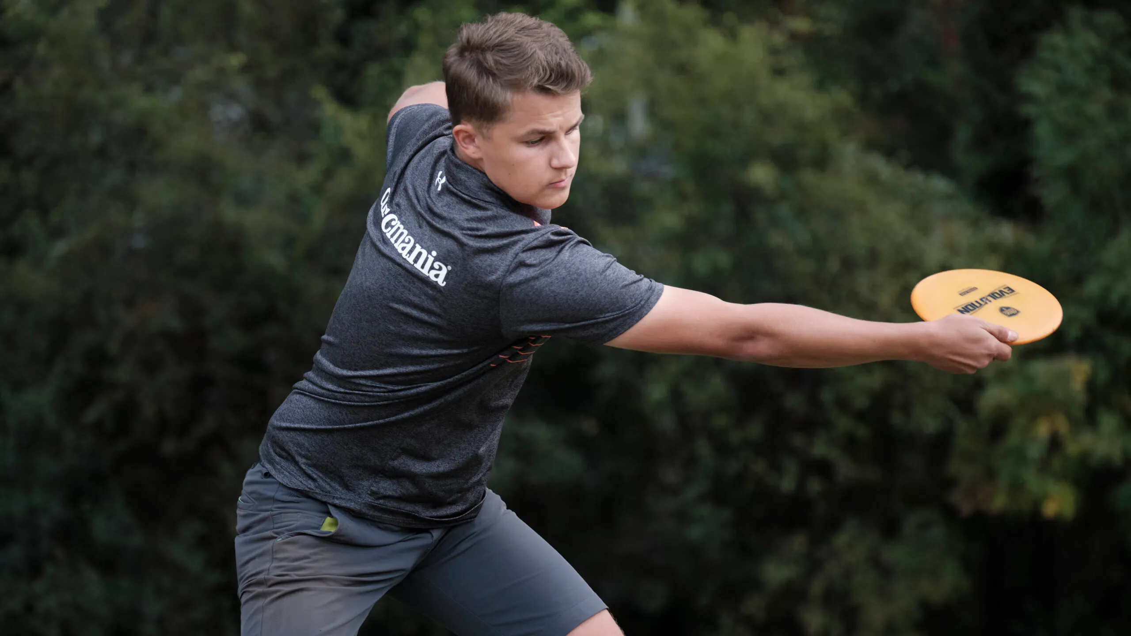
Exercise to Improve Your Game
Training is important to prevent injury to muscles and joints and will also improve your overall performance.
  Getting stronger will enable you to release with more power increasing the distance and speed of each throw.
  You will also develop more endurance giving you more energy for the entire disc golf course.

Slide 42

Exercises to Improve Your Game
Five exercises are recommended for disc golf strength training: Leg Curl, Push Up, Squat/Split Squat, One Armed Row, and Overhead Press. Click on the video to see how to perform these exercises.

Slide 43
Requirement #2 E
Show the following:
  A good throwing grip
  A good run-up (X-step) when throwing a disc
  Backhand shot
  Forehand shot
  Overhand shot
  Rolling shot
  A good (in-line) putting stance
  A good straddle putting stance
  A good putting grip
  A good putting motion and follow through
  The proper use of a mini-marking disc

Slide 44
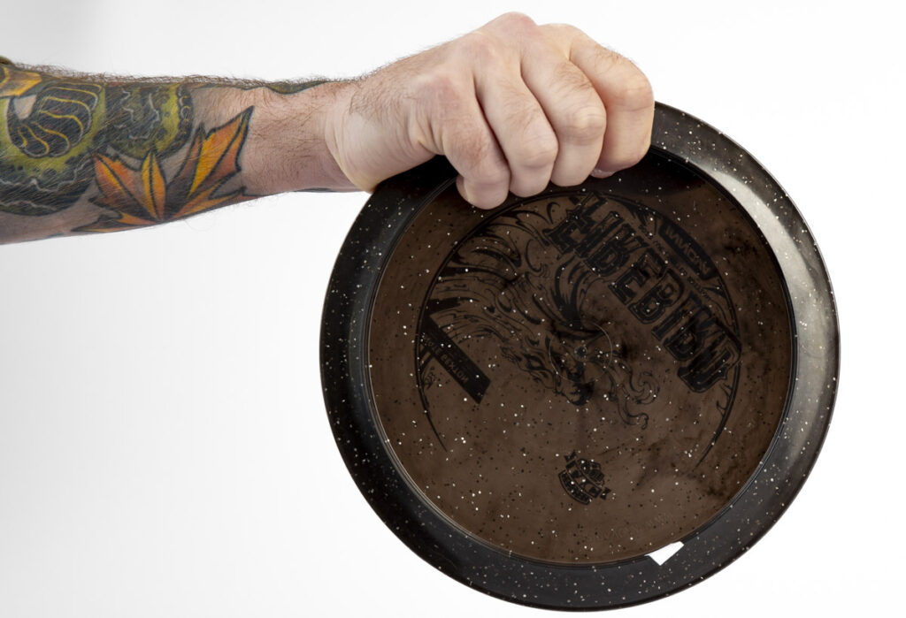
Throwing Grip
Power Grip
  This is the go-to grip for maximum distance.
  All four fingers are tucked tightly under the disc’s rim, with the thumb on top to provide control.
  It’s ideal for drives where you need to cover a lot of ground.

Slide 45
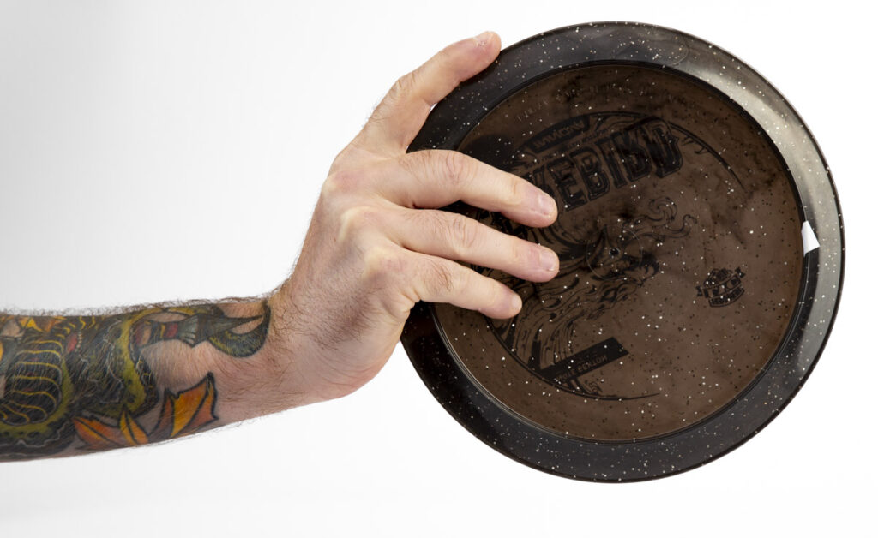
Throwing Grip
Fan Grip
  Used primarily for mid-range shots and putts, the disc golf fan grip offers more control.
  Fingers are spread out or ‘fanned’ under the disc, with the thumb on top, allowing for precise throws.

Slide 46
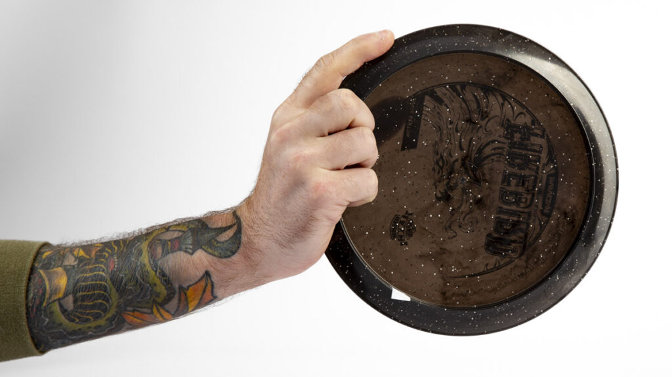
Throwing Grip
Modified Fan Grip
  A variation of the fan grip, it combines elements of both the power and fan grips, offering a balance of distance and control. This grip is often used for approach shots.

Slide 47
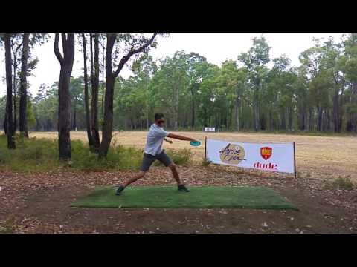
X-Step Run-Up
Click on the above video for a slow motion tutorial on how to do the X-Step Run-Up.

Slide 48
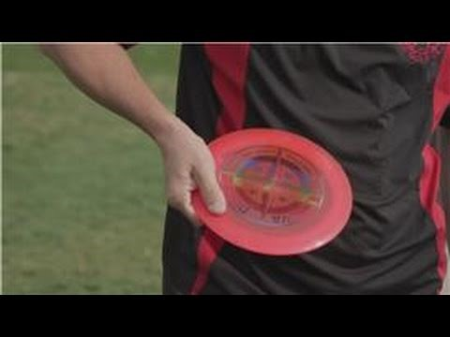
Backhand Shot
Click on the above video for a tutorial on how to do the Backhand Shot with the X-Step Run-Up.

Slide 49
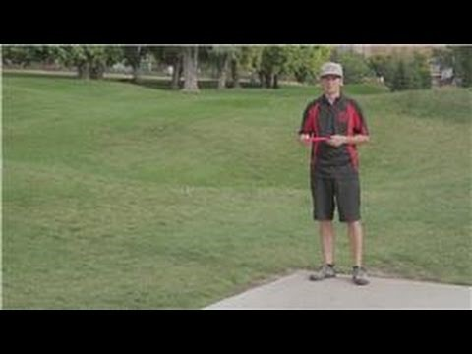
Forehand shot
Click on the above video for a tutorial on how to do the Forehand Shot.

Slide 50
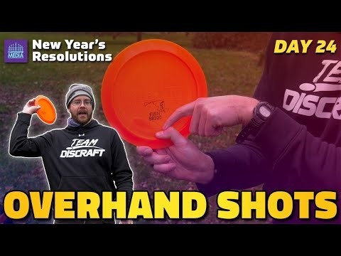
Overhand Shot
Click on the above video for a tutorial on how to do the Overhand Shot.

Slide 51
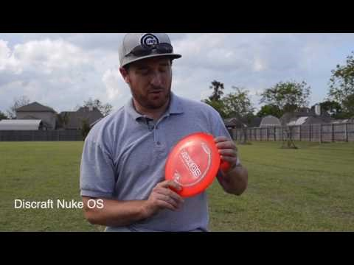
Rolling Shot
A roller is a disc golf throwing technique wherein the disc rolls along the ground rather than flies through the air. Click on the above video for a tutorial on how to do the Rolling Shot.

Slide 52
In-Line vs Straddle Putting Stance
In-Line (Staggered) Stance
Straddle Stance
The In-Line stance has the players feet staggered one in front of the other forming a line.
The player will bring the disc back and hinge at the waist and then extend the disc forward in a line to the basket.
The great thing about this stance is the player is using their weight transfer from the back foot to their forward foot and putting straightforward which keeps aiming the putt quite simple.
Wherever your front foot is pointing is where you will be putting.
The straddle putt refers to putting with your legs stretched apart usually about shoulder width.
Your weight should be distributed equally between both feet.
When using the straddle putt players are drawing the disc back and under them and then extending it forward until their release.
Video about putting stances on next slide

Slide 53
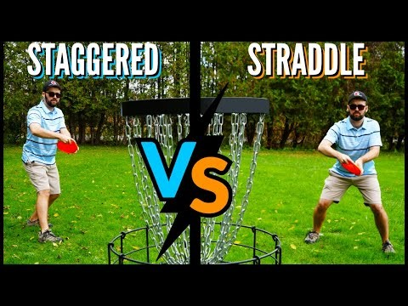
Staggered and Straddle Putting Stance
Click on the above video for a tutorial on how to do the Staggered (In-Line) and Straddle Putting Stance.

Slide 54
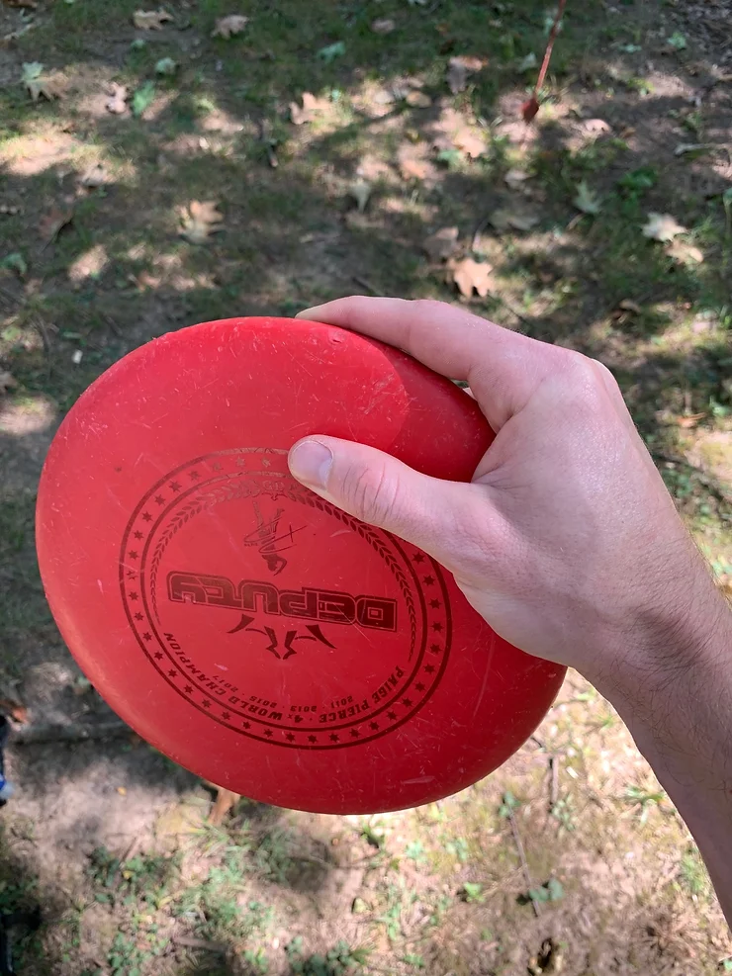
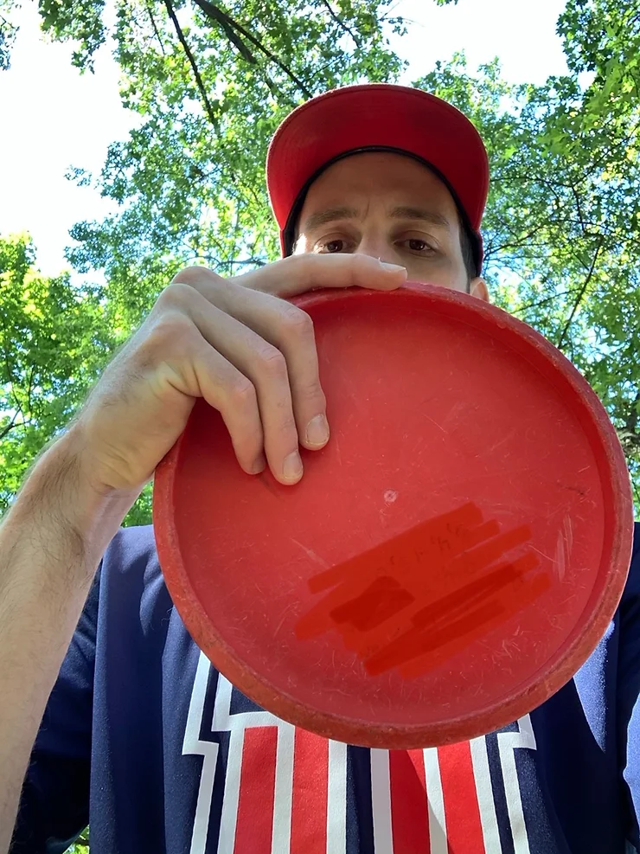
Putting Grip #1
As shown in the picture, the thumb rests on top of the disc and pointed towards the opposite side, not to the top of the disc.
Underneath the disc the fingers are close together. Some players prefer to "fan" their fingers apart. As you practice, you will figure out how you prefer to place them. Keep them the same from putt to putt.

Slide 55
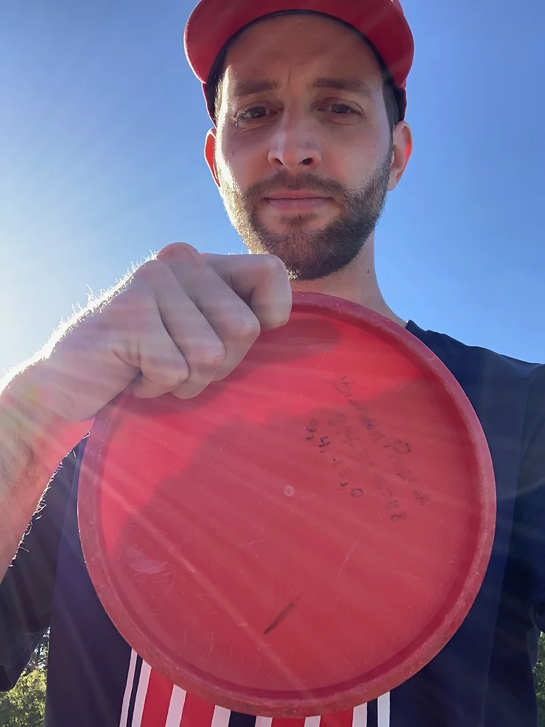
Putting Grip #2
For grip 2, the hand will look the same on top, but on the bottom, the fingers will be gripping the side wall of the disc, rather than fanning out across the bottom.
This grip is commonly used with longer putts.

Slide 56
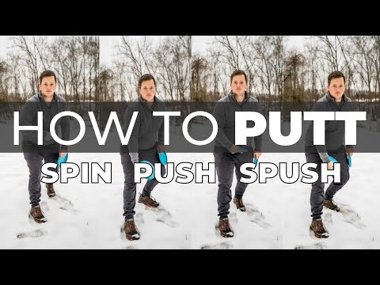
Putting Motion and Follow Through
Click on the above video for a tutorial on how to putt in disc golf. This video is meant to be a comprehensive guide for beginners to learn how to spin, push, and spush putt.

Slide 57
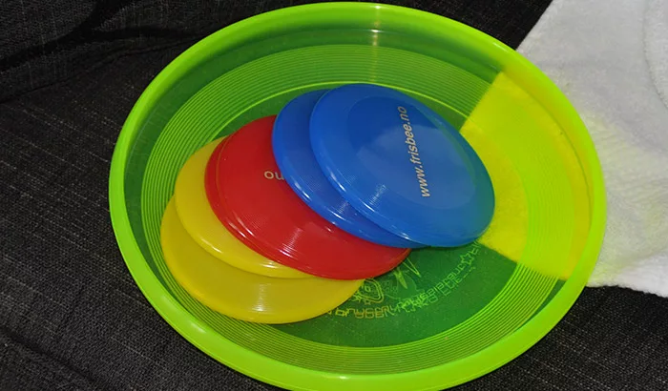
Mini-Marking Discs
The main purpose of mini disc golf discs is to mark the position of the disc previously thrown.
Every time a player throws a disc, his position on the course changes.
He then has to throw another disc (or the same disc, depending on usage) to get nearer to the hole.
However, the nearest spot to the hole from which he can throw is where the previous disc landed.
This spot is called the lie.
The mini disc marks that spot.
If a player doesn’t have a mini disc, he has to leave his previously thrown disc on the spot it landed.

Slide 58
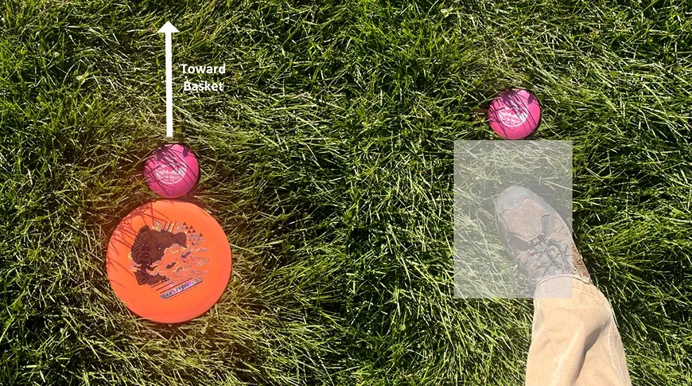
Using a Mini-Marking Disc
The player may mark the lie by placing a mini marker disc on the playing surface, touching the front of the thrown disc on the line of play.
Example – A drive lands in the middle of the fairway. You have a choice: leave the disc where it’s at and throw in the 20cm x 30cm area behind the disc, or place a mini marker in front of his disc, pick up the disc, and throw in the area behind the mini marker.

Slide 59
Requirement #2 F
Play a minimum of 18-holes of disc golf with another disc golfer about your age and with your counselor, or an adult approved by your counselor. Do the following:
  Follow the "PDGA Official Rules of Disc Golf."
  Practice good disc golf etiquette.
  Show respect to fellow disc golfers and other people in the park along with any wildlife, trees, and plants on the property.

Slide 60
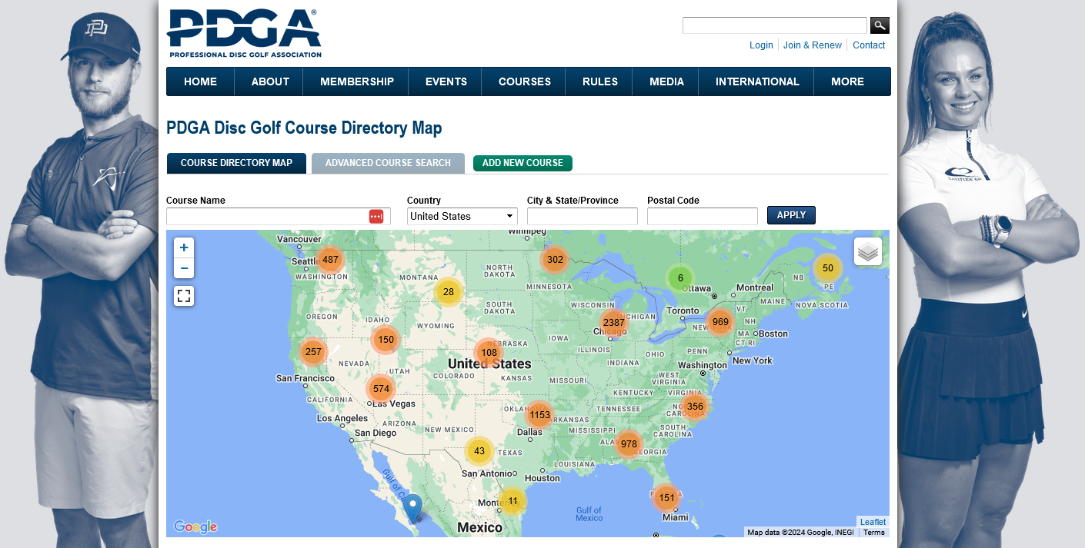
Log in to the PDGA Disc Course Directory to locate a disc golf course near you.

Slide 61
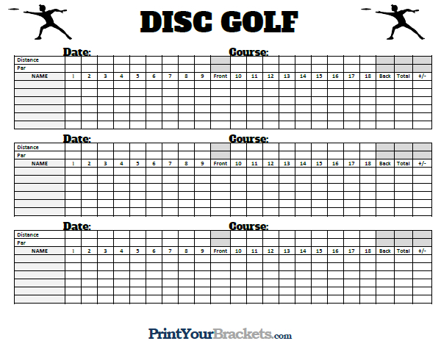
Disc Golf Scorecard
Download and print out a Disc Golf Scorecard

Slide 62
Requirement #2 G
Find out about three careers related to disc golf. Pick one and identify the education, training, and experience required for this profession. Discuss this with your counselor, and explain why this interests you.

Slide 63
Disc Golf Jobs
Disc golf jobs include positions in coaching and training, video production and editing, content creation and copywriting, social media management and marketing, graphic design and branding, web development and maintenance, course maintenance, and equipment manufacturing for the sport of disc golf.
Depending upon your job, you may help golfers as they play their way through the course, explain the game to newcomers, produce training videos, create marketing material for a disc golf supply company, or help manufacture products for this game.
Some disc golf jobs are seasonal positions, usually taking place over the summer, but indoor disc golfing facilities and courses in temperate locations may offer disc golf jobs throughout the year.
You may help to manage and maintain turf, mow and fertilize grass, maintain irrigation systems, paint lines, numbers, and logos, and perform special projects as needed.
You can find these jobs with both private companies and local governments.

Slide 64
Qualifications to Get a Disc Golf Job
The primary qualifications for getting a disc golf job include an associate degree or equivalent experience from a college or technical school and one year of related work experience.
Many employers also accept several years of additional experience in place of a degree.
Some employers also require you to have a valid driver's license, CPR certification, and a Pesticide Applicator's License for maintaining the course.
Disc golf jobs with local governments may have additional requirements.
Fulfilling the responsibilities and duties of a disc golf job requires communication skills.
The ability to perform a variety of groundskeeping tasks throughout the year and physical stamina would be necessary for course maintenance.

Slide 65
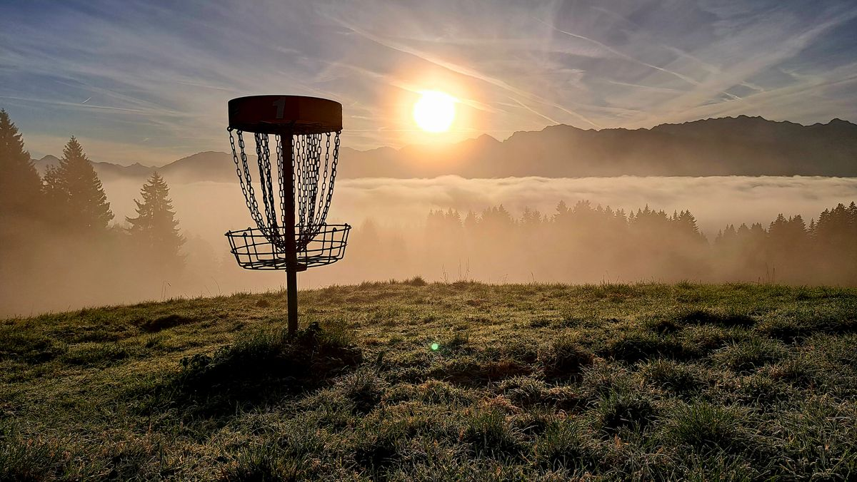
The End

