Slide 1
Backpacking Guide Course #3
Terry McKibben
Troop 344/9344
Pemberville, OH
troop344leaders@gmail.com

Slide 2
CONTENTS
01
Backpacks
Choosing a Backpack, Fitting a Backpack, Backpack Care
02
Packing a Backpack
Packing List, Packing Your Equipment

Slide 3
Choosing a Backpack
Fitting a Backpack
Backpack Care
01
Backpacks

Slide 4
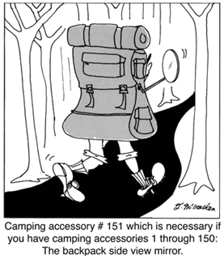
How to Choose a Backpack
Planning to buy a new pack for backpacking?
There are three main areas where you’ll need to make choices.
Backpack capacity: The size of the pack you’ll need is tied to the length of your trip and how much weight and bulk you want to carry.
Backpack features: These are the refinements that affect how the pack works for you.
Backpack fit: Torso length—not your height—matters most.

Slide 5
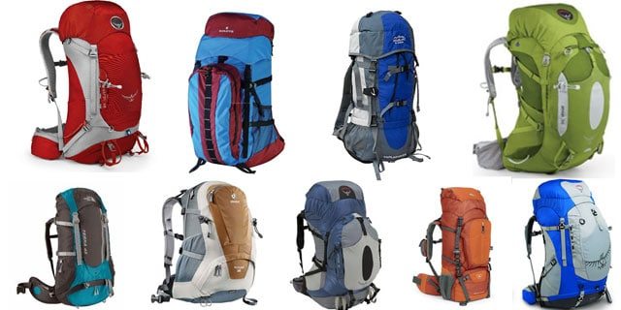
Types of Backpacks
Weekend (1-3 nights; 30-50 liters)
Efficient packers using newer, less-bulky gear can really keep things light on 1- to 3-night trips by using a pack in this range (requires self-discipline and careful planning).
Multiday (3-5 nights; 50-80 liters)
These are the most popular backpacking packs.
They’re an excellent choice for warm-weather trips lasting 3 or more days.
Extended-trip (5+ nights; 70 liters or larger)
Trips of 5 days or more usually call for packs of 70 liters or more.

Slide 6
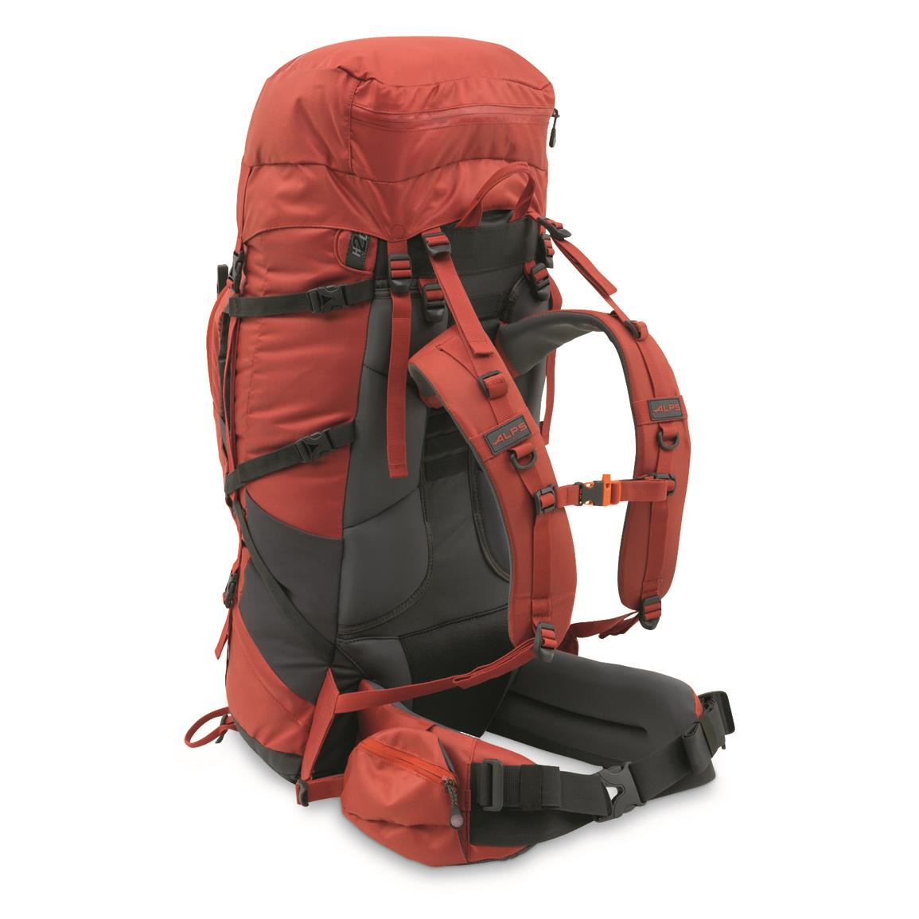
Backpack Features
Frame Type
Internal-frame backpacks: The majority of packs sold today are body-hugging, internal-frame packs where the structure is hidden inside the back panel.
They are designed to keep a hiker stable on uneven, off-kilter terrain and may incorporate a variety of load-support technologies that all function to transfer the load to the wearer’s hips.

Slide 7
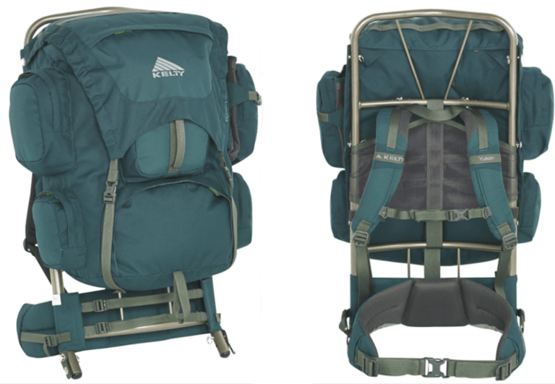
Backpack Features
Frame Type
External-frame backpacks: With an external-frame pack, you can see the structure that supports the load: aluminum (usually) hardware on the outside.
Because the frame extends beyond the packbag, a backpack like this may be an appropriate choice if you’re carrying a heavy, irregular load (like an oversize tent).
External-frame packs also offer good ventilation and lots of gear organization options.

Slide 8
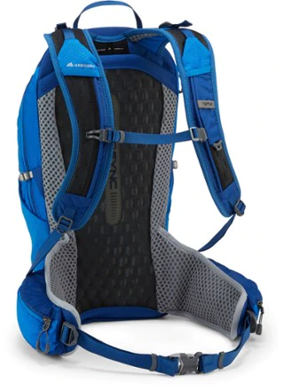
Backpack Features
Frame Type
Frameless backpacks: Ultralight devotees who like to hike fast and light might choose a frameless pack or a climbing pack where the frame is removable for weight savings.
But packs without a frame are much more uncomfortable under heavy loads.

Slide 9
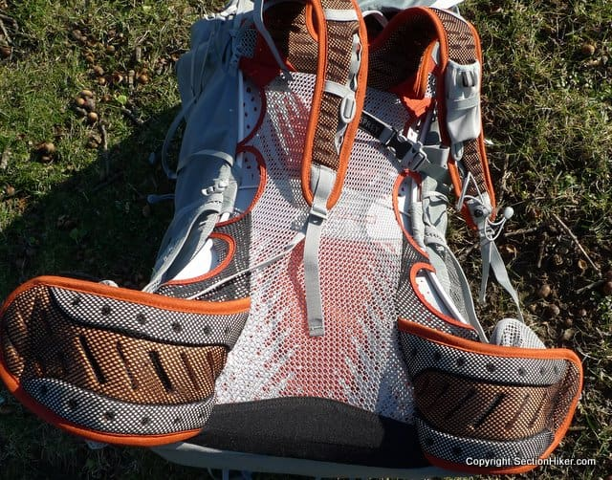
Backpack Features
Ventilation
Some packs feature a suspended mesh back panel to combat the sweaty-back syndrome you tend to get with internal-frame packs that ride against your body.
Also called a “tension-mesh suspension,” this is a trampoline-like design where the frame-supported packbag rides a few inches away from your back, which instead rests against the highly breathable mesh.
Other packs will have ventilation channels (sometimes called “chimneys”) in the back panel to solve the same issue.

Slide 10
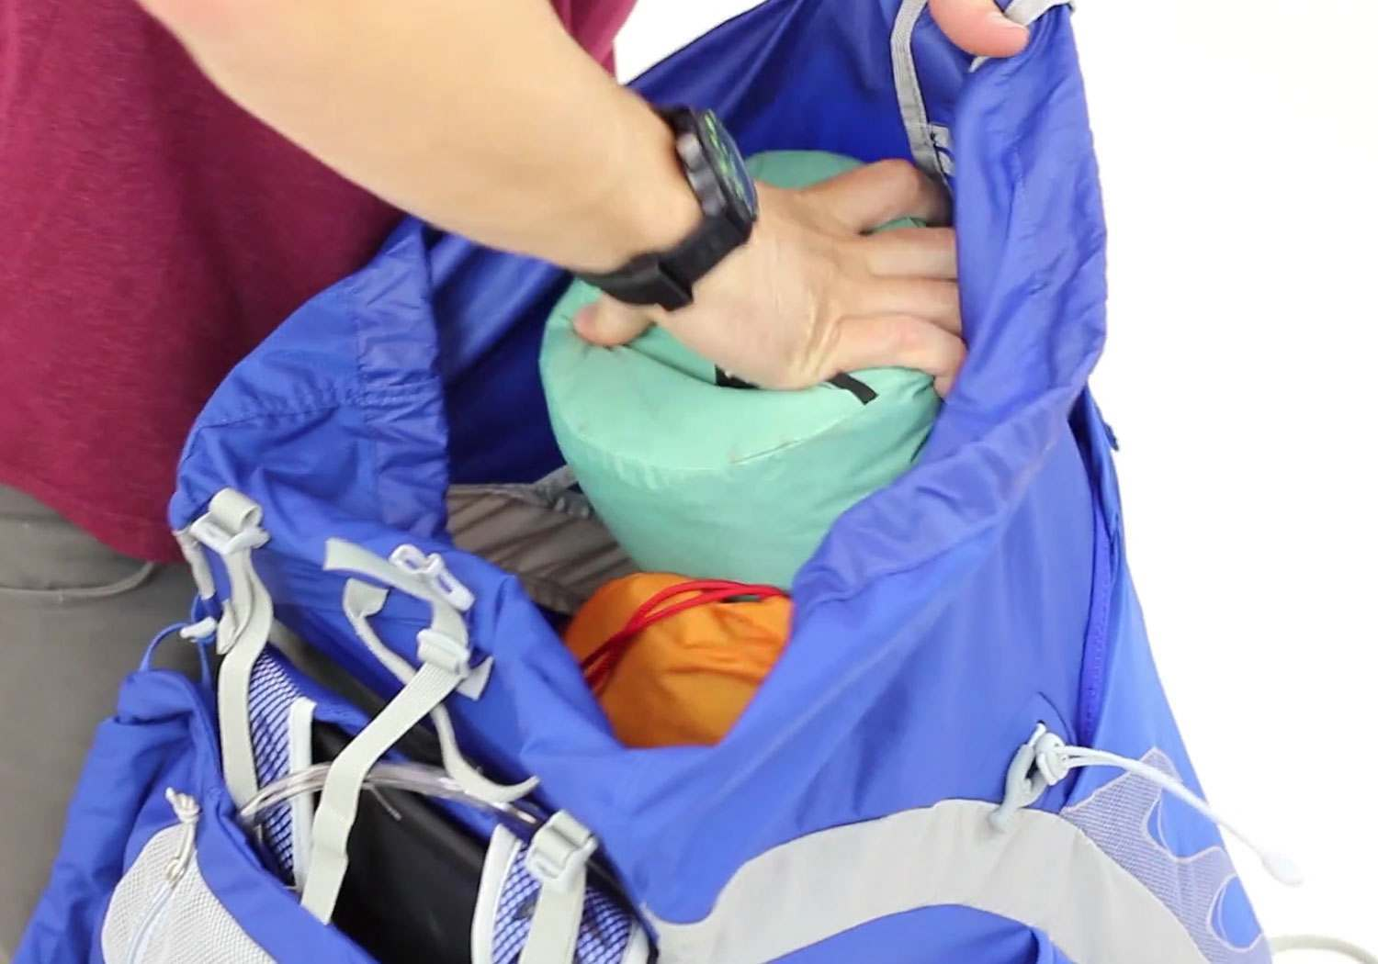
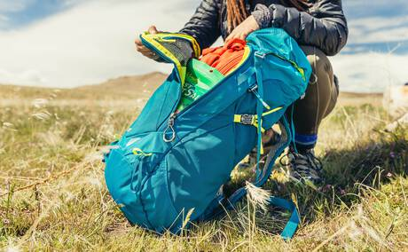
Backpack Features
Pack Access
Top-loading openings are pretty standard.
Since items near the bottom and sides are the toughest to get to, smart packers will store overnight gear there and stuff they need for hiking or throughout the day closer to the top.
Some packs, however, have panel access, so you can unzip the main pack bag without unloading it from the top.
Keep in mind that additional features like this tend to add both ounces and dollars.

Slide 11
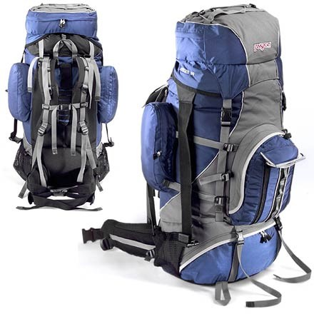
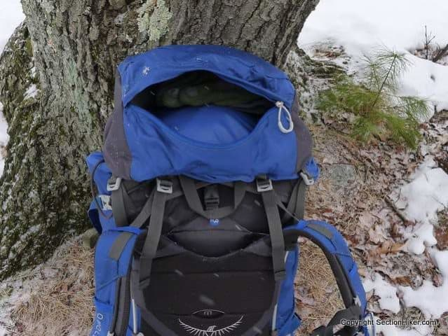
Backpack Features
Pockets
Some people like lots, and some people prefer a more streamlined pack. When evaluating pockets, consider the size and placement of each. For instance, elasticized side pockets lie flat when empty, but stretch out to hold a water bottle, tent poles or other loose objects. They can often be reached when wearing the pack. Hipbelt pockets accommodate small items you want while hiking like a phone, snacks, lip balm or sunscreen.
The top lid pocket (sometimes called a pack’s “brain”) is also a matter of preference. Some folks like a single opening for things like sunglasses and a headlamp, while others prefer a top lid with multiple compartments.

Slide 12
Backpack Features
Sleeping Bag Compartment
This is a zippered stash spot near the bottom of a packbag.
It’s a useful feature if you don’t want to use a stuff sack for your sleeping bag or if you want to be able to pull your sleeping bag out of the backpack without unloading other gear.
Though it’s designed to carry a sleeping bag, this space can hold other stuff that you’d like to access easily.

Slide 13
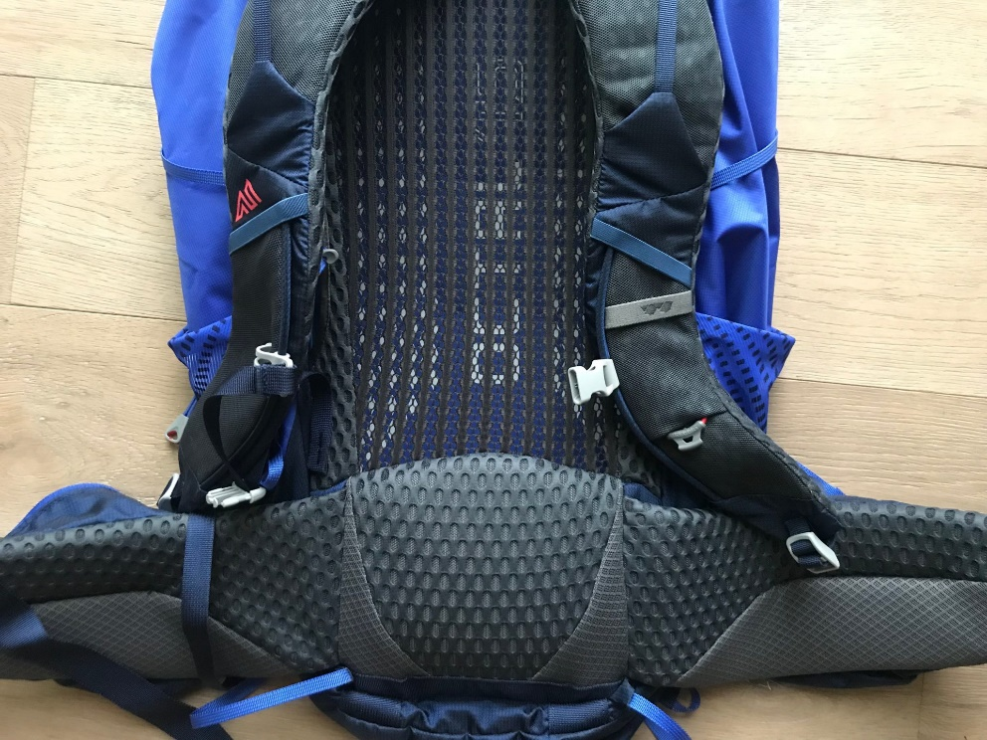
Backpack Features
Padding
If you’re using a lightweight pack with a fairly minimalistic hipbelt and lumbar pad, you can suffer sore spots on your hips, lower back or shoulders.
If this is the case for you, consider using a cushier hipbelt.
First, make sure your pack is sized and fit correctly.

Slide 14
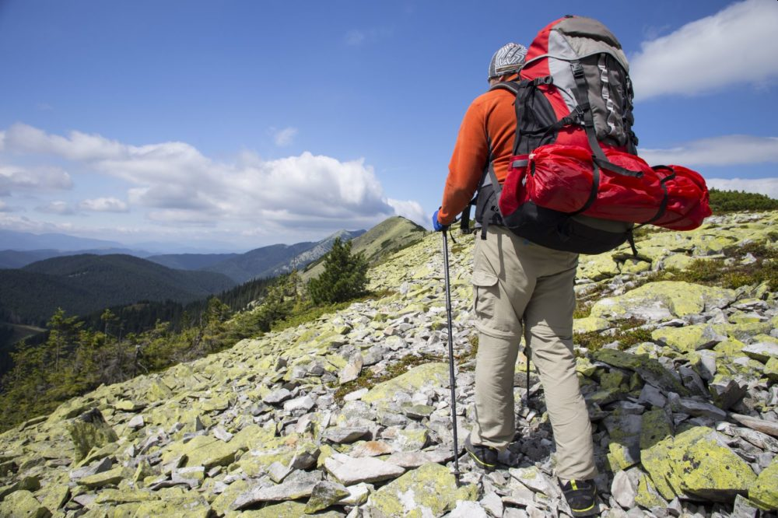
Backpack Features
Attachment Points
Tool loops: Allow you to attach an ice axe or trekking poles to the exterior of the pack.
Daisy chain: This is a length of webbing stitched to the outside of a pack that provides multiple gear loops for attaching wet gear or anything that didn’t fit inside the main packbag.
Extra gear loops: Gear loops on the hipbelt or low on the pack body are useful for tents or sleeping pads.

Slide 15
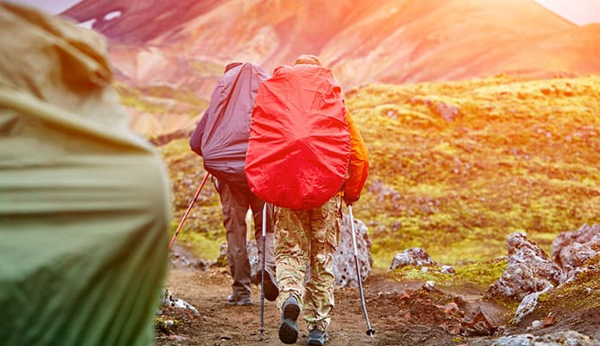
Backpack Features
Raincover
If you expect rain on your trip, this is a good item to carry.
Pack fabric interiors are usually treated with a waterproof coating, but water can seep through seams and zippers.
Also, the fabric’s exterior absorbs some water weight during a downpour.

Slide 16
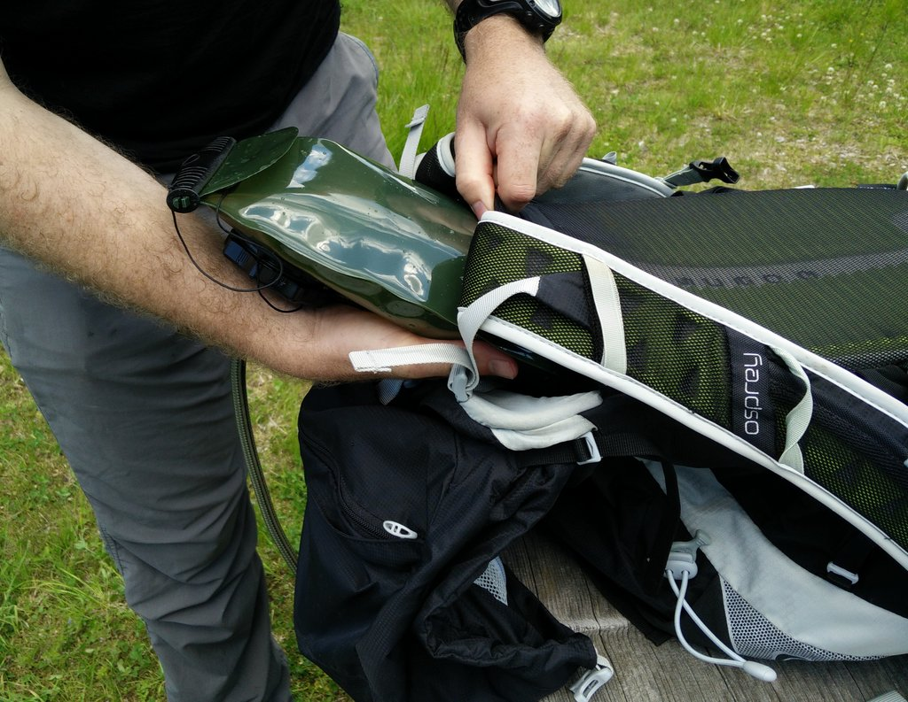
Backpack Features
Hydration Reservoir
Nearly all packs offer an internal sleeve that holds a hydration reservoir (almost always sold separately), plus one or two portals for the tube.

Slide 17
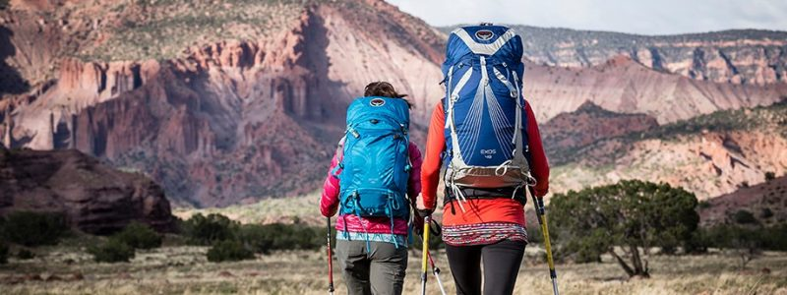
How to Fit a Backpack
Above all else, the best backpack for you is the one that fits your body the best.
One of the keys to finding that right backpack is to get one that is the correct size (e.g., small, medium, large).
Your torso length—not your height or weight—is the key measurement.
The following slides give steps for measuring at home. Your best resource, though, is a pack-fit expert at an outfitting store . Store experts can visually assess your unique fit needs and work through them with you.
These slides will also cover how to adjust the fit of your new pack and suggests tweaks to manage comfort as you hike.

Slide 18
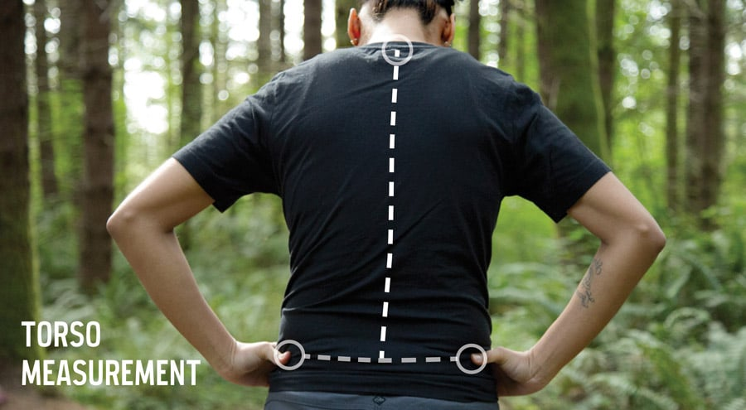
Measure Your Torso Length
In order to accurately determine this key spec, you’ll need a friend and a flexible tape measure.
Tilt your head forward and feel for the bony bump where the slope of your shoulders meets your neck. This is your 7th cervical (or C7) vertebra—and the top of your torso length.
On each side of your body, slide your hands down the ribcage to the top of your hip bones (aka the iliac crest). With index fingers pointing forward and thumbs pointing backward, draw an imaginary line between your thumbs. This spot on your lumbar is the bottom of your torso measurement.
Stand up straight and have your friend measure the distance between the C7 and the imaginary line between your thumbs. That’s your torso length.

Slide 19
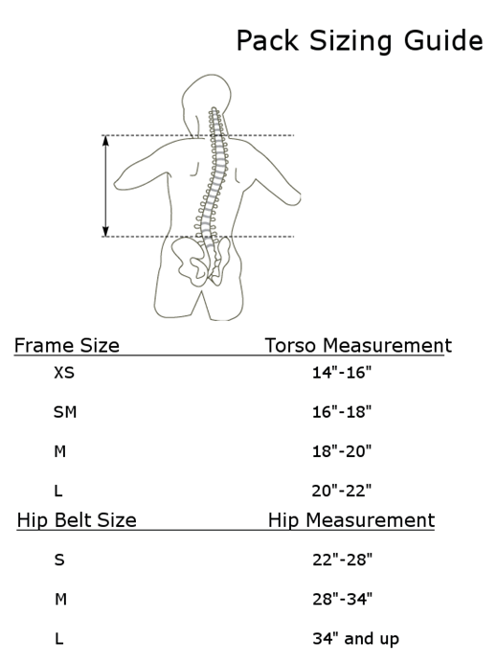
Use Your Torso Length to Find Your Pack Size
Torso ranges for pack sizes vary between brands and models, so always check the size chart for any pack you are considering.
If you fall between sizes, visit an outfitting store to try on each size.
In addition, because home measurement is rarely perfect, your best fit will always come if you physically try on backpacks.

Slide 20
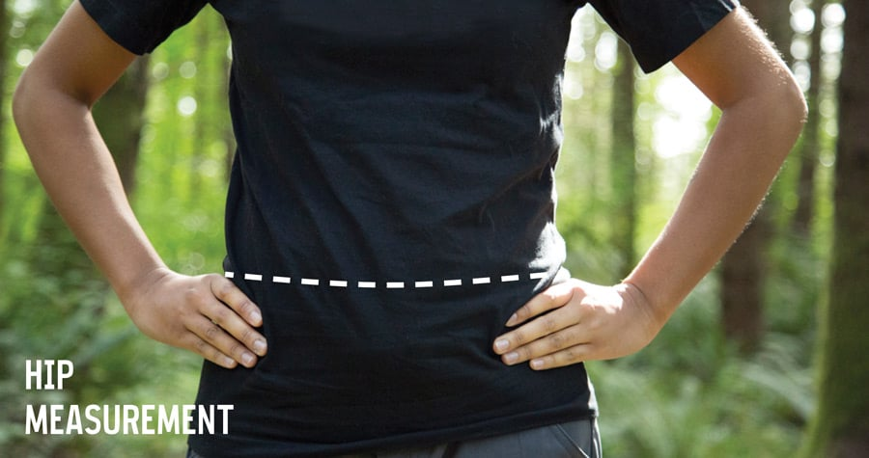
Measure Your Hip Size
While it’s rare for a pack’s waist/hips sizing to be off if your pack size is correct for your torso length, it’s still important to check your hip measurement. You’ll be carrying most of your pack weight on your hips, so good hipbelt fit is critical.
To measure your hip size, wrap your tape measure around the top of your hips, hugging the iliac crest you found when measuring your torso length. This line is slightly higher than your beltline, so hipbelt size differs slightly from pant-waist size.
Double check with the outfitter to be sure the waist/hip measurement on your chosen pack size is right for you. If not, check with the outfitter to find out about interchangeable hipbelt options.

Slide 21
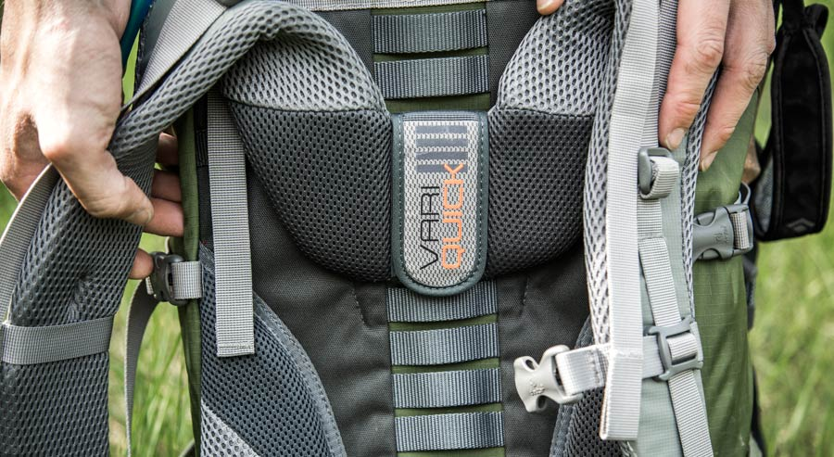
Adjusting Torso Length
Found on a lot of packs, adjustable suspension enables a pack to fit a wider range of torso lengths and to more precisely fit individual users. Different brands use different systems, but most of them are fairly intuitive. If you buy a pack with this feature, torso length is your first—and most important—fit adjustment.
If your other fit adjustments don’t seem to work correctly, re-check and reset the torso length. Adjustment straps can’t compensate for an incorrectly set adjustable suspension system. If you're having trouble, bring the pack to an outfitter for help.

Slide 22
Fit Adjustment at Home
Your new backpack has several straps to adjust your load for greater comfort. Your legs have some of the strongest muscles in your body, so the goal is to adjust your straps so that the majority of the load rests on your hips.
You have four primary adjustment straps:
Hipbelt
Shoulder straps
Load-lifter straps
Sternum strap
Start with about 15 pounds of weight in the pack to simulate a load. You’ll also need your friend or a mirror to help you check the fit after each adjustment step. Loosen all of the adjustment straps slightly before you start.
Adjustments happen in two primary phases:
The Main Event: shoulder straps/hipbelt
The Finale: load-control/sternum strap
In addition, because fit adjustment is a dynamic process, experienced hikers continuously work to relieve pressure points by fiddling with the tension in their straps when hiking.

Slide 23
Padded Hip Belt
Padded Hip Belt attaches to the bottom of the pack and goes around the waist.
The weight of the pack should rest on your hips, not your shoulders.
This requires that the hip belt be pulled fairly tight and that the shoulder straps do not lift the pack.
You should be able to slide at least two fingers under the top of the shoulder straps.
The shoulder straps should mostly just keep the pack from falling backwards off of the back.
Load Control Strap
Padded Shoulder Strap
Compression Straps
“D” Ring
Sternum Strap
Padded Hip Belt
Stabilizer Strap

Slide 24
Adjusting the Hip Belt
Put the pack on. Move the hipbelt until the padding hugs the top of your hip bones (your iliac crest). If it sits too low or too high, tighten or loosen the shoulder straps to raise or lower the hipbelt.
Fasten the hipbelt buckle and tighten it. Be careful not to overtighten the belt: It should be snug and secure without uncomfortably pinching your hips.
Check the padded sections of the hipbelt to make sure they sit on the top of your hips; if not, readjust your shoulder straps and hipbelt. Try different tensions until you find the sweet spot.
Belt padding should extend slightly beyond the front point of your hipbones. You also need at least one inch of clearance on either side of the center buckle: If you have less, check to see if a smaller belt is available.

Slide 25
Stabilizer Straps
Stabilizer Straps go from the sides of the hip belt to the pack on most internal frames (and some external frames).
They are needed because the "block" of padding at the bottom of the pack rests on the hips just above the tailbone.
It also provides a nice fulcrum for the pack to rock on as you walk, which causes instability.
By tightening these straps, the pack is restricted from side-to-side motion.
Load Control Strap
Padded Shoulder Strap
Compression Straps
“D” Ring
Sternum Strap
Padded Hip Belt
Stabilizer Strap

Slide 26
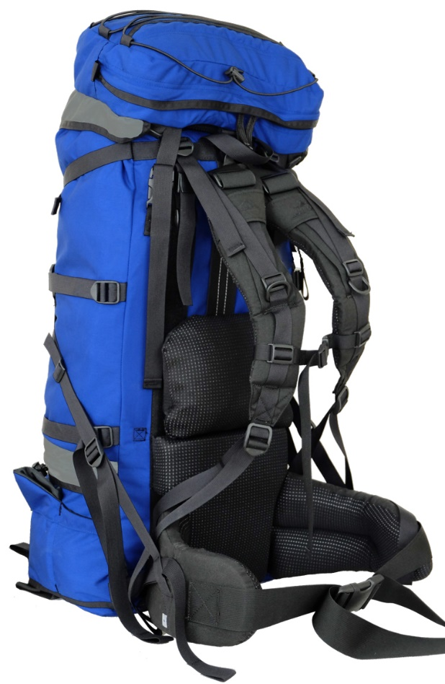
Load Lifting Straps
Load Lifting Straps are appearing on higher end internal (and a few external) frame packs to keep them from sagging and close to the torso.
They attach to the bottom of the shoulder strap and to the bottom/side of the pack and are designed to lift and snug the lower part of the pack into the lumbar area of the back.
This is not just a shoulder strap length adjustment as on many packs but specifically designed for this function.
Load Lifting Straps

Slide 27
Padded Shoulder Straps
Padded Shoulder Straps go from the pack just behind/below the top of the shoulder, over the shoulder, and back down to the pack somewhere near the hip belt (bottom).
When backpackers experience sore shoulders it is often because too much weight is being carried by the shoulders -- the shoulder straps are lifting the weight off the hip belt.
Two remedies are (1) loosening the shoulder straps, and (2) changing the position where the straps attach to the pack.
Load Control Strap
Padded Shoulder Strap
Compression Straps
“D” Ring
Sternum Strap
Padded Hip Belt
Stabilizer Strap
If loosening the straps causes the pack to "fall away off the back" and the straps attach to the pack well below your shoulders, the pack (or adjustment) may be too short for your torso length and the shoulder straps could be moved up on the pack (or some allow the hip belt to be moved down).
If it "falls away" and the straps attach above your shoulders, you may need to move them down (move the hip belt up) on the pack.
The shoulder straps should attach to the pack just below shoulder level.
Another potential remedy for the "falling away" problem is to tighten the load control straps, if the pack has them.
If problems persist and you are out of adjustments, a different pack may be necessary.

Slide 28
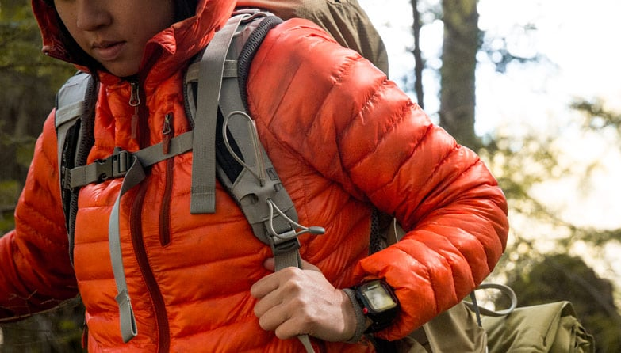
Shoulder Strap Adjustment
Pull down and back on the ends of the shoulder straps to tighten them.
Shoulder straps should wrap closely around your shoulders, but they should NOT be carrying significant weight. If they are, you'll be putting undue stress on shoulder, neck and upper-back muscles.
Check to see that the shoulder strap anchor points on your pack are 1 to 2 inches below the top of your shoulders; roughly at the top of your shoulder blades.
If not, then either your hipbelt is at the wrong level or your pack’s torso length is incorrect.
Vary shoulder-strap tension by tightening and loosening the straps.
Learn how to adjust the straps in small increments so you can relieve any pressure points or pain during your hike.

Slide 29
Load Control Straps
Load Control Straps extend from shoulder straps just in front of the shoulder to the top of the pack.
Not all packs have these.
When pulled tight, they pull the pack weight in close to the shoulders.
When loosened, they allow the pack to "fall off the back".
These are useful features on steep and/or rocky climbs.
Load Control Strap
Padded Shoulder Strap
Compression Straps
“D” Ring
Sternum Strap
Padded Hip Belt
Stabilizer Strap
Tightening them while going uphill brings the weight in closer so you don't need to bend over quite as much to maintain your balance.
Going downhill, you may want the weight to be off the back (straps loosened), so that if you stumble, you fall backward against the hill rather than forward down the hill.

Slide 30
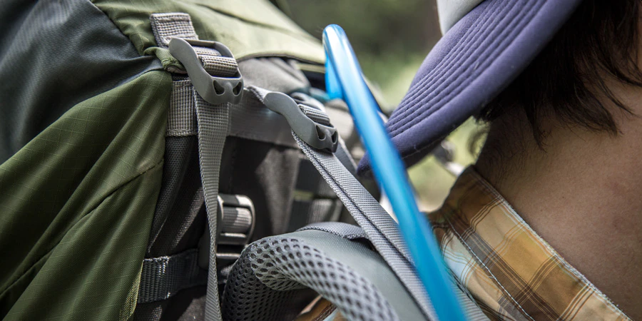
Adjusting Load Control Straps
Load control straps connect the top of the shoulder harness to an anchor point near the top of the back panel. When tensioned, they should angle back toward the pack body at roughly a 45-degree angle.
Don’t overtighten the load lifters! Excess tension that feels great initially can pinch shoulder joints and create discomfort. Strive for snug—not stiff—tension. If you notice a space at the top of your shoulder harness, loosen the load lifters and try again.

Slide 31
Sternum Strap
Sternum Strap goes from one shoulder strap to the other across the chest.
Not all packs have this strap, but it is one that may be a near necessity.
Sternum strap retrofit kits are available and a lashing strap with a quick release buckle from one shoulder strap to the other is a potential in-the-field substitute.
This strap, when pulled tight, relieves the pressure of the shoulder straps on the arms and distributes the pressure across the chest.
When backpackers experience numbness in their arms, tightening the sternum strap can often relieve it.
Load Control Strap
Padded Shoulder Strap
Compression Straps
“D” Ring
Sternum Strap
Padded Hip Belt
Stabilizer Strap

Slide 32
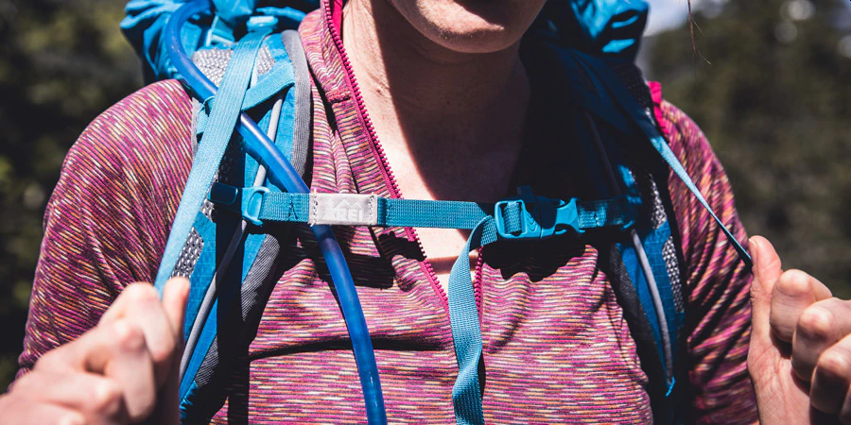
Adjusting Sternum Strap
Slide the sternum strap until it’s at a comfortable height across your chest: roughly an inch below your collarbones.
Buckle and tighten the sternum strap to set the shoulder straps at a width that allows your arms to move freely.
Avoid the common mistake of overtightening the sternum strap. This can distort the overall fit of your harness, constrict your chest muscles and restrict your breathing.

Slide 33
Compression Straps
Compression Straps generally go horizontally around the main compartment of external frame packs from the edges of the pack near the frame, or the frame itself.
They serve two purposes.
They relieve stress off the zippers, so it is very important that you snug them (with heavy firm loads, zippers can rupture and spill the guts of your pack.)
Second, the straps keep the contents from shifting.
Without compression straps, the contents of a large compartment will be loose and always settle to the bottom (you want weight high and close to the shoulders).
Load Control Strap
Padded Shoulder Strap
Compression Straps
“D” Ring
Sternum Strap
Padded Hip Belt
Stabilizer Strap
The compression straps constrict the compartment's diameter, forcing the contents to stay higher and holding the contents steady.
They may have vertical compression straps running up and down almost the length of the pack.
These straps relieve the pressure off the lower (sleeping bag) compartment zipper, secure the top cover, and compress the contents down to make the pack more stable.
They sometimes are left long at the bottom so that they can double as lashing straps for securing things external to the pack.

Slide 34
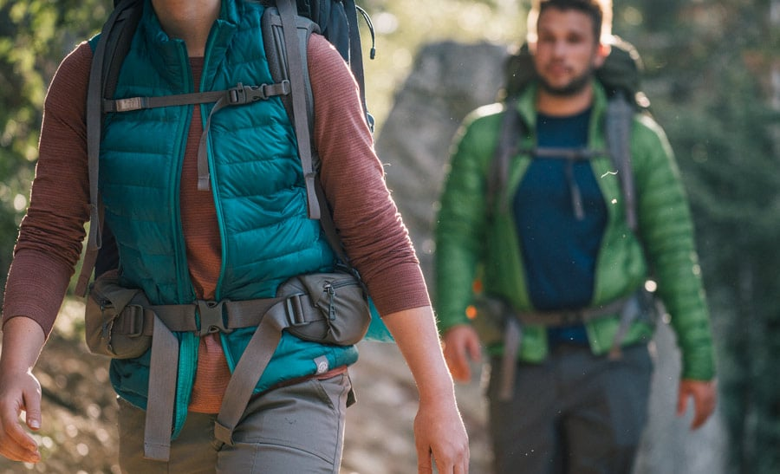
Fit Adjustment on the Trail
After mile 10, your near-perfect fit can seem like a distant memory. Good fit, though, requires continuous attention on the trail.
Master how things adjust by playing with all of your straps extensively when you first get your pack.
Ensure you can always return to your preferred fit by memorizing what that looks like at home.
Tweak adjustment straps as you hike to alleviate aches, pains and pressure points. Trial and error will tell you what works best for your pack and your body.
A common tactic to manage load fatigue is to tighten the shoulder straps and loosen the hipbelt, then reverse those steps later.
Be aware of body position: Leaning slightly forward will make the load feel more in balance.
Take your pack off whenever you stop for a break. That gives your hard-working back a chance to rest and breathe while you stretch out overworked muscles.

Slide 35
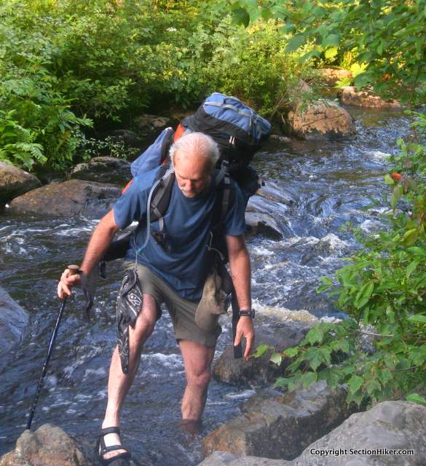
Loosening Straps in Unsure Footing
This allows you to jettison the pack if you falter.
Your pack can be shed quickly, if the hip belt and sternum strap buckles are disconnected, by simply lowering/relieving your shoulders.
This is something should be done for walking on logs across streams or rivers.

Slide 36
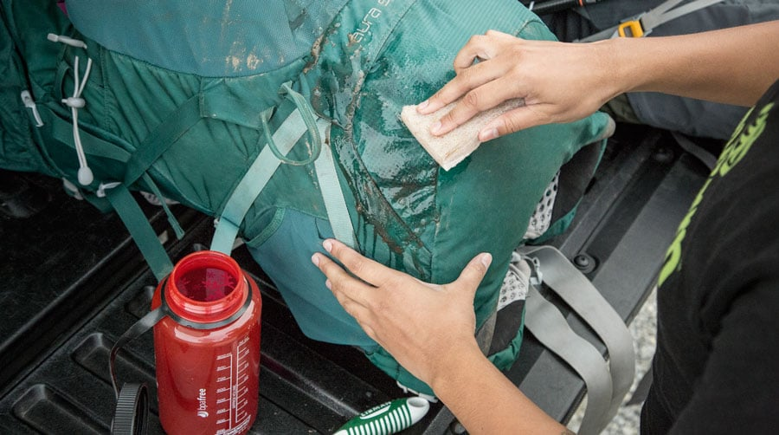
Backpack Care
The old adage, "Take care of your equipment and it will take care of you" is an important truth to live by for campers, hikers and backpackers, and one that is very true when it comes to your backpack.
Throughout a long day of hiking, you'll want your backpack to be well-fitted, comfortable and able to withstand the constant punishment of scraping tree branches, rubbing against rocks and enduring the elements, whether they are harsh sunlight, torrential rain or blinding snow.
Follow the suggestions provided in the next few slides and you'll have a backpack that will take care of you and give you years of service because you take care of it.

Slide 37
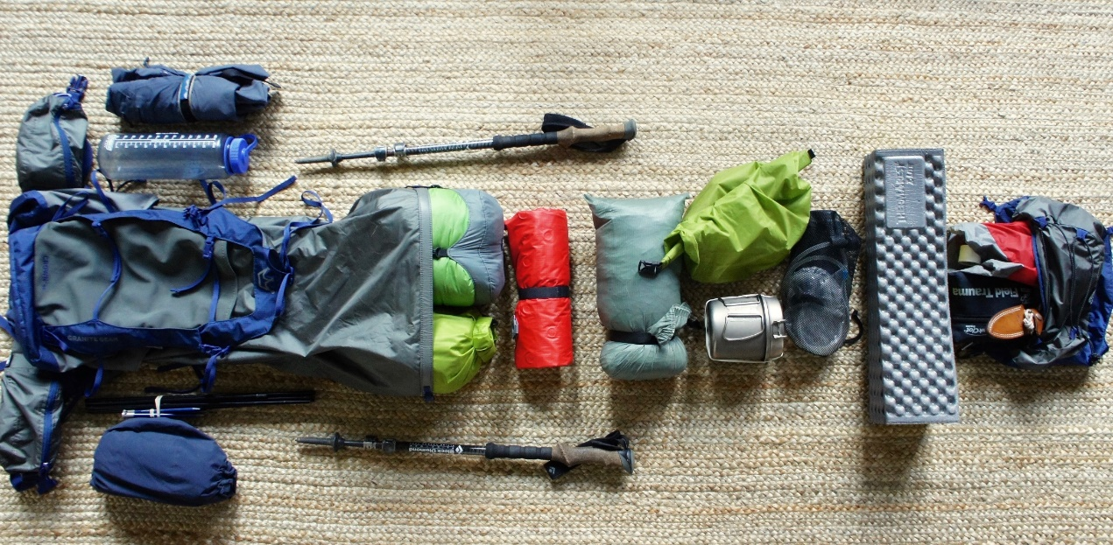
Backpack Care
Pack Carefully
Don’t throw things into your backpack at random.
Make sure you pack hard-edged and sharp items (such as a stove, cookware or tent stakes) carefully to avoid having them poke you in the back while wearing the pack, and to keep them from poking holes in the backpack or causing wear spots.
Pack deliberately and carefully to ensure that weight is distributed properly.
Distributing the load equitably will help your pack stay balanced, making it easier and more comfortable on your back as you are hiking.

Slide 38
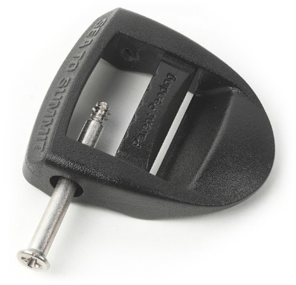
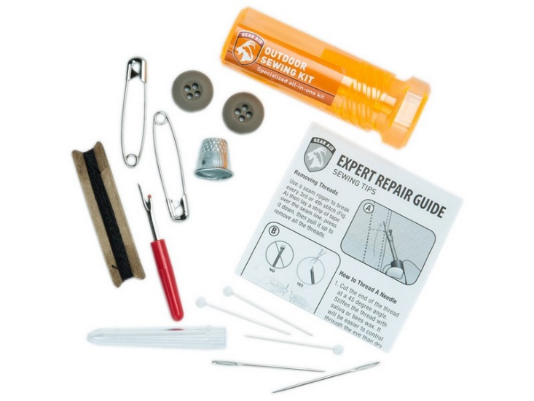
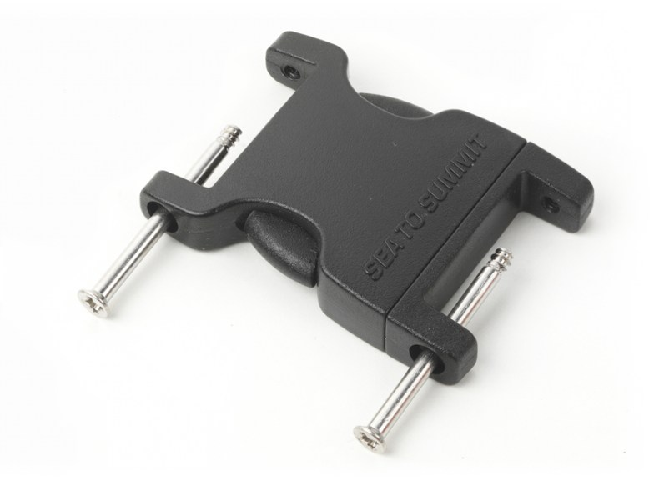
Backpack Care
Carry a Small Repair Kit
Bring along a couple of extra clevis pins and split rings if you have an external frame pack, repair buckles that fit your pack, a heavy duty sewing needle with upholstery thread, and a roll of universal patching material (duct tape).
Fix holes quickly as a smaller hole is easier to repair.

Slide 39
Backpack Care
Animal Damage
Packs are often damaged by furry creatures.
These creatures are either going after any food kept inside of your pack, or the salt deposits that form on the pack exterior.
To prevent animal damage, keep your food and your pack separate at night.
Consider leaving your pack open and unzipped, so that animals are less inclined to chew through the fabric.
Wash your pack after each trip to remove salt deposits.

Slide 40
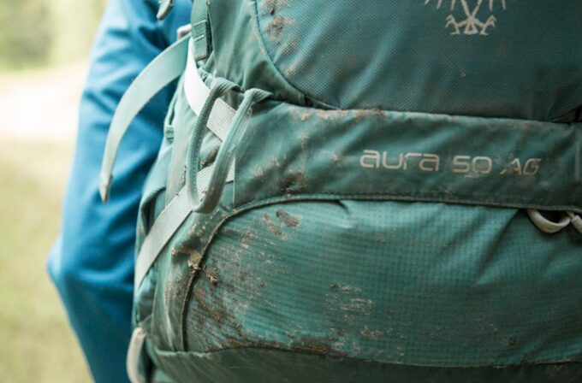
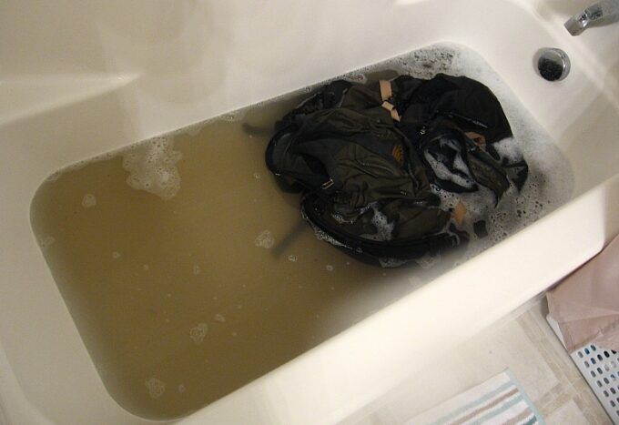
Backpack Care
Clean Your Pack Properly
When returning from a hike, empty the pack completely, shake all the loose items out.
To preserve the integrity of your pack's fabric coating, the interior should only be wiped down with a damp cloth to remove crumbs or stains.
Dirt and grime will abrade the fabric and wear it out.
On the trail, be careful of tree sap.
At the first sign of any type of stain, use a damp cloth to clean off as much as possible to minimize damage to the pack fabric.
Back home use a mild, non-detergent soap to thoroughly clean any stains, but be careful not to ruin the fabric's waterproof coating.
When cleaning the entire pack, wash in a bathtub filled with cold water.
Dry completely in a cool, airy place to avoid dampness causing mildew.

Slide 41
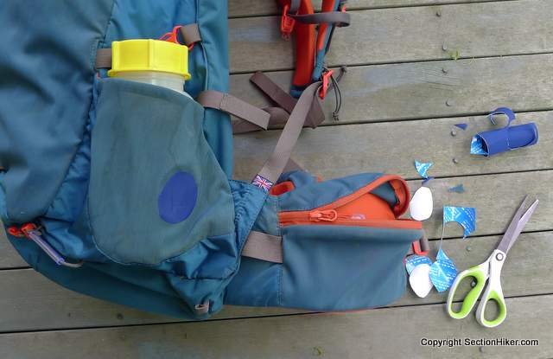
Backpack Care
Perform Regular Maintenance
Take care of problems while they are small and, preferably, while you're at home.
Sew any small rips or tears, patch any worn areas of fabric and tape seams that may be loose.
Check high-stress points such as the hip belt, suspension stabilizers and shoulder straps for wear or separation.
Keep zippers clean and free of obstructions such as stray threads or items that could damage the teeth, and spray with silicone spray to keep them easy to zip and unzip.

Slide 42
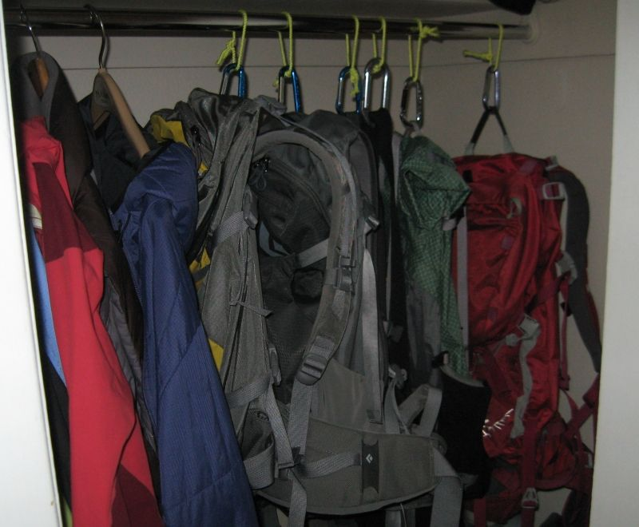
Backpack Care
Store the Backpack Properly
Keep your backpack in a cool and dry storage area to keep mildew from forming and to extend the life of the waterproof coating on most packs.
Do not stack heavy objects on top of your pack and, if possible, stuff with clothing or newspaper to help maintain its shape.

Slide 43
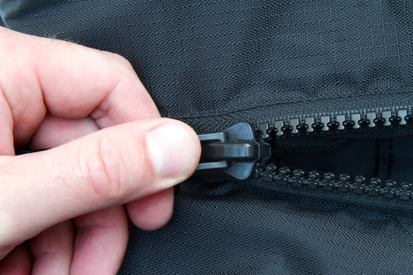
Backpack Care
Zipper Maintenance
Maintain your zippers' longevity by keeping them clean, free of sand and grit, and out of the dirt.
Most zippers fail due to wear and tear to the coating on the inside of the zipper slider (the metal toggle on your zipper).
Once the coating wears off, the metal abrades rapidly, and the zipper slider no longer joins the plastic coils securely, causing the coils to separate from the slider.
Hand wash your pack frequently to remove dirt and grime, and preserve the coating on your metal zipper slider.
Keep loose threads trimmed.

Slide 44
02
Packing List
Packing Your Gear
Packing

Slide 45
Backpacking Equipment List
Consider borrowing equipment you don't already own.
Everything must be packed in.
Keep weight down; bring as little as possible but be sure to bring essentials.
Total pack weight is not to exceed 25% of body weight.
All clothes, sleeping gear and food are stored in waterproof bags (Ziplocs).
[BC] = Goes in bear canister, away from tent area.
[SD] = Stored in sump or dining area away from tent area.

Slide 46
Backpacking Equipment List (Non-Winter)
Basic Gear
Frame pack with hip belt
Pack cover (packs stay outside tent; heavy garbage bag OK
Sleeping bag in waterproof (garbage) bag
Sleeping pad (optional)
Hiking Boots not on ground at night
Water bottles/bladder 1 qt. for every 100 lbs. Weight
Extra plastic bags for trash, dirty clothes, etc. (Ziplocs and garbage bags)
Camping/Hiking Gear
Map (supplied) in Ziploc
Compass
Pocket knife/Leatherman
Small flashlight or headlamp with new batteries
Whistle - accessible; not packed
[BC] Matches in waterproof container or disposable lighter
Walking stick/trekking poles
Clothes (wearing + packing)
Socks (3 heavy wool pairs, 3 liner pairs)
Shorts/pants (2) not cotton
Tee shirts (3)
Underwear (3) not cotton
Clothes (continued)
Sleepwear
Fleece jacket
Long sleeve shirt
Poncho or rain suit
Hat, bandanna, bug netting
Sandals/light sneakers to relax in camp (optional but highly recommended)
Toiletries/Personal (BB items not used after 5:00pm)
[BC] Biodegradable soap
[BC] Toothbrush/paste
[BC] Sunscreen
[BC] Lip balm
[BC] Insect repellent
[BC] Small first aid kit -- moleskin, bandages, drugs for medical conditions (allergies) or to self-administer (Advil), medical card
Toilet paper in Ziploc bag
[BC] Hand sanitizer (inside of toilet paper roll)
Watch
Money
Sunglasses with hard case
[BC] Camera
Mesh bags
Backpacking towel
Cooking & Eating
[BC] Food
[SD] Spoon
[SD] Bowl
[SD] Cup (preferably with measured markings)
Shared with buddy
Tent
Ground cloth for under tent
[SD] Backpacking stove
[SD] Fuel bottle
Stove repair kit
Water filter, iodine or chlorine
Parachute cord (25 ft.)
Shared Crew Equipment
[SD] Pots for heating water, etc.
[SD] Cleaning/scrub pad
Bear canister
75-100 ft. parachute cord
Trowel (for cat holes & sump)
[BC] Repair kit - needle, thread, duct tape, wire ties, etc.
Dining fly (optional)
Wilderness permit
Shower/wash bag

Slide 47
Packing Your Equipment
There are lots of different ways and philosophies on where things go in the pack.
Recent versions of internal and external frame packs are shown as illustrations.
Internal and external frame pack designs seem to be converging, with external frames sometimes taking on nearly the same profile as internal frames -- tall and narrow with a lower (sleeping bag) compartment -- and internal frames adding many external pockets and places (web daisy chains and lash patches) to hang things off the top, sides and back outside the pack -- areas where external frame have traditionally excelled.
Some external frame packs have also become more flexible with poly/PVC frames.
Both have added mechanisms to adjust the shoulder strap position, a feature first found only on a few external frames.
We now see in the blending together of the "best" features of traditional external and internal frames designs.
This should all but finish the debate as to which is best – you can "have your cake and eat it too".

Slide 48
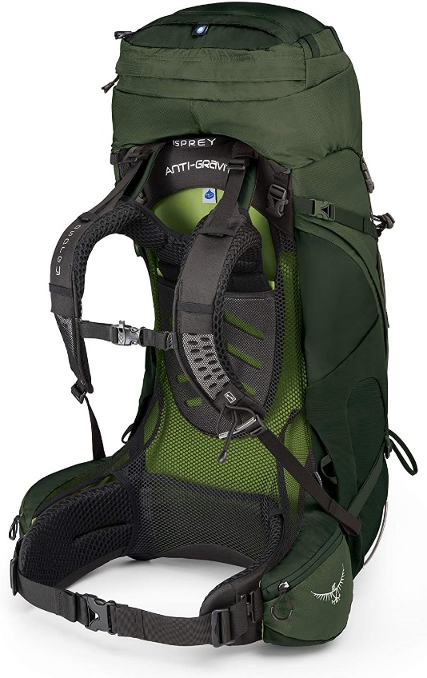
Internal Vs. External Frame Packs
To the left and right are somewhat typical external and internal frame packs.
As the name implies, the external frame (often looks like a ladder) can be seen from the back of the pack (the side against your back).
The frame stays of internal packs are often two 3/4" to 1" wide flat aluminum bars 20" to 30" long sewn into the back of the pack itself.
One main difference is that the sleeping bag and tent are often lashed to the outside of an external frame at points #8 and #9, while, internal frames are designed so that, all gear can either be stored inside the main compartments or in the outside pockets.
External Frame
Internal Frame

Slide 49
Considerations for Packing Gear
After you've decided on your list of backpacking equipment to carry, you'll need to pack for the trail. Before getting into the details of matching equipment to compartments and pockets, consider the following observations:
Small, frequently used items should go in your pants pockets, "throw" pockets on the pack, hung from your shoulder straps, or placed in other readily accessible place. These include knife, compass, map, whistle and watch.
Other items that need to be readily accessible to you or others should be in conspicuous outside pockets. These may include rain gear, first aid kit, sun and insect protection, trail snacks and lunch, bandana, some matches, toilet paper, digging trowel, and perhaps a camera.
Packing several small similar items together in heavy plastic (Ziploc) bags organizes items that could get "lost" inside the pack and keeps the contents dry even if the pack gets soaked.
Items that must be kept dry but are too large for Ziploc bags, like a sleeping bag, should be placed inside a heavy plastic bag and the opening closed with a "gooseneck".
Your water bottle should be easy to retrieve. The harder it is to drink, the more likely you are to get dehydrated.
Equipment you won't need until you make camp can be buried deep in the pack, but reserve an outside pocket for isolating your fuel and any other "smellables" that might contaminate food, clothing, tent or sleeping bag.
Assign each item a specific "home" in your pack so that it can be located quickly and always return it to that home.
Normally, arrange the pack's contents so that its center of gravity (heavy gear) is high and close to your back. Compression straps can help. Where stability is vital, some comfort can be traded for the stability of a lower center of gravity by placing heavy gear in the bottom of the pack.

Slide 50
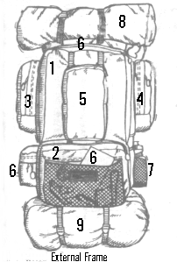
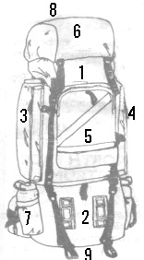
Matching the Compartments/Pockets with the Gear
The pockets and compartments in the illustrations are designated as follows:
Upper Main Compartment. It usually holds the bulky and heavy things (to keep weight over your skeleton). The external frame shown is "front-loading", meaning that it has a zippered door/flap that allows scouts to place gear when the pack is lying down. The internal frame pack is "top-loading". The top pocket (#6) is swung off and all gear is loaded from the top like putting groceries into a shopping bag. On most newer design packs, that compartment has a draw string at the top to close it before it is covered by the top flap/pocket. Some external frames are also top loading. Top-loading main compartments are often quite a bit larger than front-loading main compartments. Basically, everything that doesn't go somewhere else gets "dumped" into here.
External Frame
Internal Frame

Slide 51
Matching the Compartments/Pockets with the Gear
The pockets and compartments in the illustrations are designated as follows:
Lower Main Compartment. It is often called the sleeping bag compartment, after its usual contents in internal frames. Generally, this compartment is front-loading with a heavy zipper. On an external frame this compartment can be used for clothing because the sleeping bag is put in a stuff sack and lashed on the outside (at #8 or #9). Many external frames (especially ones with top-loading main compartments and older designs) don't have this second main compartment, so more is stored in the upper compartment. Sometimes the two compartments have a removable (drawstring or zipper) separator and it is incomplete so that long things (like tent poles) can "passed-through" both compartments. Instead, sometimes one of the external side pockets is not fastened to the main pack at the top and bottom to allow tent poles to be "passed-behind" or "tunnel" it to rest in a lower pocket.
External Frame
Internal Frame

Slide 52
Matching the Compartments/Pockets with the Gear
The pockets and compartments in the illustrations are designated as follows:
Left Upper Pocket. Because of accessibility, this is a good place to put rain gear.
Right Upper Pocket. Because external pockets allow isolation of potentially contaminating items, this is a good place for the stove fuel bottle and other potential contaminants (toiletry articles) and things that can be washed if contaminated (cat hole/sump trowel).
Front Pocket. It is sometimes called a "shovel pocket". Because of accessibility and its prominent visible position, this is a good place for important things like the first aid kit, tour permit and medical forms. It may also be a place for a camera and binoculars. Frames without this pocket often have a "top pocket" that can be used for the same purpose.
External Frame
Internal Frame

Slide 53
Matching the Compartments/Pockets with the Gear
The pockets and compartments in the illustrations are designated as follows:
Other External Pockets. They may include the top pocket on a top-loading main compartment (#6 of internal illustration), lower external pockets (lower-left #6 of external illustration) and elasticized throw pockets (middle #6 of external illustration). Don't put the fuel bottle or other contaminants in a top pocket for fear of contaminating the contents of main compartments; they can be used to distribute the contents of #3, #5 and #6. The lower left pocket is where you can keep a compass, flashlight, toilet paper and iodine bottle.
Water Bottle Holder Pockets. Sometimes they are specifically designed for this function. Other times extra external zippered or elasticized pockets can be used. Some packs have the bottle pockets near the top where #3 and #4 are pictured, with these pockets positioned lower. This provides "over-the-shoulder" access instead of "under-the-shoulder" access. Both work. If none of these are available, bottle bags or canteen holders with belt loops or clips can be used on the hip belt.
External Frame
Internal Frame

Slide 54
Matching the Compartments/Pockets with the Gear
The pockets and compartments in the illustrations are designated as follows:
Top Lash Points. These points are often used for sleeping bags (in stuff sack), sleeping pads, tents (in bag) and ground cloths, especially on external frames (as pictured). The same purpose can be achieved by placing things between the top pocket (#6 of internal illustration) and the top-loading upper main compartment (#1 of internal illustration) and tightening the fastening straps. This isn't recommended if you don't have a drawstring on that compartment.
Bottom Lash Points. They serve the same purpose as those on top.
External Frame
Internal Frame

Slide 55
Questions?
Terry McKibben
Troop 344/9344
Pemberville, OH
troop344leaders@gmail.com

