Slide 1
Backpacking Guide Course #2
Terry McKibben
Troop 344/9344
Pemberville, OH
troop344leaders@gmail.com

Slide 2
CONTENTS
01
Sleeping Bags
Sleeping Bag Types, Ratings, Insulation, Care and Maintenance
02
Sleeping Pads
Sleeping Pad Types, Sleeping Pad Warmth, Backpacking Pillows
03
Sleeping Clothes
For Sleeping Only

Slide 3
Sleeping Bag Type
Ratings
Insulation
Care and Maintenance
01
Sleeping Bags

Slide 4
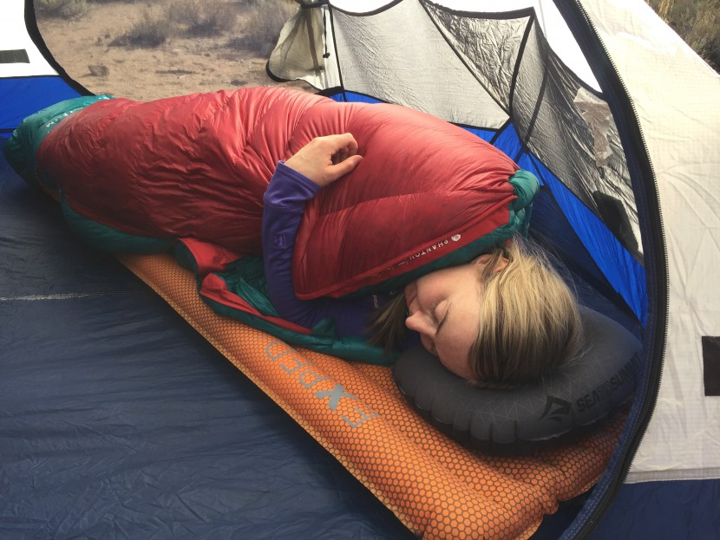
Sleep System
A backpacking sleep system refers to the collection of gear and clothing used for sleeping in camp.
It’s called a system because the items have to work together and complement one another to perform a common function.
The common components of a sleep system are:
Sleeping bag or top quilt and pad attachment straps
Sleeping pad
Pillow
Long sleeve shirt
Long underwear bottoms
Fleece hat
Dry Socks

Slide 5
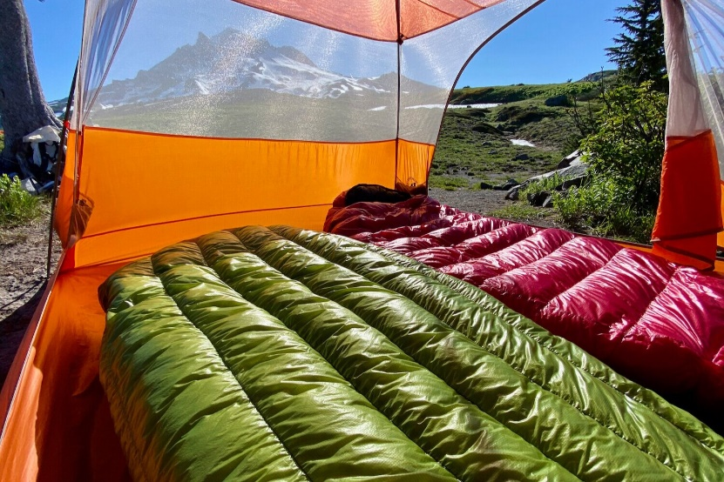
How to Choose Sleeping Bags for Backpacking
When deciding on a sleeping bag for backpacking, consider these key factors:
Temperature rating: Choose a sleeping bag rated a little bit lower than the typical low temperatures you anticipate on your backpacking trips.
Sleep system: Being comfortable at a particular temperature depends on many other variables, especially the R-value of your sleeping pad, the other key component of your sleep system.
Type of insulation: The big choice is down vs. synthetic. Each has its pros and cons, explained below.
Weight: The quality of your insulation and the cut of your bag are the big factors. When you compare weights, compare bags with the same temperature rating.
Features: Consider the extras that make your bag work best for you, including types of adjustment features, stash pockets, pad compatibility and more.

Slide 6
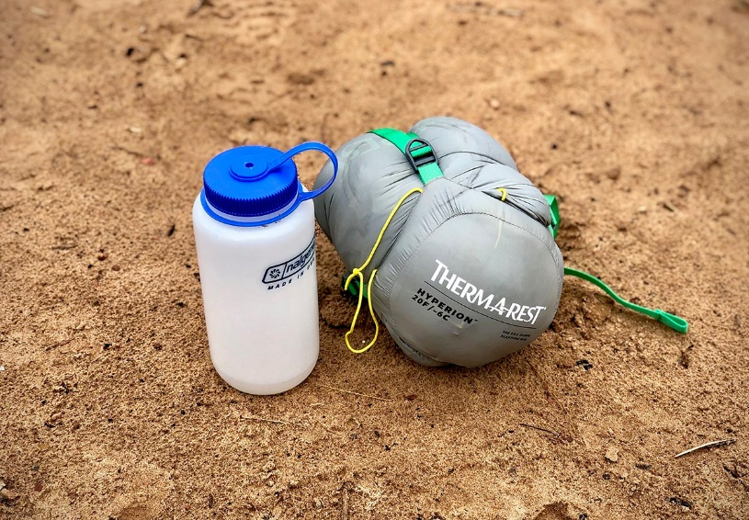
Difference Between a Backpacking and a Camping Sleeping Bag
In general, backpacking bags differ from camping bags in three ways:
They are more lightweight.
They pack down smaller.
They are more efficient, providing more warmth for the weight.
If you’ll be doing both activities, go with a backpacking bag because every ounce counts when you carry it in a pack rather than in a car.

Slide 7
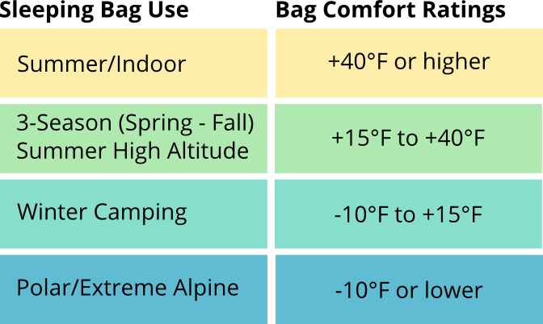
Understanding Sleeping Bag Temperature Ratings
A sleeping bag's temperature rating identifies the lowest temperature at which a bag was designed to keep an “average sleeper” warm.
For starters, you want to select a sleeping bag with a temperature rating that’s lower than the lowest temperature you expect to encounter.
When in doubt, choosing a bag with a lower temperature rating is wise because you can always open up a bag to cool down when conditions are warmer.

Slide 8
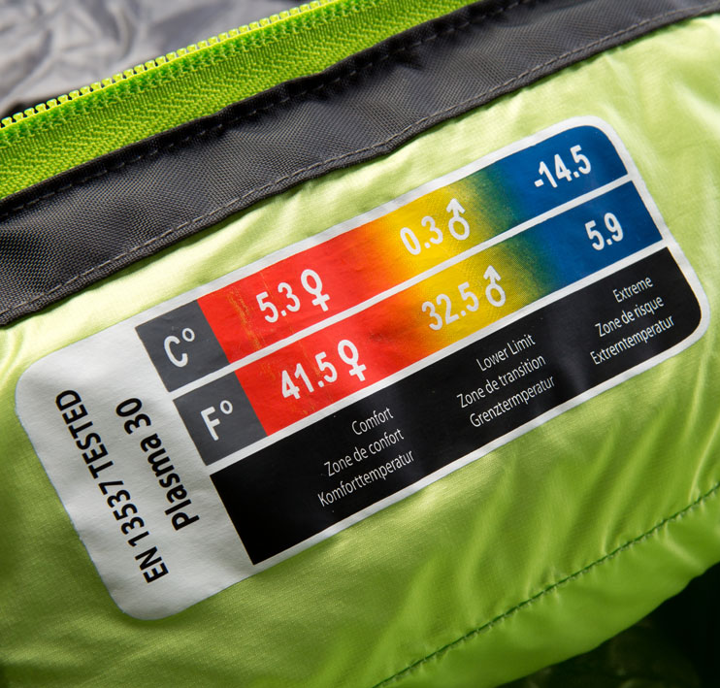
Understanding Sleeping Bag Temperature Ratings
Having a spec for easy comparison is useful, but it’s important to understand more about temperature ratings and the terms attached to those ratings.
Here are the essentials:
An “ISO” or “EN” temperature rating indicates you can reliably compare any two backpacking sleeping bags. These standardized tests mean you can truly compare temperature ratings between brands. ISO and EN ratings are comparable.
With ISO/EN testing, a bag is assigned two temperature ratings: comfort and limit ratings. “Comfort” rating is the lowest temperature at which the bag will keep the average “cold sleeper” comfortable, and is generally the temperature assigned to women’s bags. “Limit” rating is the lowest temperature at which the bag will keep a “warm sleeper” comfortable, and is generally the temperature assigned to men’s or unisex bags.
A temperature rating is not a guarantee of warmth for any bag. The rating is helpful in that all brands test bags the same way, so you can compare bags from different brands.

Slide 9
Understanding Sleeping Bag Insulation Types
Your insulation choice is an important first step in choosing a sleeping bag for backpacking. The chart below lists the key differences between down and synthetic fills.
Insulation Type | Key Benefit
Down | Lightweight Easy to compress Excels in cold, dry conditions Durable
Synthetic | Quick drying Insulates when wet Non-allergenic

Slide 10
Down Insulation
More expensive on average than synthetic insulations, down is sought after because it’s lighter and more compressible.
Down fill is more durable than a synthetic fill, which means it retains a more consistent level of warmth for longer period of time (decades, if properly cared for).
Here are a few common questions when considering down insulation:
What does “fill power” mean? Not all down is created equal. “Fill power” is a spec that indicates the quality of down—a higher number indicates down that lofts higher to generate greater warmth for its weight. The priciest down bags, ones intended for extreme cold or ultralight backpacking, have the highest fill powers—closer to 800- than to 500-fill-power.
What is water-resistant down insulation? To combat down’s loss of insulating efficiency when wet, most sleeping bags are filled with down that has a water-repellent treatment.

Slide 11
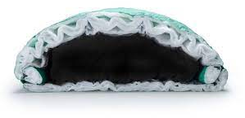
Synthetic Insulation
Synthetic insulation offers solid performance at an affordable price.
Unlike down, it continues to insulate when wet, so it’s the bag insulation of choice for damp climates and new campers.
Available in a variety of branded names, most synthetics are made of polyester.

Slide 12
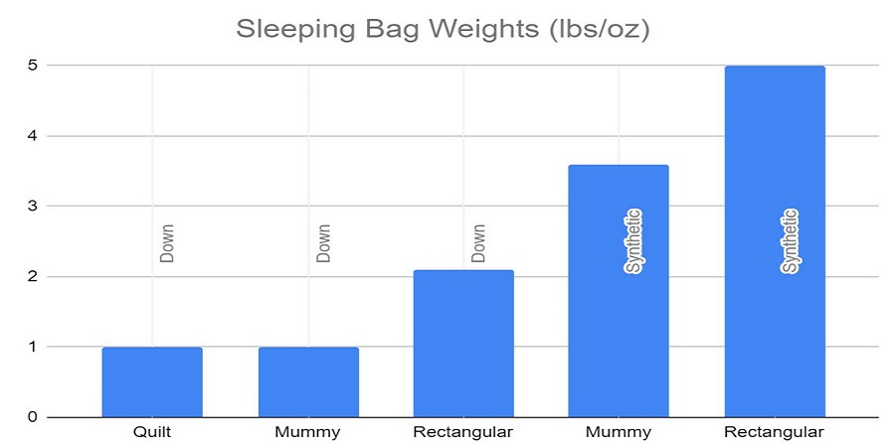
Understanding Sleeping Bag Weight
The biggest factors in the weight of a sleeping bag are its insulation and its shape.
More efficient insulations, like advanced synthetics and high-fill-power downs, will deliver greater warmth for less weight than less efficient fills.
Because a bag requires more insulation to get a warmer (lower) temperature rating, you should always compare bags of similar temperature ratings when comparing bag weights.

Slide 13
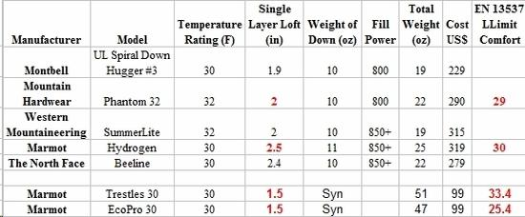
Insulation Fill Weight
Insulation fill weight:
The overall bag weight is what matters when you’re carrying a bag in your pack.
Insulation fill weight tells you only the weight of the insulation in the bag.
Some people use it as another rough indicator of bag warmth, reasoning that having more fill in a bag makes it warmer.
The bag's temperature rating, though, is the more reliable indicator of warmth.

Slide 14
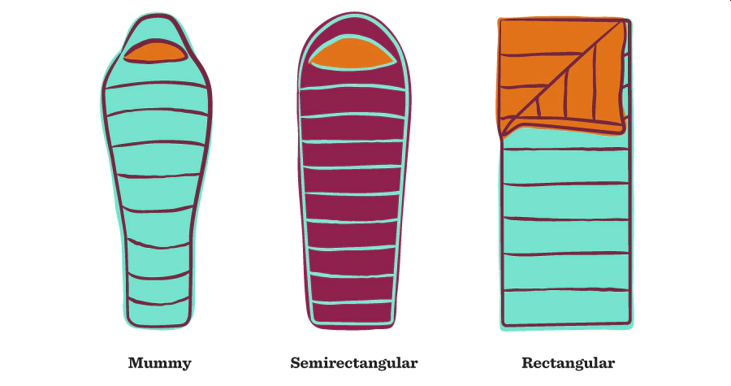
How Sleeping Bag Shape Affects Weight
How sleeping bag shape affects weight:
A bag with a sleek shape and a snug fit will be lighter than a similar bag that’s nice and roomy.
Sleeping bags come in three basic shapes:
Mummy: In order to boost warmth and reduce weight, this type of bag has a slim cut, along with a contoured hood you can cinch tight for greater warmth. Overall fit is snug—you typically roll over with your bag rather than inside of it.
Semirectangular: Also known as a “modified mummy” or “barrel” shape, this designation covers a variety of shapes, all of which offer a compromise between warmth and roominess.
Rectangular: A lot of camping bags have a simple rectangular shape that maximizes roominess.

Slide 15
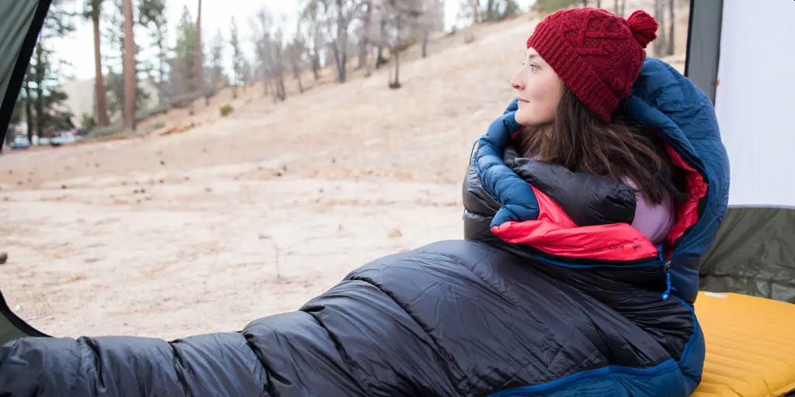
How Sleeping Bag Shape Affects Warmth
How sleeping bag shape affects warmth:
Sleeping bags keep you warm by retaining heat emitted by your body, which can warm a small space up more efficiently than an expansive space.
So, a bag with a sleek shape and a snug fit (i.e. mummy bag) will be warmer than a similar bag that’s nice and roomy (i.e. rectangular).

Slide 16
How to Get the Best Sleeping Bag Fit
The shape categories are very general—dimensions vary quite a bit from bag to bag.
In addition, much like shoe brands, bag brands have differing fits.
To see which bag shape and brand’s dimensions feel most comfortable to you, head to an outfitting store so you can “try on” different bags.
Sleeping bags also come in a variety of sizes:
Adult sleeping bags: Most bags come in regular and long sizes. Some also come in a short size. If your height is close to the upper end of a size’s “fits up to” spec, try both that bag and the next size up to see which you prefer. Generally, though, you’ll be warmer and save a little weight by going with the smaller of the two sizes.
Women’s sleeping bags: These are engineered to more closely fit an “average woman’s” contours. They are typically shorter, narrower at the shoulders and wider at the hips than a men’s or unisex bag.
Kids’ sleeping bags: These are simply shorter and smaller variations of adult sleeping bags, which makes them more affordable, too. ISO and EN testing can’t be done on them, though brands still provide an estimated temperature rating for kids’ bags.

Slide 17
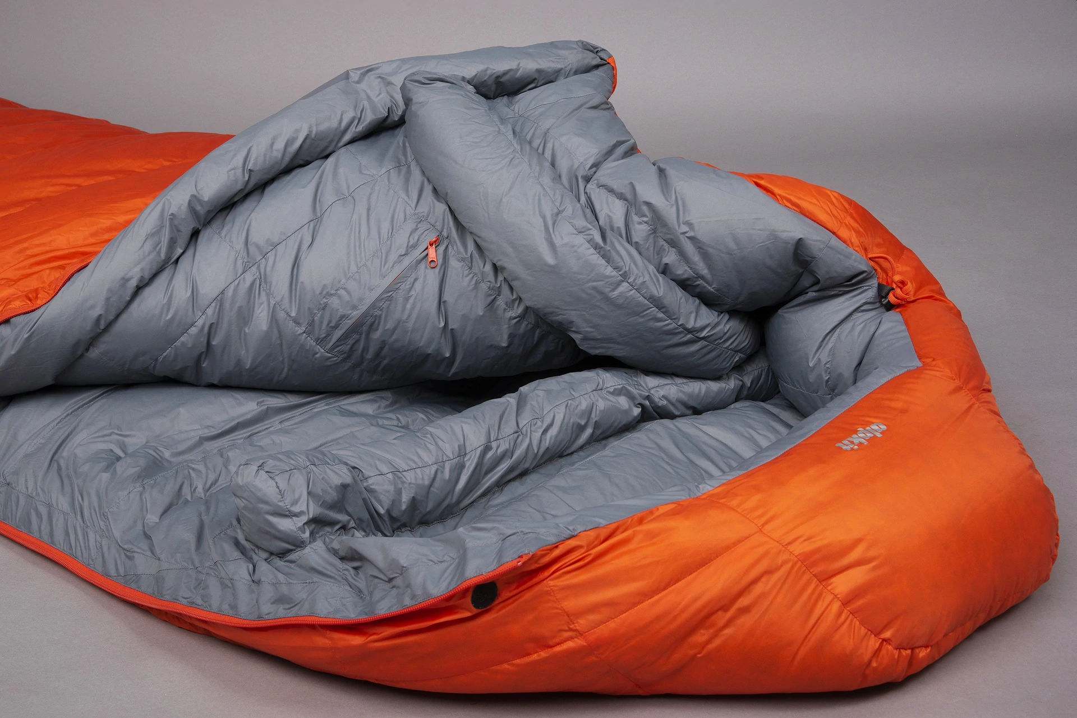
Additional Sleeping Bag Features
Sleeping bag hood: A hood offers added warmth, especially when cinched tightly around your head. Some hoods include “differentiated drawcords,” which have different thicknesses so that you can easily tell which cord adjusts the neck fit and which adjusts the hood opening.
Draft-blocking features: Draft tubes run the length of the bag behind the zipper to help keep warm air from escaping. Draft collars or yokes are at the top of the bag around your neck to prevent warm air from escaping there.

Slide 18
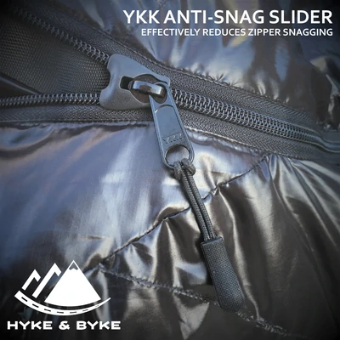
Additional Sleeping Bag Features (continued)
Anti-snag zipper features: Snagging the zipper as you try to open or close your bag is annoying and causes extra wear and tear on its fabric. Some bags shield the zipper with a guard along its full length; others tackle the issue with a cover of the zipper itself.
Left or right zip: Don’t worry about this unless you are a couple who wants to zip two bags together. One person needs a bag with a left-hand zip and the other a bag with a right-hand zip. Having the same zipper type is also important. If a brand makes comparable bags for each gender, then the men’s is typically a left zip and the women’s is a compatible right zip. If you plan to share bags all the time, then also look at double bags that are specifically designed for two sleepers.

Slide 19
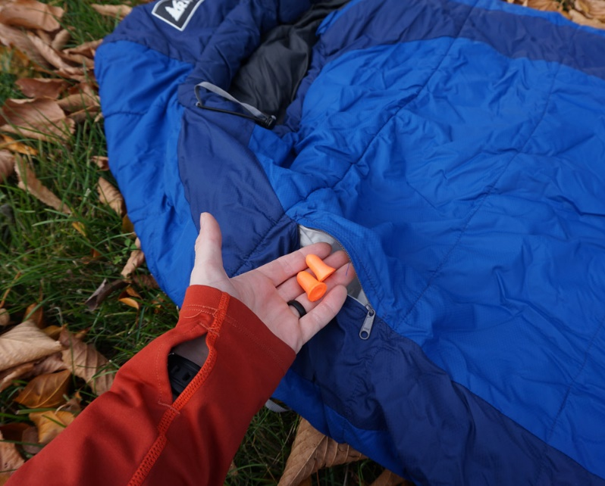
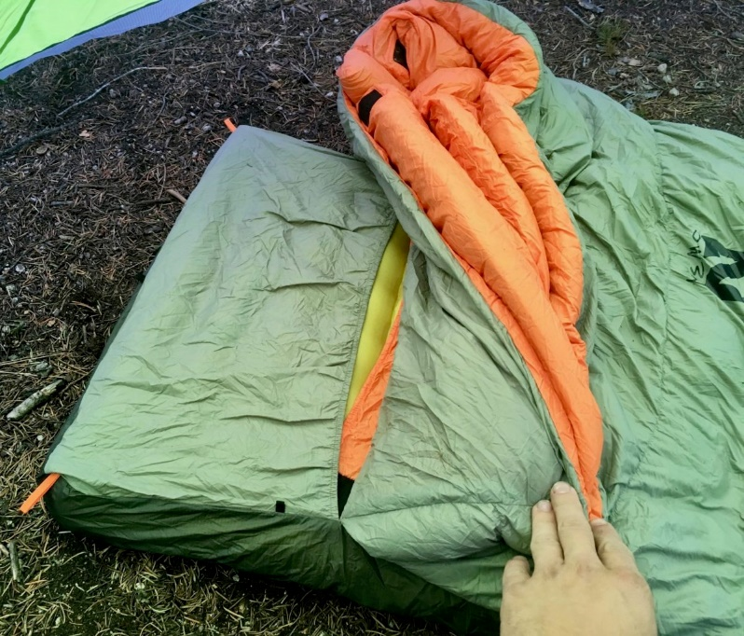
Additional Sleeping Bag Features (continued)
Stash pocket: Typically located on the chest near the top of the bag, this is handy for keeping small items, such as a watch or lip balm, close at hand.
Sleeping pad compatibility: On a few bags, the underside insulation has been replaced with a sleeve to fit a sleeping pad (sold separately). Similarly, pad loops allow you to use straps (sold separately) to connect the bag to your pad.

Slide 20
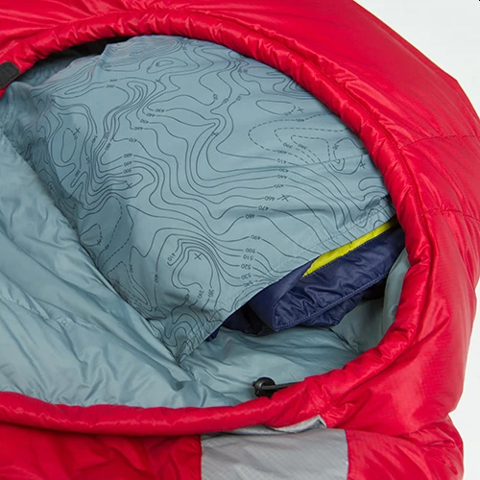
Additional Sleeping Bag Features (continued)
Pillow pocket: Some bags include a “pillow pocket“ that allows you to stuff clothes inside to create a pillow. If your bag doesn’t have this feature, you can always bring a pillow from home or purchase a camping pillow.
Sleeping bag fabric: The outer shell of a backpacking bag is typically made of a ripstop nylon or polyester. Many shell fabrics are also treated with a durable water repellent (DWR) finish to prevent moisture from soaking through and dampening the fill. Lining fabrics, on the other hand, have a brushed texture for added softness.

Slide 21
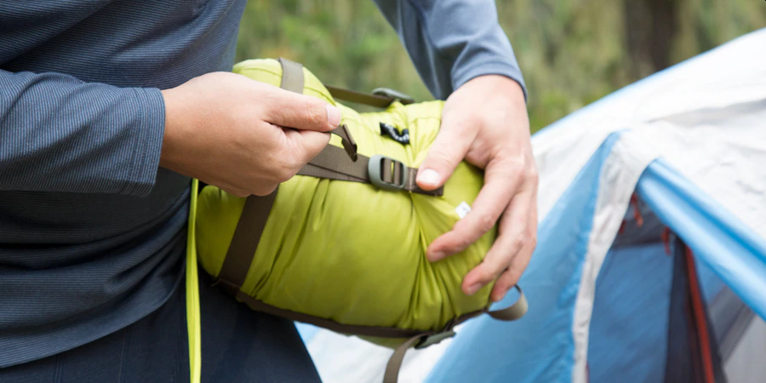
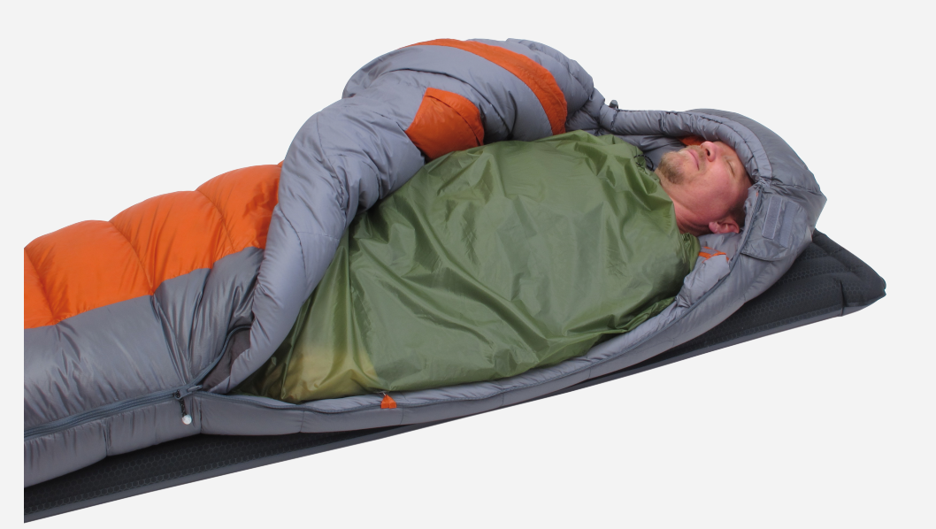
Sleeping Bag Accessories
Stuff sack: Many bags come with a stuff sack (sometimes sold separately) to easily compress your bag down small for easy packing.
Storage sack: Because leaving a sleeping bag compressed tightly in a stuff sack for long periods of time will impair its ability to loft fully and insulate efficiently, a lot of bags also come with a large mesh or cotton storage sack.
Sleeping bag liner: Buying a soft sleeping bag liner and slipping it inside your bag minimizes wear and helps keep the bag clean. Adding a liner to your bag can add a little extra warmth, allowing a single bag to serve you in a wider variety of temperatures.

Slide 22
Choosing a Sleeping Bag for a Scout
Weight less than 3 ½ pounds for a 6' bag.
Tapered "mummy" bags hold weight down and the heat in.
Stay away from department store rectangular bags; they generally are low priced, less efficient heat preservers and usually weigh a minimum of seven pounds -- way too much for a 100 lb. scout who needs to keep total pack weight below 25 lbs. (25%).
The bag is rated for 20º-30º temperatures.
This is a good balance of weight and function, and the rating of the majority of bags on the market.
Such bags span three seasons - Spring, Summer, and Fall.
With additional clothing or a liner, they can go lower.

Slide 23
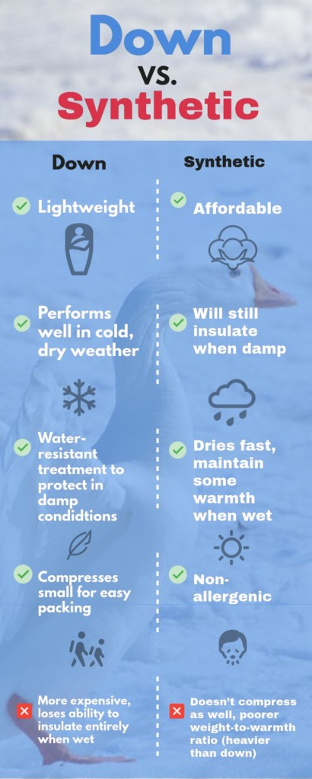
Choosing a Sleeping Bag for a Scout
The bag uses synthetic fill of Hollofil, Quallofil or Polarguard:
Down is for experienced backpackers only.
It is lightweight, stuffs into a small shape, is expensive and has great insulating qualities, but is disastrous when wet.
Further, once wet, it is heavy and hard to dry.
Synthetic fill is more forgiving for newbie scouts.
Don't worry too much about the outer shell of the bag; most are made of some form of serviceable washable nylon.
Most synthetic bags wash and dry easily.
It fits your build:
If you are 5'4", why carry the weight for fitting a scout 6 feet tall?
If you are 6'4", a standard 6' bag will be cramped.
Most people will fit a 30" width bag -- lower weight.
Those over 200lbs should stick to 32" widths and those very full bodied (well-muscled) should consider "oversized" bags that are 36" wide.

Slide 24
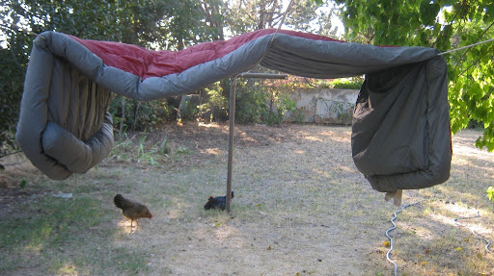
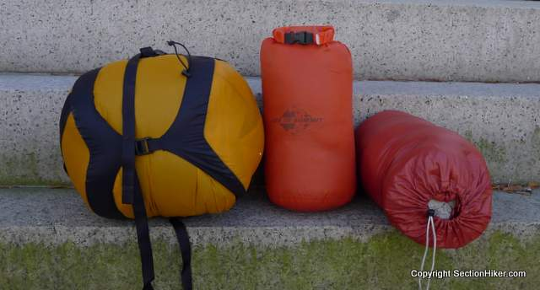
Care for a Sleeping Bag
Tips to help you care for your bag:
Don’t pack your bag wet. If your bag does get wet hang it out to air dry or fluff dry it in a dryer without heat.
Hang your bag out after each trip and allow it to air out.
When hiking or going into the backcountry, store your bag in a waterproofed compression sack. The bag will stay dry, even if you fall into a river by accident when traveling the backcountry. Also, the compression sack will reduce the amount of space your sleeping bag takes up in your pack by as much as fifty percent.
Remember the best secret weapon when in the outdoors, duct tape. Your six to twelve feet of emergency duct tape can be used to patch a tear or seal up a broken zipper.

Slide 25
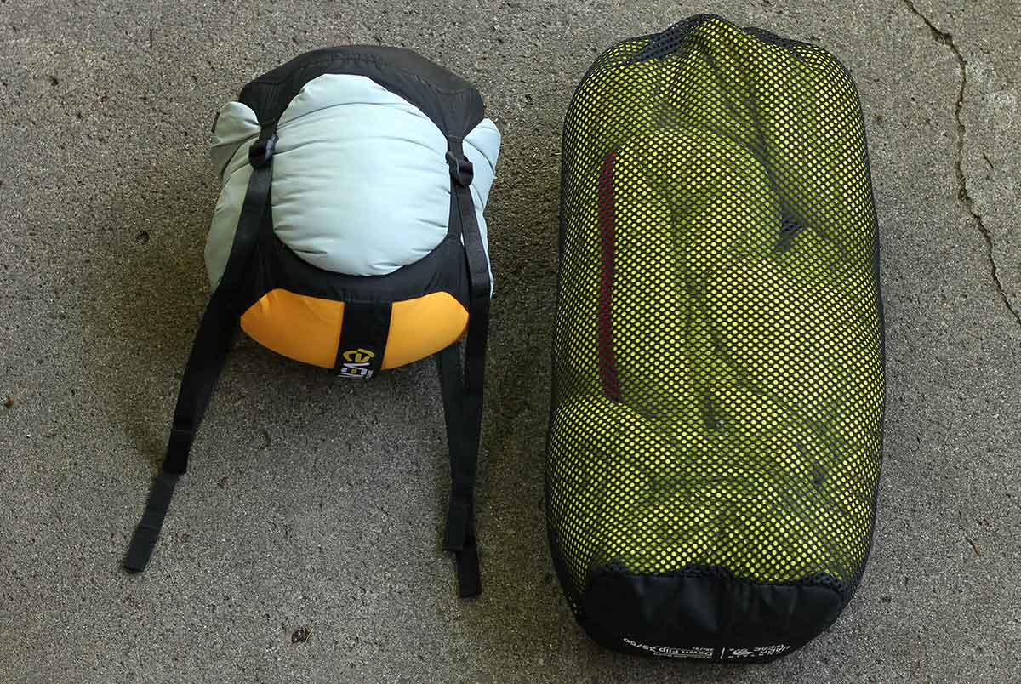
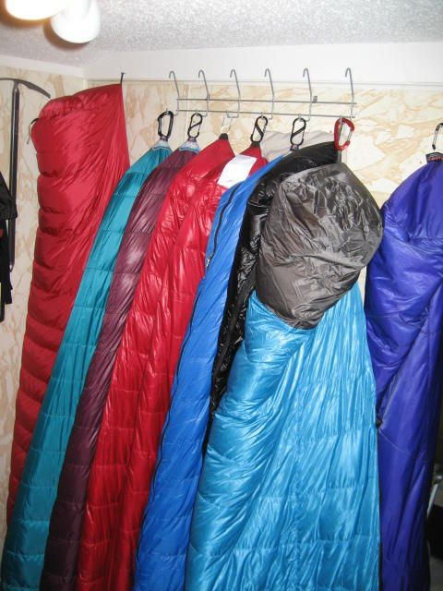
Care for a Sleeping Bag
Tips to help you care for your bag (continued):
Always stuff your sleeping bag, never roll it.
Be gentle with your sleeping bag when removing it from the stuff sack, never yank it.
Store your bag uncompressed in a large, breathable storage sack or king-sized pillowcase.
Hanging it or storing it flat also works.

Slide 26
How to Clean a Sleeping Bag
If you decide to wash your bag yourself, use a gentle, non-detergent soap such as Nikwax Down Wash 2.0, which is made for washing down- and synthetic-filled items.
Down: For down bags, hand-washing in a bathtub works best. Fill the tub with warm water and add one of the above-recommended cleaners. Put the bag in and gently work in the soap, then allow it to soak for 15 minutes. Drain the tub and press out any remaining water. In a cold-water rinse, work the soap out gently, let the bag sit for 15 minutes and drain. Press out any remaining water. Repeat the rinse until all the soap is out. It's also possible, (according to some bag manufacturers) to machine wash a down bag, as long as a front-loading washer is used. Never use an agitator-style machine as the motion can damage the stitching and insulation. Make sure to wash on the gentle cycle in cool water with one of the aforementioned down soaps.
Synthetics: Synthetic bags can be washed in the same way. Hand-wash in a bathtub, or use a large, front-loading washer with no agitator. Use cool water and mild soap. Rinse several times to make sure all the soap is removed. An extra spin cycle or an extractor may be used to remove excess water.

Slide 27
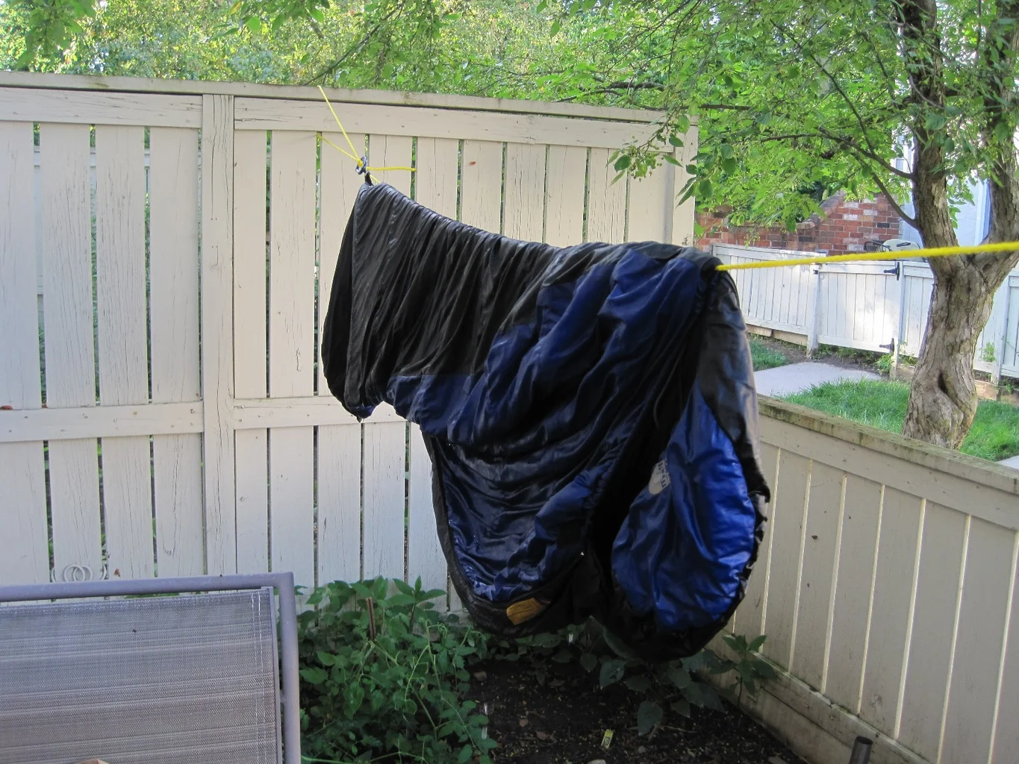
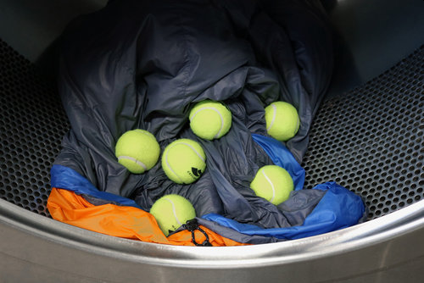
Drying a Sleeping Bag
Air drying is the safest way to dry your bag, but obviously the longest.
If you tumble dry your bag, use very low heat or a no-heat setting and keep an eye on it.
Dryers have varying heat outputs, so you need to check periodically to make sure the shell and insulation aren't overheating, which can actually lead to melting.
Add a couple of clean tennis balls when the bag is nearly dry.
This will help break up any clumps of insulation and help restore the loft.

Slide 28
Sleeping Bag Maintenance
Dry cleaning is not appropriate for sleeping bags, especially down.
Solvents used in dry cleaning can strip the natural oils from down that help it retain loft. Solvents are also very difficult to remove from synthetic insulation.
Restoring DWR
The original DWR (durable water repellent) finish on a sleeping bag's shell eventually wears off.
You can restore water repellency and help keep the bag cleaner if you reapply this finish. There are several products available to restore the DWR to your sleeping bag shell fabric.
Leaking Down
Many, but not all, goose-down bags feature "down-proof" liners and shells made of very tightly woven fabric which prevent the down from getting through.
If a few feathers escape through the shell or liner of your bag, don't become too concerned.
This is normal, especially along the seams.
The sharp quills of the feathers may poke through, especially when the bag is new and the down hasn't totally settled.
Work the feathers gently back inside, pulling from the opposite side; the holes should be minimal and close back up.
Fabric Tears
For small holes or tears in the sleeping bag shell, a patch of nylon repair tape will do the trick until you get home.

Slide 29
Sleeping Pad Types
Warmth
Pillows
02
Sleeping Pads

Slide 30
Sleeping Pad
Sleeping pads play two very important roles for getting a solid night's sleep in the great outdoors: cushioning and insulation.
While it might seem like having a comfortable surface to sleep on is a pad's most useful function, its ability to keep you warm throughout the night is often more important.
How to choose a sleeping pad for camping or backpacking:
Types of sleeping pads: Learn about the three basic types of pads and how they perform: air, self-inflating and closed-cell foam.
Warmth (R-value): A pad’s ability to resist heat loss to the ground is measured as R-value—higher R-values are warmer.
Sleep system: Being comfortable at a particular temperature depends on many other variables, including the temperature rating of your sleeping bag. Correctly pairing your pad and bag in your sleep system is key to staying warm.
Features: Decide which other features are most important to you: weight, cushioning, size, inflation ease and more.
Try them in person: To make your final decision, try to visit a store and test a few different pads. Lie down in your typical sleeping position and move around as you normally would. Seeing pads in person also allows you to easily assess weight and packed size.

Slide 31
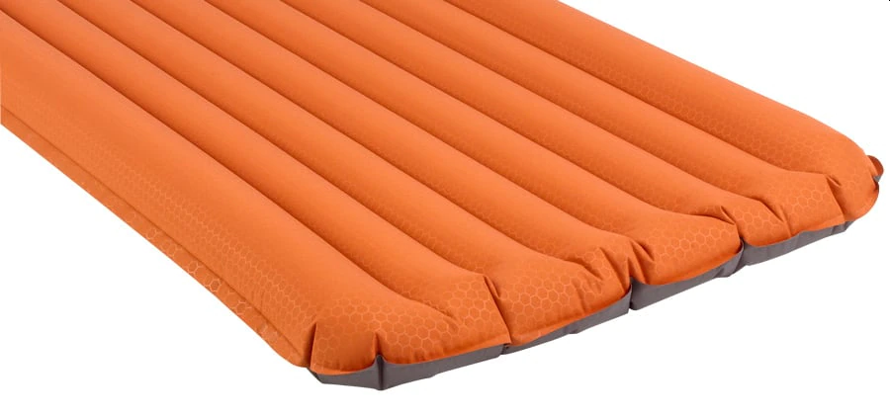
Types of Sleeping Pads
Air Pads come in a wide variety of styles, from lightweight ones ideal for backpacking up to extra-thick ones that are great for glamping. Most air pads now contain insulation and/or reflective materials to increase warmth. Many air pads feature alternative inflation methods so you can save your breath.
Pros: Air pads are incredibly comfortable and lightweight and the most compact type of pad when packed. You can customize the firmness of the mattress by releasing or adding air from the valve(s). Designs and intended end uses vary widely. Be sure that the one you pick has an R-value suited for the conditions you expect.
Cons: Air pads tend to be more expensive the lighter and more compact they are. They can be punctured or ripped (this is most common when sharing a tent with dogs), but field repairs are possible if you carry the appropriate patch kit.
Air pads tend to feel as if they are losing air if the outside temperature fluctuates, so check and adjust the firmness right before you go to sleep. Moisture from breath can get trapped inside, which may eventually lead to degraded performance or bacterial or mold issues. Using a hand pump will help prevent moisture buildup, as will storing your pad unrolled with valve(s) open.
Some air pads make a loud crinkly sound when you move around, which can be annoying to yourself or tent mates. This is another good reason to test pads out in a store.

Slide 32
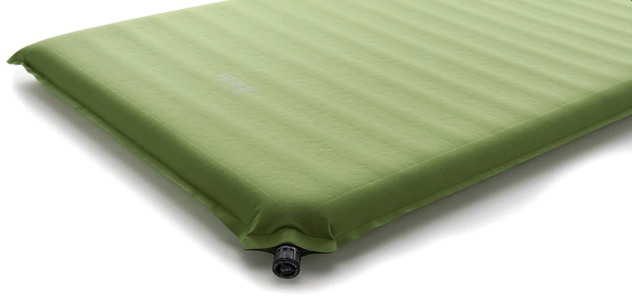
Types of Sleeping Pads (continued)
Self-Inflating Pads offer a combination of open-cell foam insulation and air. Opening the valve(s) allows the foam to expand and brings in air automatically. Some are specifically designed for backpacking and can be folded lengthwise and then rolled up to fit inside your pack. Others are designed for car camping and are rolled up without folding. Self-inflating pads offer you a broad range of options for warmth, size and cost.
Pros: They’re comfortable and reasonably compact, they offer excellent insulation, and you can adjust their firmness by adding or releasing air. They’re generally more durable than air pads.
Cons: They’re heavier and more expensive than simple foam pads, and not as compact as air pads. They can be punctured or ripped, though field repairs are not difficult.

Slide 33
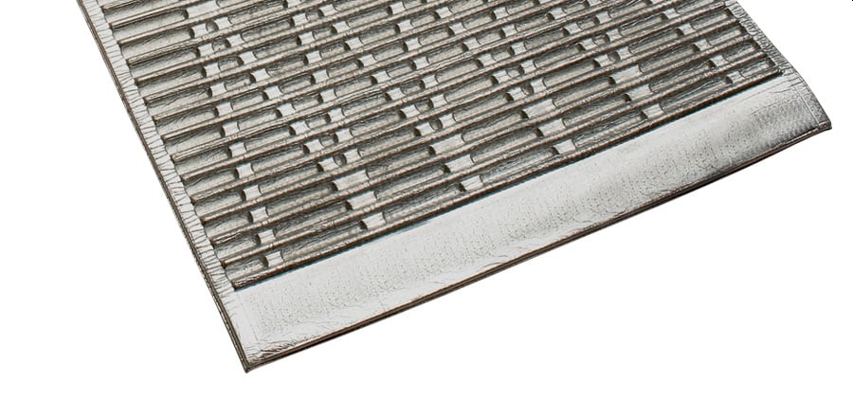
Types of Sleeping Pads (continued)
Closed-Cell Foam Camping Mats are basic backpacking and camping pads that are made of dense foam filled with tiny closed air cells.
They’re usually rolled up or folded in a Z formation.
Pros: They’re lightweight, inexpensive, durable and offer consistent insulation in all conditions. You don’t need to worry about punctures or leaks. They work great underneath other types of pads to improve insulation and prevent punctures. These are the only pads that can be carried on the outside of your pack without fear of damage. They can also double as sit pads in camp.
Cons: They are less comfortable. They’re relatively stiff and firm, and tend to be bulky.

Slide 34
Sleeping Pad Warmth
Insulation and R-Value
A sleeping pad's insulation is crucial to a warm night’s sleep because you lose body heat to the cold ground beneath you. To counteract this, pads use a variety of materials and construction techniques to prevent heat loss.
A sleeping pad's R-value measures its capacity to resist heat flow through it (hence the "R"). The higher a pad’s R-value, the better it will insulate you from cold surfaces. Sleeping pad R-values range from less than 2 (minimally insulated) to 5.5 or more (very well insulated).
Manufacturers now have a uniform way to test sleeping pads for R-values, which means you can compare this key spec between any two pads, regardless of the brand, model or type of pad.
Key facts about R-values in sleeping pads:
Higher numbers mean more insulation.
The scale is simple: A pad with an R-value of 2.0 is twice as warm as pad with an R-value of 1.0.

Slide 35
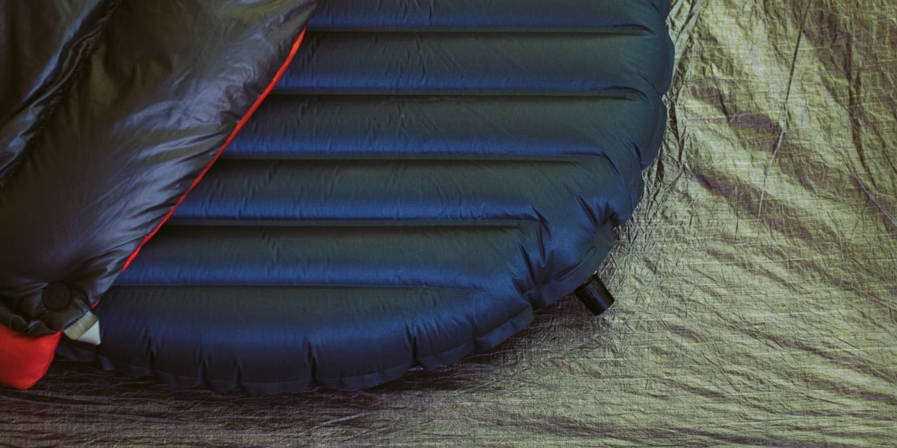
Your Sleep System
Your Sleeping Pad and Bag Work Together
Your real-world warmth and comfort can vary from the tested temperature ratings based on many variables, including humidity, wind, type of shelter, ground conditions, clothing, and personal preferences.
The central consideration, though, is your sleep system.
A sleep system consists of three basic components: 1) the sleeping bag, 2) the sleeping pad, and 3) the sleeper’s clothing.
If you use a less-insulated pad at colder temps, your sleeping bag might not live up to its temperature rating.

Slide 36
Your Sleep System
The simple table below shows recommended sleep system combinations based on expected nighttime low, R-value of the sleeping pad, and the sleeping bag temperature rating.
Sleep Systems: What Sleeping Pad and Sleeping Bag Rating Should I Get?
For the temperature rating of your bag, use its “lower limit” rating if you are a warm sleeper; use its “comfort” rating if you are a cold sleeper.
CONDITIONS | WARM | COOL | COLD | EXTREME
Expected Nighttime Low | 50°F | 32°F | 20°F | 0°F
Pad: R-Value Range | Under 2 | 2 – 3.9 | 4 – 5.4 | 5.5+
Bag: Temperature Rating | 30°F or lower | 20°F or lower | 15°F or lower | 0°F or lower

Slide 37
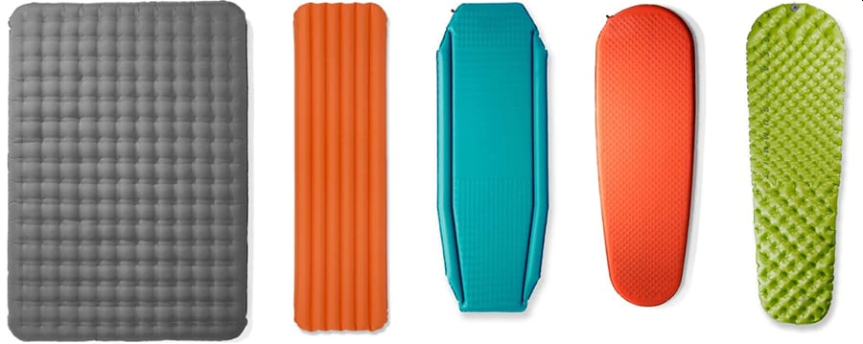
Sleeping Pad Features
Sleeping Pad Weight
Ultralight pads are excellent for backpacking but are more expensive. You can save weight by choosing a mummy or tapered shape that reduces volume and packs smaller. Closed-cell foam pads in short lengths are also quite low in weight. If you’re backpacking with a partner, a two-person lightweight sleeping pad can save ounces.
Sleeping Pad Length
At a minimum, your shoulders and hips need to fit on a pad. Regular (typically 72 inches long) and long (typically 78-inch) pads will insulate your legs and feet—a big plus on chilly fall and winter trips. A short or 3/4-length pad (usually 47 or 48 inches) weighs less and packs smaller (you can put folded clothing or your pack under your legs and feet for some insulation).
Sleeping Pad Width
Nearly every pad offers a standard width of 20 inches. If you’re a large person or tend to roll around a lot, you may want a width of 25 or 30 inches (but consider the size of your tent to ensure you can fit two wider pads side by side).

Slide 38
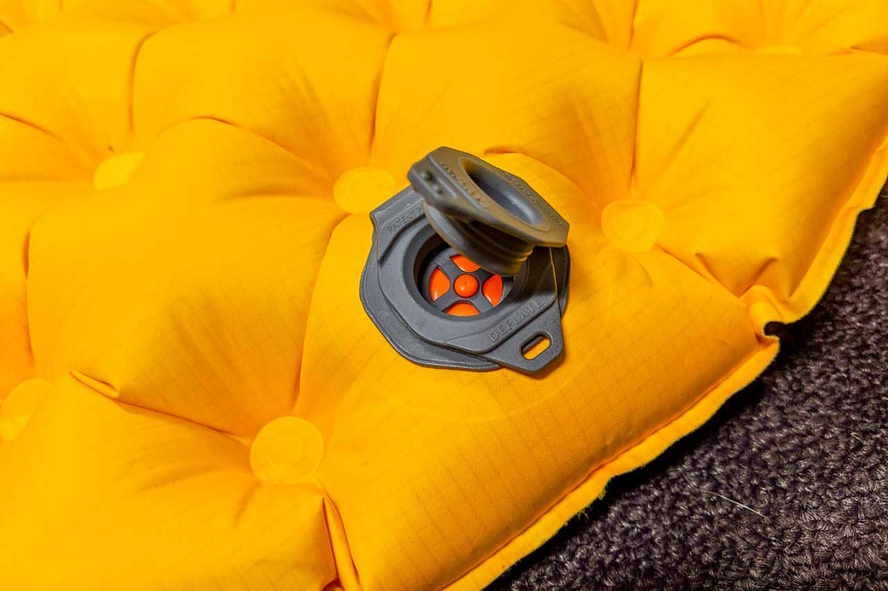
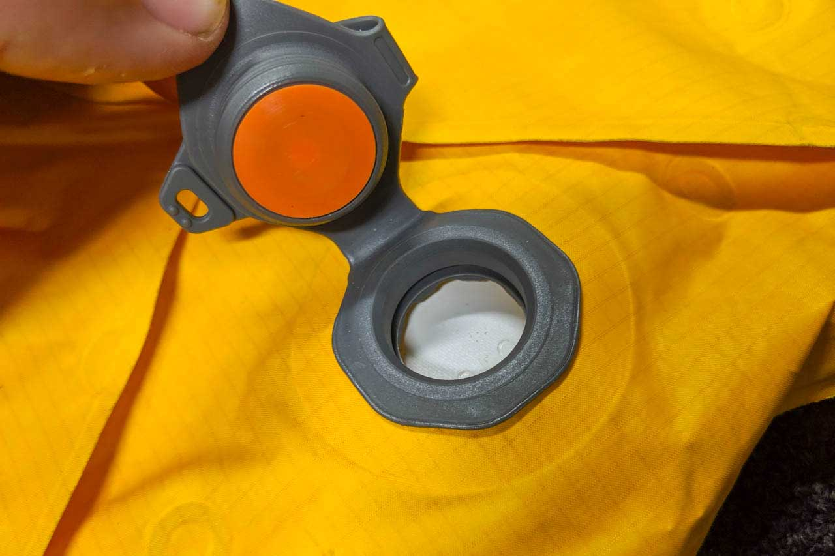
Sleeping Pad Features
Sleeping Pad Inflation
Some pads have both a high-volume inflation valve and a deflation valve, which can speed air flow in or out.
Some new pads have larger “neck” openings that allow fast inflation with fewer breaths.
Sleeping Pad Surfaces
If you're a restless sleeper, look for a pad with a textured or brushed-fabric surface.
This helps keep you and your sleeping bag from sliding off during the night.
It might also be quieter.
Valve in inflate mode
Valve in deflate mode

Slide 39
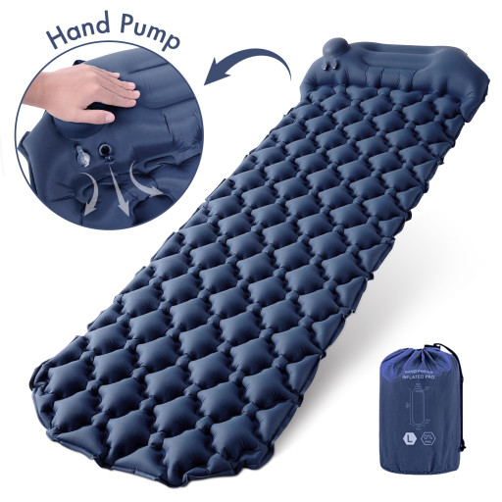
Additional Sleeping Pad Considerations
Pad sleeves: Some sleeping bags have an integrated sleeve to hold a pad. This keeps you and your sleeping bag from sliding off in the night. Check the sleeve width before you buy a pad.
Hand pumps: If you don’t like expending breath after a long day of hiking, look for a pad with an integrated hand pump or purchase a bag-style hand pump that rolls up small and weighs only a couple ounces (sold separately).
Patch kits are a good idea for backpacking. Find out whether they come with the pad or are sold separately. Be sure to understand how to patch a puncture before you leave home, in case you have to repair one in the dark.

Slide 40
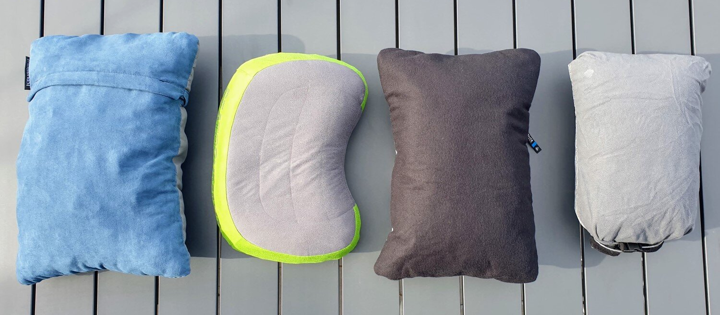
Backpacking Pillow
While pillows may seem trivial and are often overlooked, they can make all the difference between sleeping like a baby and tossing and turning through the night.
There are four main types of camping pillows to choose from:
Air Pillows
Foam/Filled Pillows
Stuff Sack Pillows
Hybrid Pillows

Slide 41
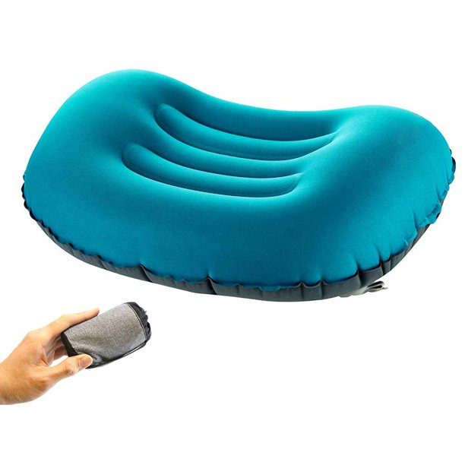
Air Pillows
Very small pillows with a baffled air chamber core.
They can be inflated to the desired firmness level and once deflated, they pack down to the size of a deck of cards.
They are comfortable, tiny and ultralight.

Slide 42
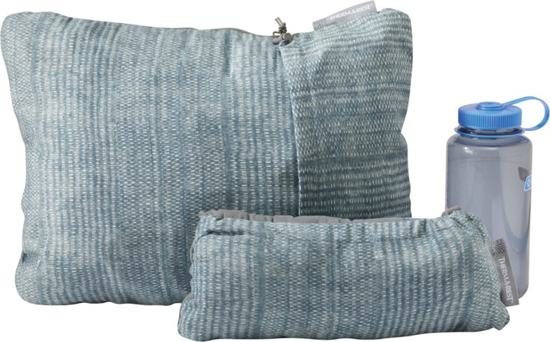
Foam/Filled Pillows
Compact pillows stuffed with foam or down.
Good for car camping, but can be heavy for backpacking depending on the nature of the trip.
They are a very comfortable option.

Slide 43
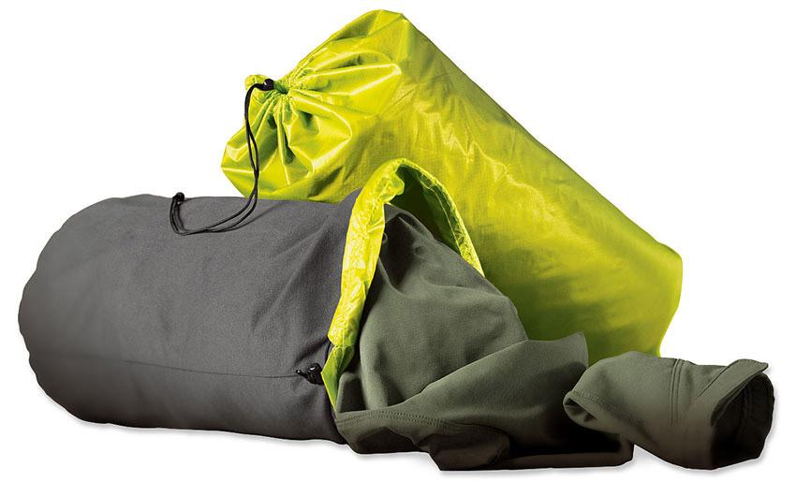
Stuff Sack Pillows
The classic stuff-your-clothes-in-a-stuff-sack-and-call-it-good pillow.
Some manufacturers even make stuff sacks designed for this purpose, with a fleece covering for comfort.
While this is not the most comfortable option when compared to a pillow that is dedicated to the purpose, if you do have spare clothing on hand this can be worth a try to see if it’s comfortable enough for you since this would be the lightest option out there.

Slide 44
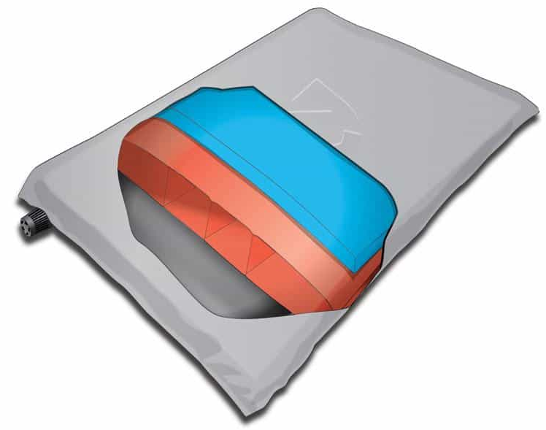
Hybrid Pillows
Hybrid Pillow: An inflatable pillow that features an internal air chamber for height, but also has a cover of some type with at least a thin layer of cushioning – foam, down, or synthetic insulation.
This additional layer will add an ounce or two, but helps offset any balloon type impression you can get for air chamber only solutions.
Since the outer cover and layer is thin, these types of pillows are light enough – usually 3-5 ounces, and still pack small.
As a bonus, some warmth is to be had with the addition of the synthetic, down, or foam layer.

Slide 45
03
Sleeping Clothes
Sleeping Clothes

Slide 46
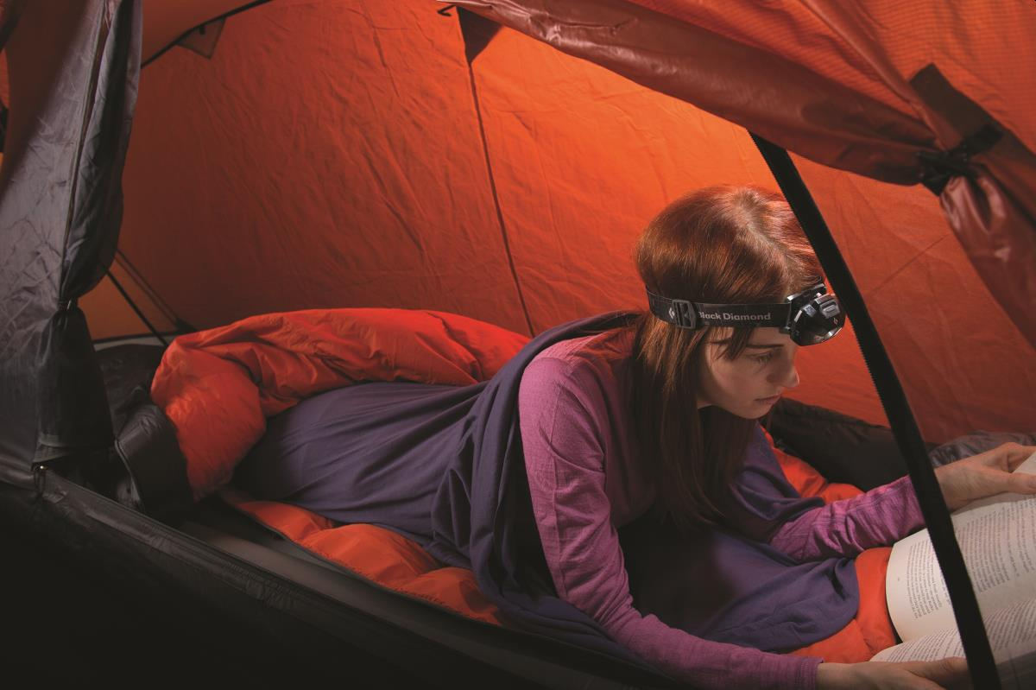
Sleeping Clothes
Accumulated body oils, sweat and dirt can rob your sleeping bag of its insulating power. Don't go to bed in the same clothes you hiked in. You'll drag dirt into the bag with you, and you're likely to sleep colder because of accumulated perspiration in the clothes (even if they feel dry).
Never sleep in the clothes you cooked or ate in. This is extremely important in bear country!
Sleep in clean, warm, and comfy clothes such as a long top and bottom reserved only for sleeping.
Wear a hat if it’s cold.
A lightweight pair of socks adds the final touch.
Keep your sleepwear in a stow bag separate from your smelly hiking clothes.

