Slide 1
Backpacking Guide Course #7
Terry McKibben
Troop 344/9344
Pemberville, OH
troop344leaders@gmail.com

Slide 2
First Aid Kit
Basic Hiker’s First Aid
Wilderness First Aid
High Altitude Acclimatization and Illness
01
First Aid

Slide 3
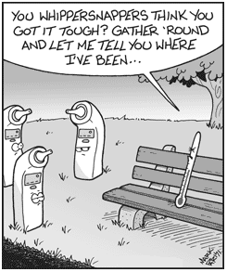
Backpacking First Aid Kit
Emergency first aid in the wilderness begins with your own personal first aid kit.
The kit should be small and waterproof.
Doubled heavy-duty Ziploc bags or a waterproof ditty bag can be used.
It should contain the essential medical instruments and bandage materials listed in the following slides.
Asterisked items (*) need only to be carried by the group leaders.
All medications should be stored in separate air-tight plastic containers and clearly labeled as to the name of the drug, dosage, and expiration date.

Slide 4
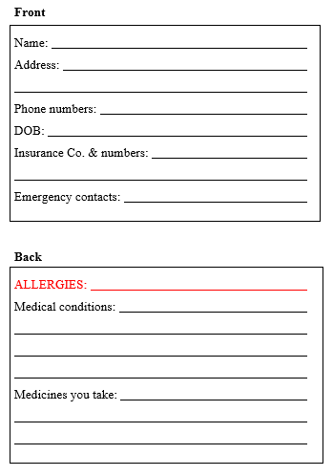
Backpacking First Aid Kit Contents
ID Card
On a 3” X 5” index card print the titles illustrated below legibly in black ink.
Complete the cards with the requested information and in RED ink write your allergies.
Laminate the card and place it in your personal first aid kit.

Slide 5
Backpacking First Aid Kit Contents
Bandage Materials
Qty | Description | Uses
10 | 1” X 3” Band-Aids | Covering small cuts and scrapes
10 | 2” X 4” Band-Aids | Covering small cuts and scrapes
10 | Butterflies | Close long cuts and wounds
4 | Knuckle Band-Aids | Covering cuts and scrapes on knuckles
4 | 2” X 2” gauze pads | Used to cover wounds
4 | 4” X 4” gauze pads | Used to cover wounds
4 | 4” X 4” Telfa pads (non-adherent dressing) | Place directly on wound, under sterile dressings
1 | 2” or 3” gauze roll (self-adhering) | Hold dressings in place
*2 | Trauma dressings (surgipad or sanitary napkins) | Large wound or abrasion pressure dressing
9’ | Duct tape (wrapped around a short pencil) | Hold dressings in place, preventing blisters
Wound Management
1 | .5oz tube triple antibiotic ointment | For cuts, scrapes, burns
1 | Tincture of Benzoin | Increases the stickiness of wound closure strips
1 | 6oz bottle of camp soap | Cleansing wounds
Medications
24 | Ibuprofen tablets | Reduces inflammation, relieves pain
6 | Immodium/Pepto-bismol tabs | Controls the symptoms of diarrhea
6 | Antihistamine tablets (Benadryl or Sudafed) | For treatment of allergic symptoms
*Carried by group leaders

Slide 6
Backpacking First Aid Kit Contents
Blister Care
Qty | Description | Uses
1 | Moleskin pad | For preventing and protecting blisters
1 | Molefoam pad | For preventing and protecting blisters
Personal Protection
*2 | Nitrile examination gloves | To help prevent the spread of infectious disease
*1 | Microshield CPR mask | To help prevent the spread of infectious disease
Hardware
*1 | Small scissors or trauma shears | Removing clothing, cutting bandages
1 | Tweezers | Removing ticks or embedded objects
*1 | Razor | Removing hair around wounds
6 | Large safety pins | 100’s of uses
*1 | Mirror | Removing specks in eye, signaling device
1 | Whistle | Signaling device
1 | Lighter/matches in waterproof container | Starting a fire, sterilizing instruments
Other Essential Items
1 | 1.5oz SPF 15 sunscreen | Prevent sunburn
1 | Lip balm tube with SPF protection | Prevent dry, chapped, sunburned lips
1 | 2-4oz tube of Insect repellant (DEET) | Repel mosquitoes, ticks, and flies
*1 | Water purification tablet system | Emergency clean water supply
*Carried by group leaders

Slide 7
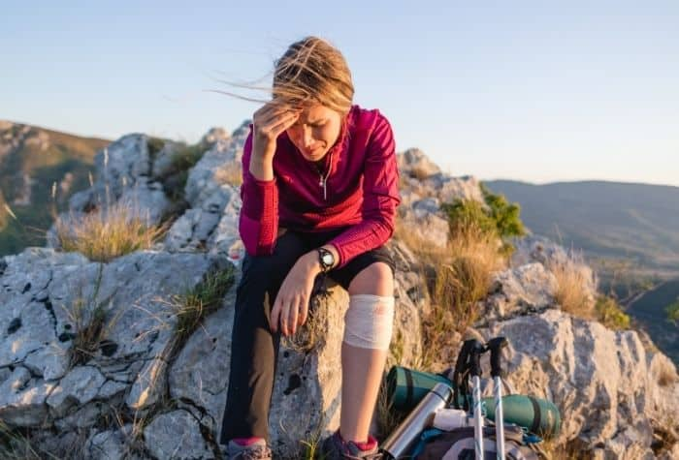
Basic Hiker’s First Aid Everyone Should Know
No wound, no matter how minor, should go ignored in the backcountry.
Treating minor injuries and health problems miles from the ER is an essential skill.
Learn them and go forth to save lives.

Slide 8
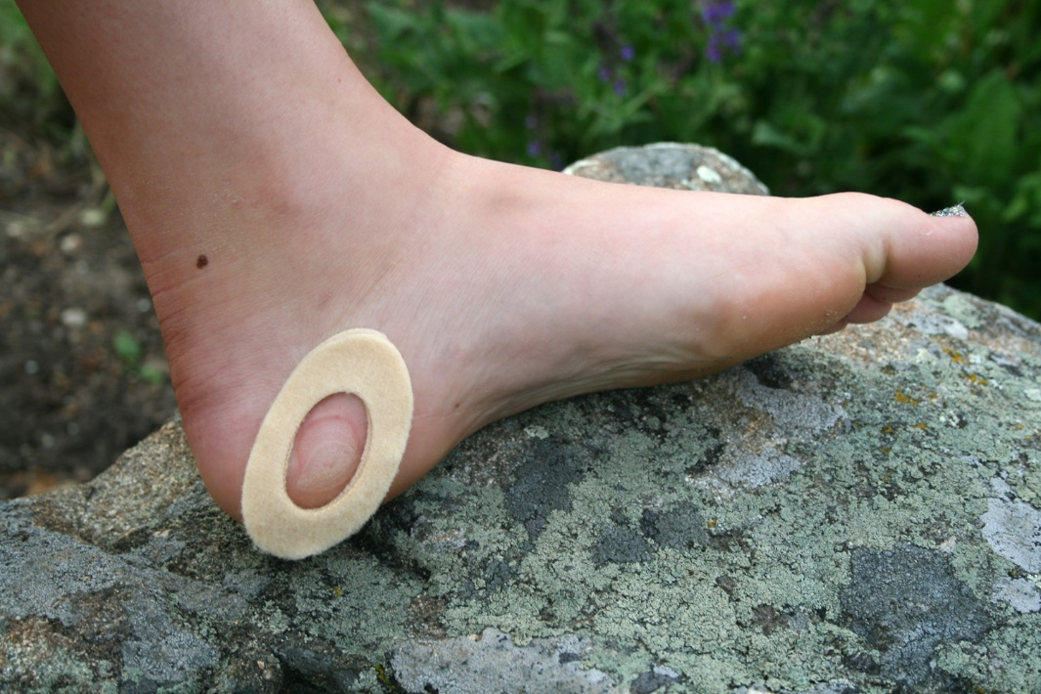
Minor Wounds
Blisters:
Clean well with an antiseptic wipe.
Sterilize the point of a pin or knife with flame or an alcohol swab and gently pierce the blister.
Massage the fluid out, leaving the roof of the blister intact.
Cover with a friction-reducing dressing by cutting a donut-shaped piece of moleskin and place it over the blister.
Fill the hole with antibiotic ointment and cover the moleskin with athletic or duct tape.

Slide 9
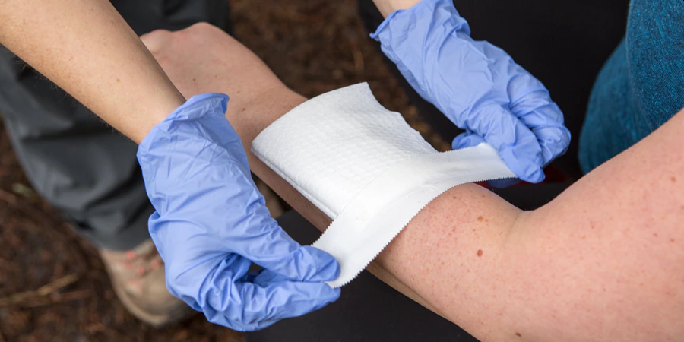
Minor Wounds
Abrasions
Scrub the wound with soap and a gauze pad or bandanna, making sure to remove all debris (warning: It'll hurt).
Rinse off all of the soap, then apply a layer of antibiotic ointment to a non-stick gauze pad and tape it in place. (You can also use a commercial pad with adhesive edges.)
The pad should completely cover the wound.

Slide 10
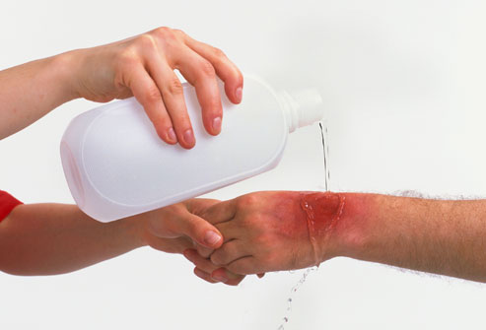
Minor Wounds
Minor Burns
Immediately plunge the burn site into cold water.
Second best: Apply a water-soaked bandanna, a burn gel, or aloe vera.
Continue cooling until pain has substantially subsided, then cover the burn with ointment and a gauze pad.
If blisters form, prevent the blisters from popping as long as possible.

Slide 11
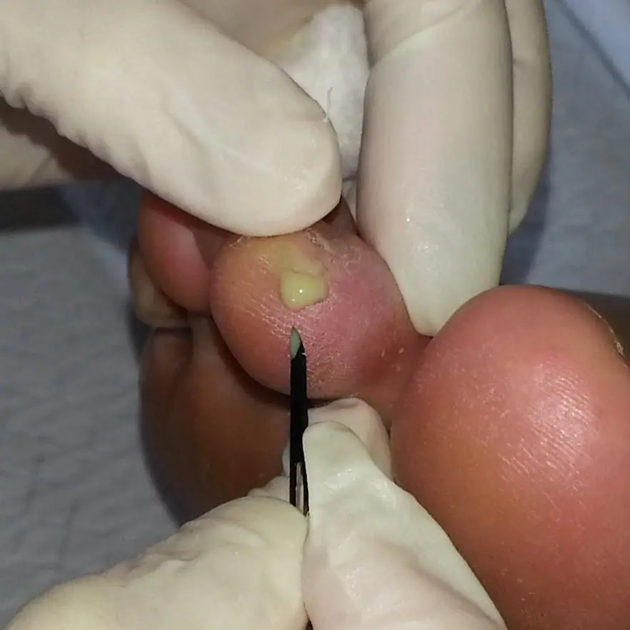
Minor Wounds
Check all wounds (including burns and abrasions) regularly for signs of infection:
Increasing pain, heat, redness, and swelling;
More than a little white pus;
Appearance of red streaks just under the skin near the wound; and
Fever. If these signs appear and grow steadily worse, find a doctor.
NOTE: Do not close wounds caused by animal bites or crushing injuries; anything involving damaged tendons, ligaments, or bones; or those too heavily contaminated to clean thoroughly. All have a high risk of infection. Instead, pack the wound with moist gauze, cover with dry gauze, and evacuate the patient.

Slide 12
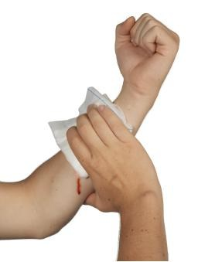
Heavy Bleeding
Apply direct pressure until bleeding stops.
Pack the wound with absorbent gauze, apply direct pressure on top, and elevate it above the heart.
If it soaks through, add more gauze on top and keep applying pressure.
When bleeding stops, clean the wound thoroughly with a high-pressure stream of water.
Apply antibiotic ointment to a sterile dressing and completely cover the wound, securing it with tape or roll gauze.
Gaping wound? Press the edges together gently and hold them there with wound closure strips. Then apply the ointment and sterile dressing.

Slide 13
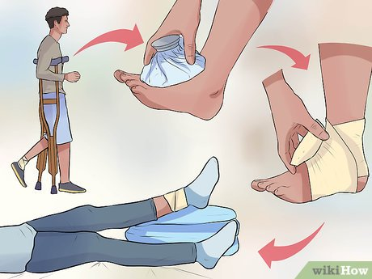
Sprains and Strains
Remember RICE: This stands for Rest, Ice, Compression and Elevation.
The ankle should be quickly Rested and Iced if possible or soaked in cold water from a stream.
Even snow can be used as a substitute for ice.
Ice the ankle for 20 minutes to half an hour and then remove the cold and let the injured area warm naturally for 10 to 15 minutes before use.
Compress the injury with elastic wrap or athletic tape.
Apply it snugly, but not tight enough to cut off circulation, and wrap it toward the heart (for example, up the leg, not down).
Elevate the injury by keeping it higher than the heart.
Repeat three to four times a day until pain and swelling subside.

Slide 14
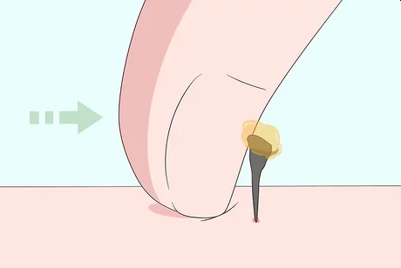
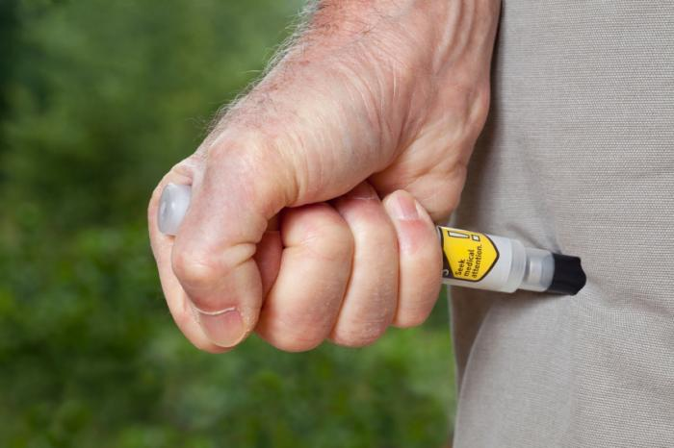
Animal and Insect Bites
Bees and Wasps
If the stinger remains in the skin, remove it immediately.
Apply a cold pack for pain and swelling, and give an oral antihistamine.
If the patient has an allergic reaction–difficulty breathing, tightness of the chest, swelling of the throat, dizziness–give a dose of injectable epinephrine (prescription required) and the antihistamine.
Evacuate to medical attention ASAP, keeping a second dose of epi on hand and giving more antihistamine every four to six hours.

Slide 15
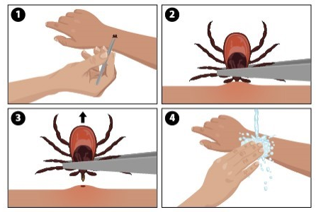
Animal and Insect Bites
Ticks
These bloodsuckers can transmit disease if allowed to embed in the skin (sometimes a few hours is all it takes), so check yourself twice a day.
Found one? Remove it immediately with tweezers.
Grasp the tick at skin level, perpendicular to the long axis of the tick, and pull it gently straight out.
Wash the site.
If illness and/or an unusual rash develop, consult a doctor.

Slide 16
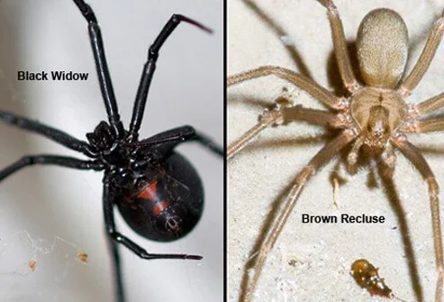
Animal and Insect Bites
Venomous Spiders
Black widow bites can be tough to diagnose (many victims don't feel the bite when it occurs).
Look for vomiting, weakness, headache, fever, and intense abdominal and/or back pain.
Brown recluse bites might sting or itch.
For both, clean the wound, apply cold to the site, and give the patient an antihistamine (for itching) and ibuprofen for pain.
Hike out to a doctor (don't worry: death is rare).

Slide 17
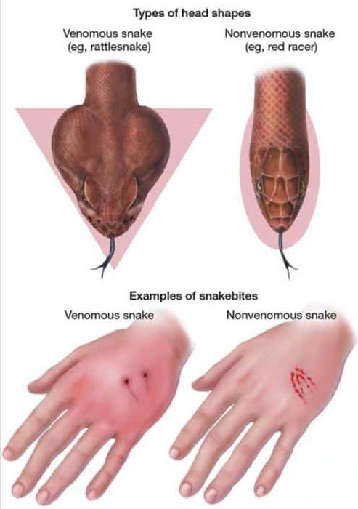
Animal and Insect Bites
Venomous Snakes
First, keep the victim calm (a low heart rate minimizes venom circulation, and death from snakebite is unlikely).
Remove jewelry, watches, and any snug clothing that could cut off circulation when the bite site swells.
Splint the bitten arm or leg, but do not elevate it.
Carry the victim out if you can; otherwise, have him slowly walk out for a dose of antivenin.

Slide 18
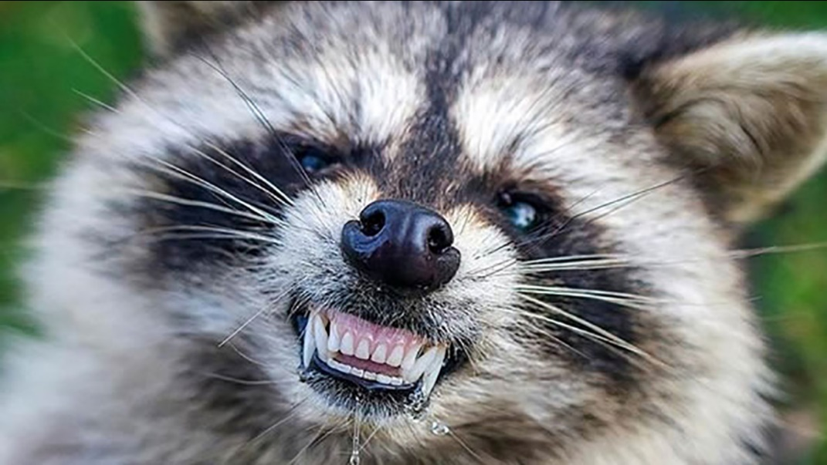
Animal and Insect Bites
Mammals
Stop the bleeding.
Immediately wash the wound thoroughly with soap and water.
Rinse clean, cover with a sterile dressing smeared with antibacterial ointment, and find a doctor ASAP.
These bites have a high risk of infection, including rabies–and in that case, the victim needs a vaccination within 72 hours for the best chance of survival.

Slide 19
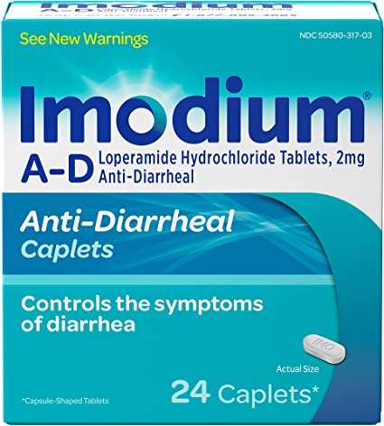
Gastrointestinal Illness
Diarrhea
In all cases, give lots of fluids to prevent dehydration and pop an Imodium AD tablet.
For more severe diarrhea, add electrolyte tablets to the water.
Give easily digested foods (such as rice or oatmeal); avoid fats, dairy products, and caffeine.
If it's not under control within 24 hours, find a doctor–sooner if bloody bowel movements, fever, and pain exist.

Slide 20
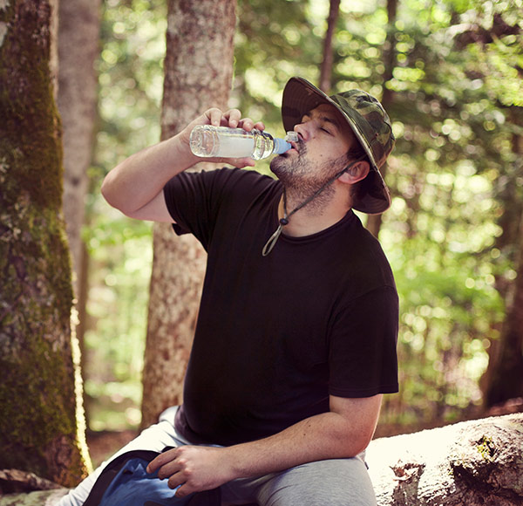
Gastrointestinal Illness
Vomiting
Give as much fluid as the patient can tolerate and have him rest.
Evacuate if the problem persists for more than 24 hours.

Slide 21
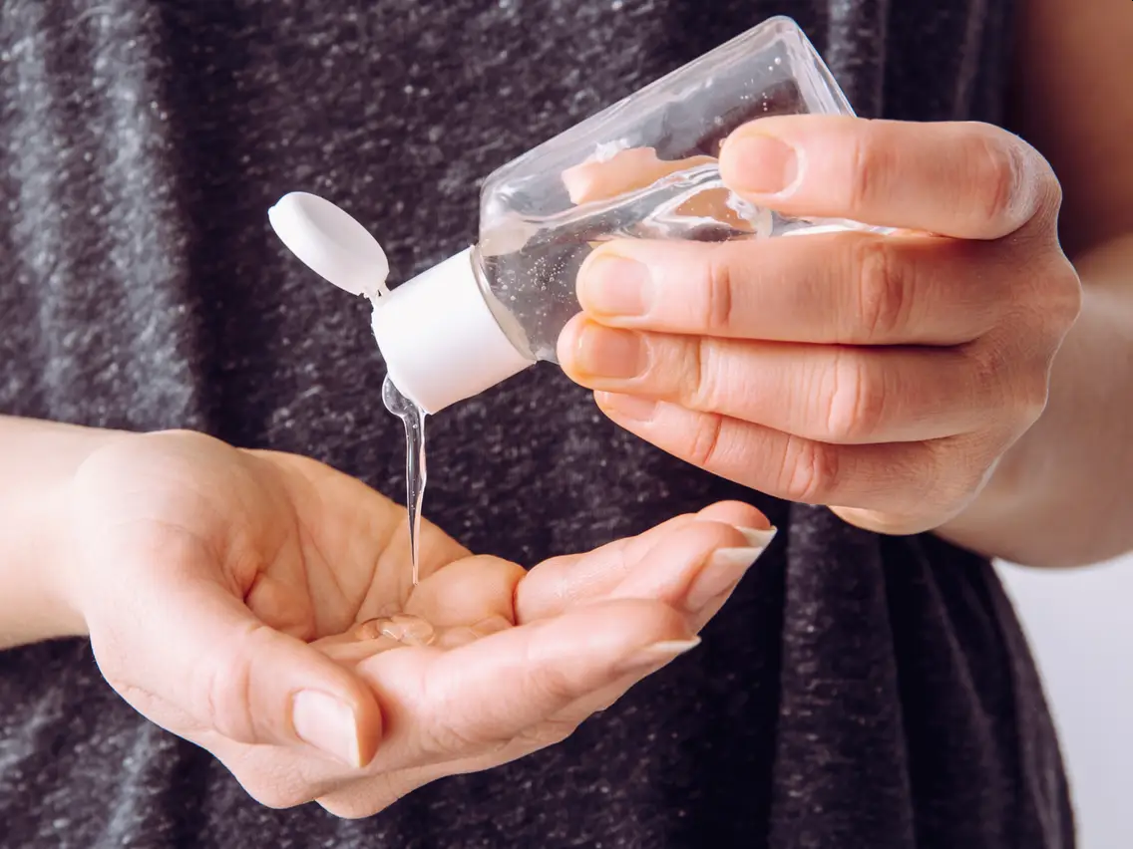
Gastrointestinal Illness
Wash Your Hands
A Journal of Travel Medicine report found that 61 percent of Appalachian Trail hikers who "rarely or never" washed their hands after a bathroom break got diarrhea, compared to just seven percent of those who did scrub.
Here's how to wash up right:
Wet hands (hot water is best) and add a drop of biodegradable soap.
Work up a lather and scrub for 30 seconds–especially fingertips and under nails.
Rinse, repeat, then dry hands with a bandanna reserved for this purpose.
Hand sanitizer works as well.

Slide 22
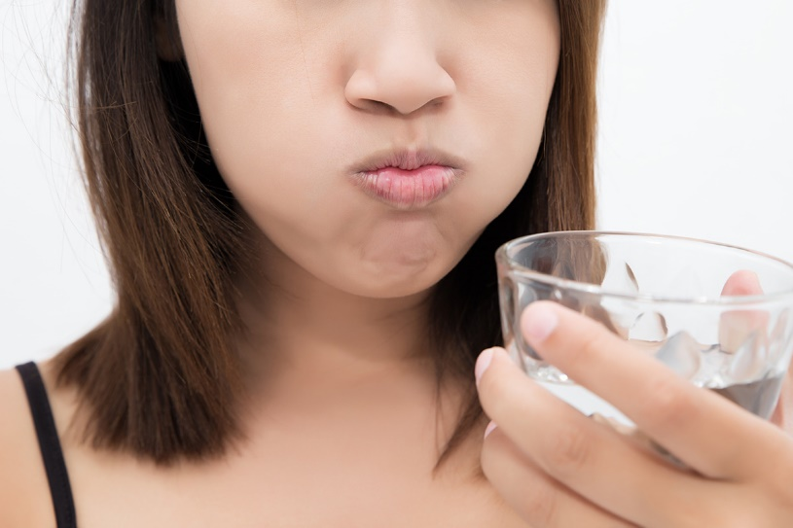
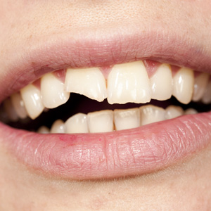
Dental Emergencies
Toothache
Rinse your mouth with a solution of half a teaspoon of salt and eight ounces of water several times a day.
If pain, sensitivity to hot and cold, and swelling exist, get to a doctor–it could be an abscess.
Broken tooth
Rinse the tooth thoroughly with drinking water, and then protect the sensitive nerve by placing a chewed piece of gum over the break.
Apply a cold-water bladder to the patient's cheek to reduce swelling, and take ibuprofen for the pain.
Hike out to your dentist.

Slide 23
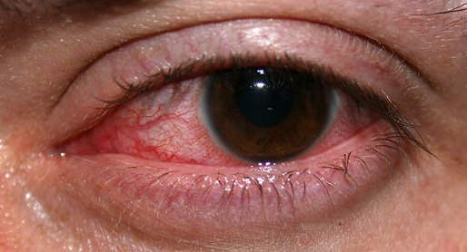
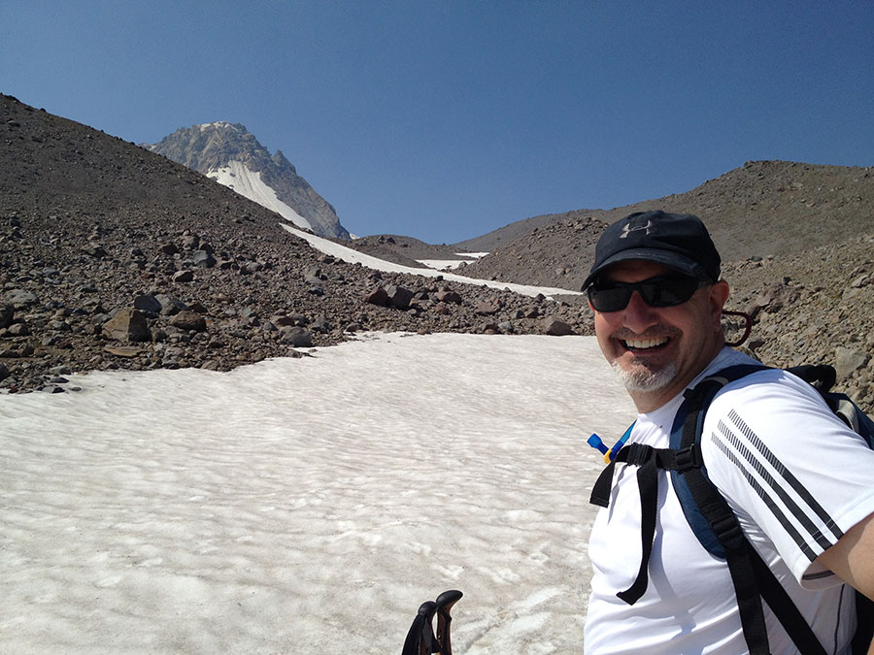
Snowblindness
Symptoms:
Redness, tearing, and a sandpapery pain when opening or moving the eye are signs of sunburned corneas.
Treatment:
Don't let the patient rub his eyes; it could further damage the corneas.
Give ibuprofen for the pain, apply a cold compress, and cover eyes with gauze.
Wear sunglasses and stay in a dark environment until vision returns to normal (usually in about 18 hours).

Slide 24
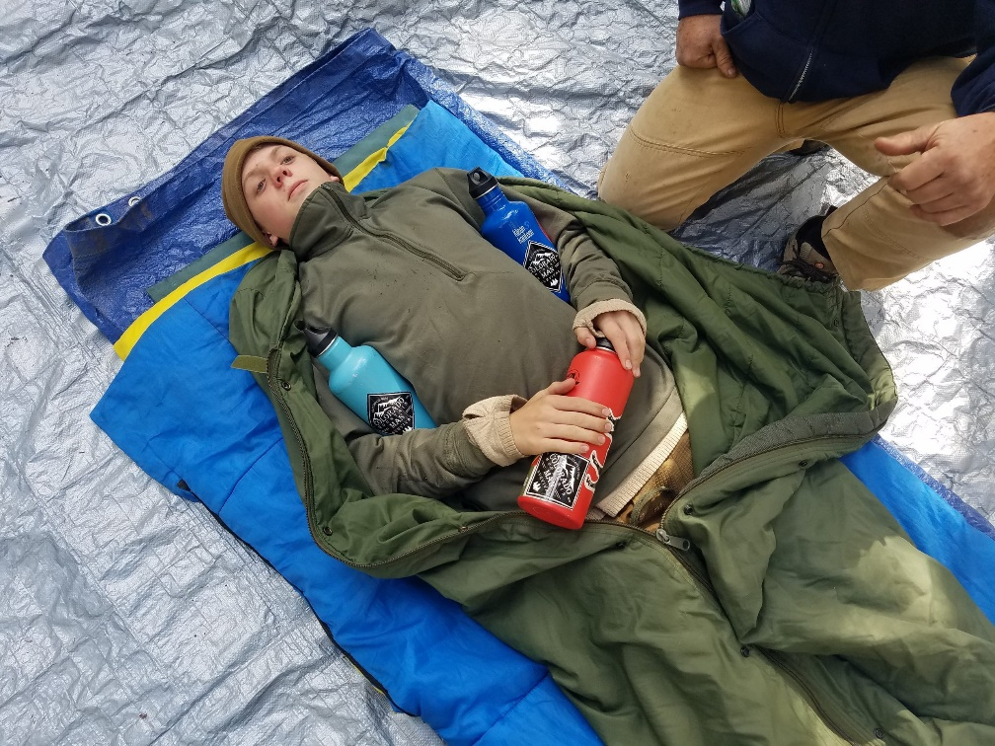
Hypothermia
Symptoms:
The person complains of feeling cold and shivers.
More advanced hypothermia patients exhibit "the umbles:" stumbling, fumbling, mumbling, and grumbling.
Treatment:
Get the patient into warm, dry clothes and place him in a sheltered area–such as in a sleeping bag, inside of a tent.
Give water and simple sugars, such as hot chocolate or candy, to generate quick body heat.
Place warm water bottles around the body core.

Slide 25
Stay or Go?
Use this chart to determine if you can finish your trip–or should head for help.
Problem | Stick it out if . . . | Head for help if . . .
Hypothermia | Person warms up and feels fine | Pulse slows; shivering stops; person becomes incoherent or unconscious
Frostbite | Tissue warms and looks normal | Blisters or black tissue form
Heat illness | Persons cools off and feels fine | Person has altered mental status and red, hot skin
Muscle/bone injury | Person can use the injured part | Person cannot use the injured part
Diarrhea | Problem resolves within 24 hours | Problem persists for more than 24 hours
Wounds | They are cleaned, properly dressed, and don't require closure | They are large enough to require closure; they're deep wounds on the face or neck
Burns | Pain is manageable and no large blisters form | Pain is intense; blisters are large; face is burned

Slide 26
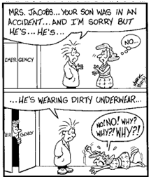
If You Must Go, Evacuate or Wait for Rescue?
Your buddy just slid down a steep scree and broke his leg. Should you go for help–or haul him out? It's a tough call. The answer depends on several factors. Here's how to decide.
How bad is it? Patients with life-threatening injuries should usually stay put and wait for trained medical professionals; those with less serious injuries can walk or be carried out. If the patient can handle it, walking out is the best option.
How far is the trailhead? One fit hiker can move a lot faster than a group carrying a litter. If you're deep in the wilderness, a messenger might bring back help before you could carry the patient out.
Can the rescuer(s) handle it? You'll need strength, stamina, and skill to navigate the terrain with an injured person in tow.
What's the weather like? Stay put if severe weather puts the rescuers in danger of getting lost or injuring themselves.
Is there imminent danger? Even severely injured patients might need to be moved if the current location is unsafe–e.g., lightning is striking or you're on an unstable slope.

Slide 27
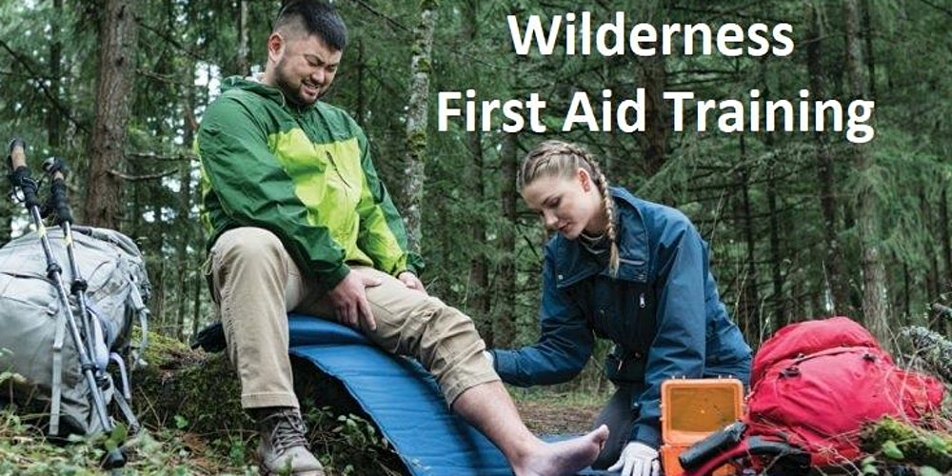
Wilderness First Aid
Wilderness First Aid is a requirement for units traveling to a BSA National High Adventure such as Philmont, Northern Tier, Sea Base or participating in some high adventure activities when medical help may be delayed.
CPR certification is a prerequisite.

Slide 28
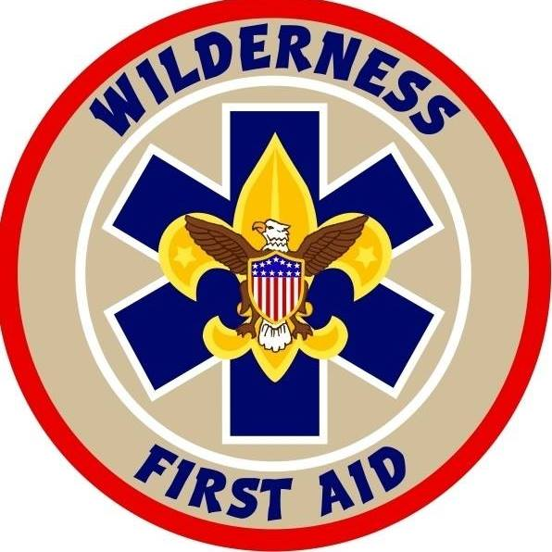
Why Take Wilderness First Aid?
Accidents happen and people get hurt, sick, or lost. The temperature drops, the wind picks up, and it starts to rain. Would you know what to do?
When calling 911 is not an immediate option, or when help could be an hour or even days away, the task of managing the injured and the ill will challenge you beyond basic first-aid knowledge.
Remote locations and harsh environments may require creative treatments.
The equipment needed for treatment and evacuation may have to be improvised from what’s available.
The skills you learn in a Wilderness First Aid course addresses these issues and can make the difference between a good outcome and a bad one.

Slide 29
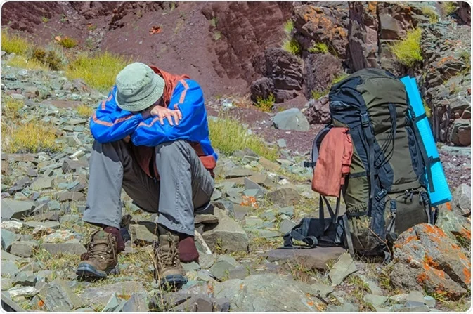
High Altitude Acclimatization and Illnesses
The pleasures of trekking in mountain ranges cannot be overstated. Neither can the dangers. Altitude sickness can occur in some people as low as 8,000 feet, but serious symptoms do not usually occur until over 12,000 feet. Even then it is not the height that is important, rather the speed in which you ascended to that altitude.
Acute mountain sickness (AMS) is actually more common in fit young men because they are more likely to attempt a rapid ascent by racing up the mountain like some indestructible super hero! As a general rule, it is far safer (and more enjoyable) to avoid altitude sickness by planning a sensible itinerary that allows for gradual acclimatization to altitude as you ascend, (you can race back down as fast as you like!)

Slide 30
High Altitude Acclimatization and Illnesses
What is High Altitude?
High | 2,500 to 4,000 meters | 8,000 to 13,000 feet
Very High | 4,000 to 5,500 meters | 13,000 to 18,000 feet
Extremely High | Over 5,500 meters | Over 18,000 feet
It is difficult to determine who may be affected by altitude sickness since there are no specific factors such as age, sex, or physical condition that correlate with susceptibility. Some people get it and some people don't because some people are more susceptible than others.
Most people can ascend to 2,500 meters (8,000 feet) with little or no effect. If you have been at that altitude before with no problem, you can probably return to that altitude without problems as long as you are properly acclimatized. If you haven't been to high altitude before, you should exercise caution when doing so.

Slide 31
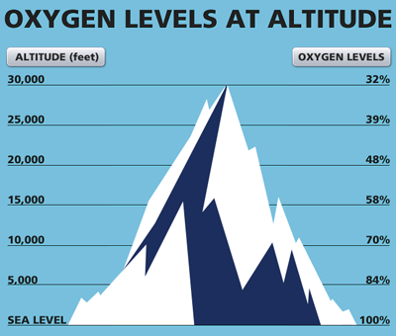
Cause of Altitude Sickness
The percentage of oxygen in the atmosphere at sea level is about 21% and the barometric pressure is around 760 mmHg.
As altitude increases, the percentage remains the same but the number of oxygen molecules per breath is reduced.
At 3,600 meters (12,000 feet) the barometric pressure is only about 480 mmHg, so there are roughly 40% fewer oxygen molecules per breath so the body must adjust to having less oxygen.
In addition, high altitude and lower air pressure causes fluid to leak from the capillaries in both the lungs and the brain, which can lead to fluid build-up.
Continuing on to higher altitude without proper acclimatization can lead to the potentially serious, even life-threatening altitude sickness.

Slide 32
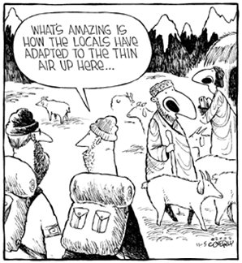
High Altitude Acclimatization
Given enough time, your body will adapt to the decrease in oxygen at a specific altitude.
This process is known as acclimatization and generally takes one to three days at any given altitude.

Slide 33
High Altitude Acclimatization
Several changes take place in the body, which enables it to cope with decreased oxygen:
The depth of respiration increases.
The body produces more red blood cells to carry oxygen.
Pressure in pulmonary capillaries is increased, "forcing" blood into parts of the lung, which are not normally used when breathing at sea level.
The body produces more of a particular enzyme that causes the release of oxygen from hemoglobin to the body tissues.

Slide 34
Symptoms of Altitude Sickness
**If you or anyone in your party experience these symptoms, immediately begin descending and seek medical attention.

Slide 35
Acute Mountain Sickness (AMS)
AMS is very common at high altitude.
At over 3,000 meters (10,000 feet) 75% of people will have mild symptoms.
The occurrence of AMS is dependent upon the elevation, the rate of ascent, and individual susceptibility.
Many people will experience mild AMS during the acclimatization process.
The symptoms usually start 12 to 24 hours after arrival at altitude and begin to decrease in severity around the third day.
Symptoms tend to be worse at night and when respiratory drive is decreased.
Mild AMS does not interfere with normal activity and symptoms generally subside within two to four days as the body acclimatizes.
As long as symptoms are mild, and only a nuisance, ascent can continue at a moderate rate.
When hiking, it is essential that you communicate any symptoms of illness immediately to others on your trip.

Slide 36
Prevention of Altitude Sickness
You should also:
Avoid flying directly to areas of high altitude, if possible.
Take 2 to 3 days to get used to high altitudes before going above 2,500m (8,000 ft.).
Avoid climbing more than 300m (1,000 ft.) in a day.
Have a rest day every 600m (2,000 ft.) to 900m (3,000 ft.) you go up, or rest every 3 to 4 days.

Slide 37
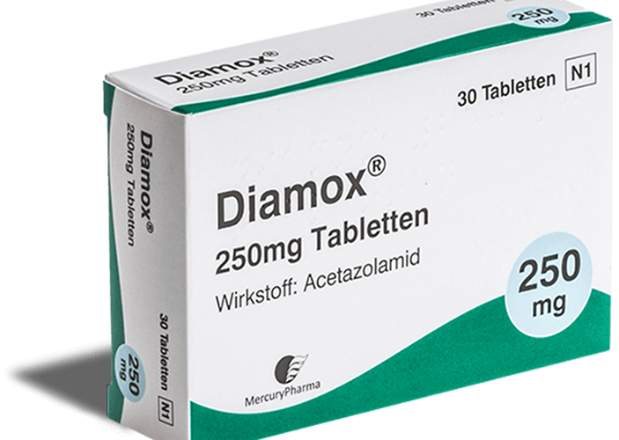
Preventative Medications
Acetazolamide (Diamox):
Works by increasing the amount of alkali (bicarbonate) excreted in the urine, making the blood more acidic.
Acidifying the blood drives the ventilation, which is the cornerstone of acclimatization.
Side effects of acetazolamide include: an uncomfortable tingling of the fingers, toes, and face; carbonated drinks tasting flat; excessive urination; and rarely, blurring of vision.

Slide 38
Other Treatments/Preventative Medications
Ibuprofen/Naproxen/Aspirin: Can be effective in relieving altitude-induced headache. Take as directed.
Conditioning: Working out before you go is another great preventative measure. While this doesn’t guarantee an easier time when up high, it can enhance your lungs’ ability to cope with the challenges of high elevations.

Slide 39
Questions?
Terry McKibben
Troop 344/9344
Pemberville, OH
troop344leaders@gmail.com

