Slide 1
Backpacking Guide Course #6
Terry McKibben
Troop 344/9344
Pemberville, OH
troop344leaders@gmail.com

Slide 2
CONTENTS
01
Water Treatment
Water Treatment Methods, Filter Selection, Treatment Tips
02
Sanitation
Dishwashing, Backpacking Hygiene, Laundry, Human Waste

Slide 3
01
Water Treatment Methods
Filter Selection
Treatment Tips
Water Treatment

Slide 4
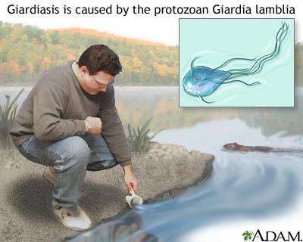
Water Treatment Basics
Today’s natural water sources are nearly always home to such invisible characters like Giardia lamblia, Cryptosporidium, and other nasty “bugs”.
Generally, these protozoa and bacteria and viruses won’t kill you, but just make you wish you were dead before they run their course – run being the operative word here.
Where did these nasties come from? The worst come from mostly other people, or rather their feces to be more exact, but animal feces cause problems too.
Since you can’t tell if water is safe to drink just by looking at it, the best idea is to use something that will eliminate harmful or undesired pollutants.
You really don’t want to spend your backpacking trip battling diarrhea, nausea, cramping or worse, all because you drank untreated water.

Slide 5
Ways to Treat Water
Method | All-around performance | Large volume | Low maintenance | Ease of use | Low weight | Low cost | Speed
Pump filters and purifiers | x | x
Gravity filters and purifiers |  | x |  | x
Ultraviolet (UV) purifiers |  |  | x | x |  |  | x
Bottle filters and purifiers |  |  |  | x | x |  | x
Squeeze filters |  |  |  | x | x |  | x
Straw-style filters |  |  |  | x | x |  | x
Chemicals |  |  | x | x | x | x
Boiling | x | x | x |  |  | x

Slide 6
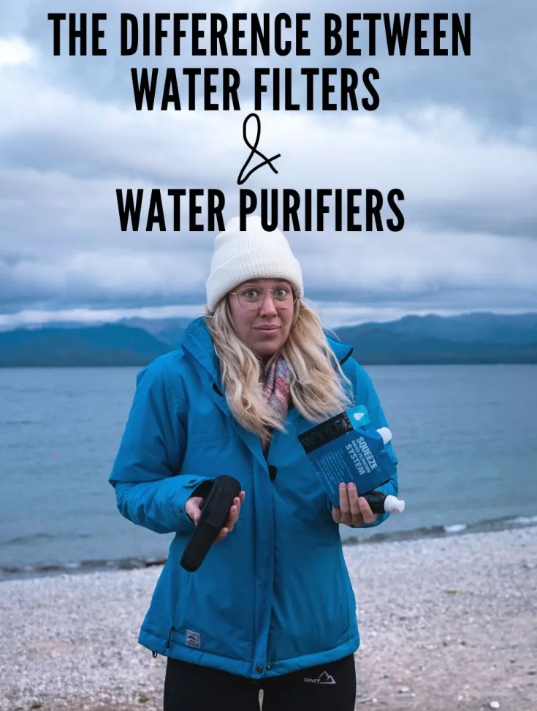
Water Filters Vs. Water Purifiers
The difference between a water filter and a water purifier is the size of the microorganism each combats:
Water filters work by physically straining out protozoan cysts (such as Cryptosporidium and Giardia lamblia) and bacteria (such as E. coli, Salmonella, Campylobacter and Shigella). These biological pathogens are the main water concerns if you’re traveling in the U.S. and Canada.
Water purifiers also combat viruses, which are too tiny for most filters to effectively catch. If you’re traveling in less-developed areas of the world, consider products that also provide protection for viruses (such as hepatitis A, rotavirus and norovirus).

Slide 7
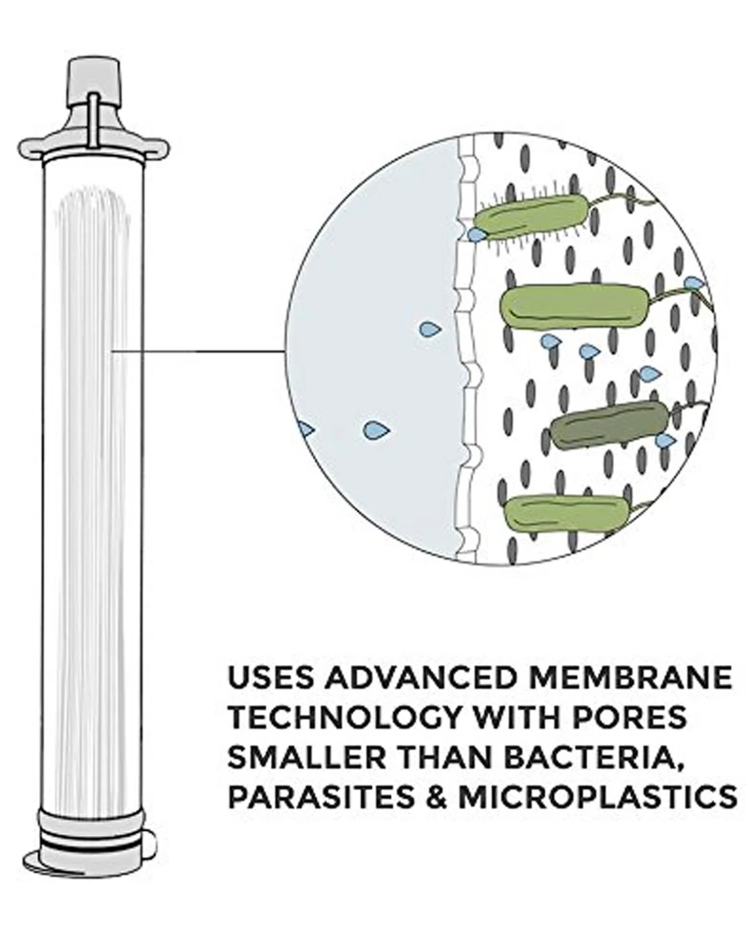
How Water Filters and Purifiers Work
Every filter and many purifiers include an internal element or cartridge, a component that has microscopic pores that catch debris, protozoa and bacteria. Over time, strained matter gums up an element’s pores, requiring it to be cleaned and eventually replaced.
Most purifiers use chemicals (such as iodine) to kill viruses, which are too small for most filter elements. Another purification method relies instead on ultraviolet light to treat the pathogens.
Many filters and purifiers also include activated carbon in their elements because it’s effective at removing unpleasant tastes from things like leaf tannins. Activated carbon also reduces contaminants like pesticides and other industrial chemicals.

Slide 8
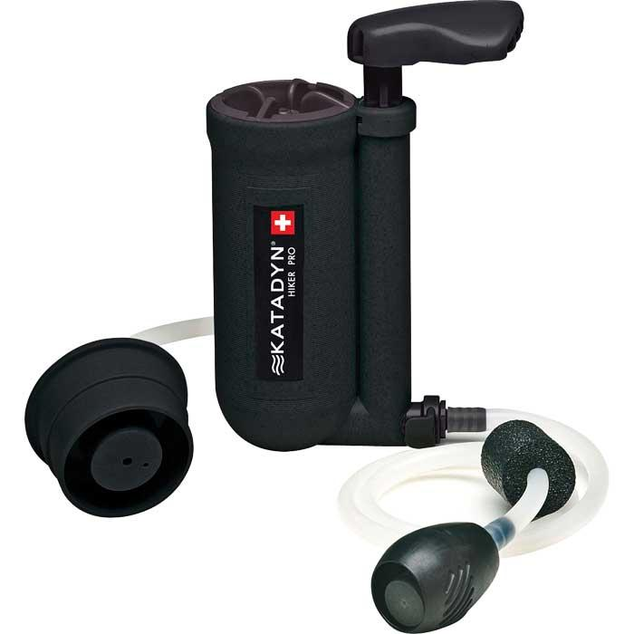
The Role of Prefilters
Silty water, leaf debris and mud, though not a health concern, impact how easy water is to treat, how much field maintenance is required and the lifespan of filter elements.
Use a prefilter to remove large particles from your water to improve the treatment process.
Many pump-style products come with a prefilter, or you may need to purchase one separately.
Here are some reasons to consider using one:
It helps maintain a pump filter’s flow rate, lessen cleaning chores and extend its element life.
It improves the effectiveness of chemical treatments.
It’s absolutely essential prior to using a UV purifier on nonclear water.
Prefilter

Slide 9
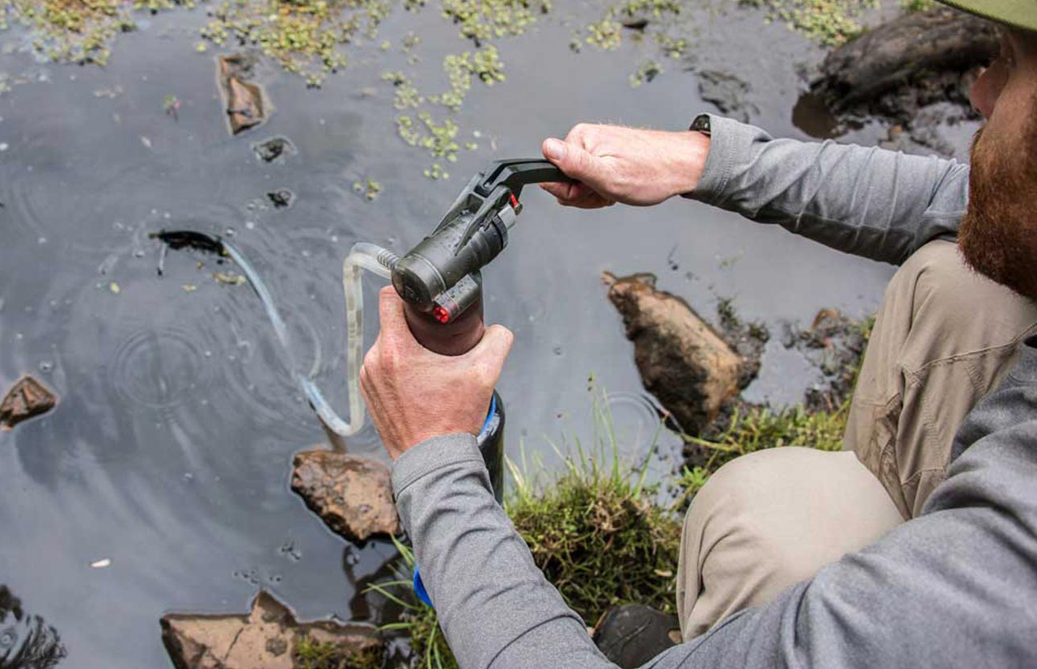
Water Treatment Methods
Pump Filters and Purifiers
Drop the intake hose into your source and the outlet hose into your water bottle, then work the pump. Some models thread directly to a bottle or reservoir. Pump mechanisms differ, as do flow rates, so compare specs.
Pros:
You can process precisely the amount of water you need.
Water can be pulled from seeps and shallow water sources.
The internal element or cartridge is replaceable.
Cons:
Pumping can be a chore, especially at the end of the element’s lifespan.
Field cleaning of the element is required.
Weight and bulk are greater than other treatment methods.

Slide 10
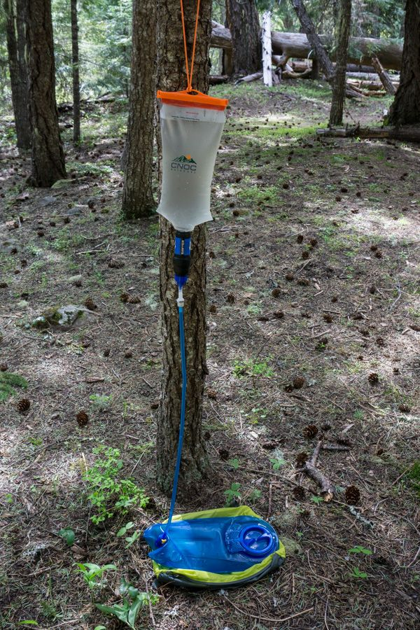
Water Treatment Methods
Gravity Filters and Purifiers
Fill a reservoir, find a suitable place to hang everything up and wait. Most models come with a pair of reservoirs and an inline filter, though the exact setup and provided water containers can vary.
Pros:
Gravity does the work for you.
You can easily process large quantities of water for a big group.
The element or cartridge is replaceable.
Cons:
It can be hard to find a place to hang reservoirs.
Treatment process is slower than pumping.
Seeps and shallow water sources can make it challenging to fill a reservoir.
Field cleaning of the element is required.

Slide 11
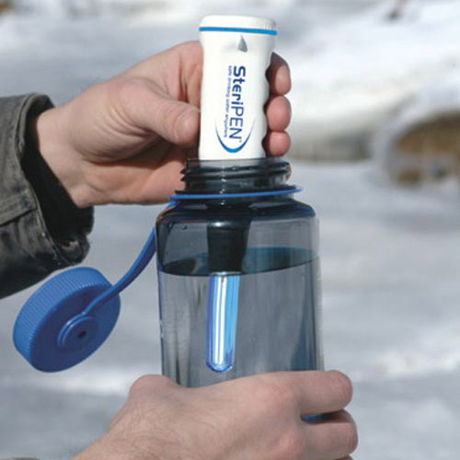
Water Treatment Methods
Ultraviolet (UV) Light Purifiers
Grab one of these pen-style devices, push a button and stir. Stop when its UV light turns off (60 seconds or so) and you will have treated all the water inside a bottle.
Pros:
Treatment is easy and water is quickly drinkable.
No element cleaning and replacement are ever needed.
Cons:
Requires batteries.
Silty or cloudy water impairs effectiveness, requiring you to prefilter.
Multiple treatments are required to produce large quantities.

Slide 12
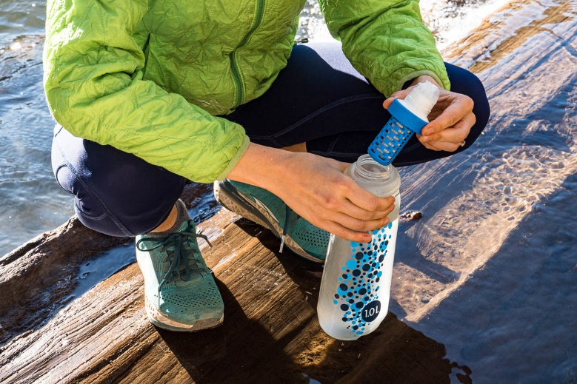
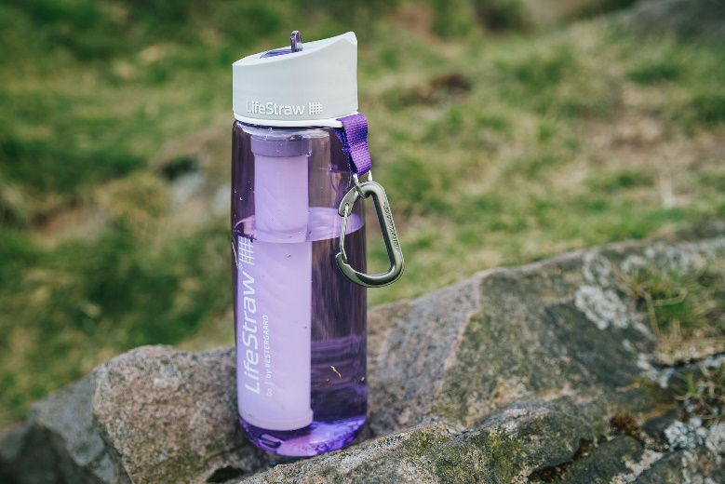
Water Treatment Methods
Bottle Filters and Purifiers
Offering fill-and-sip simplicity, these bottles have built-in filtration or purification elements. Some use the suction provided when you sip from a bite valve, while others work like a coffee press. Another model uses UV light.
Pros:
Treatment is easy and water is quickly drinkable.
The element or cartridge is replaceable.
On average, lighter and cost less than pump and gravity filters.
Cons:
Water quantity is limited by bottle size.
Field cleaning of the element is required.

Slide 13
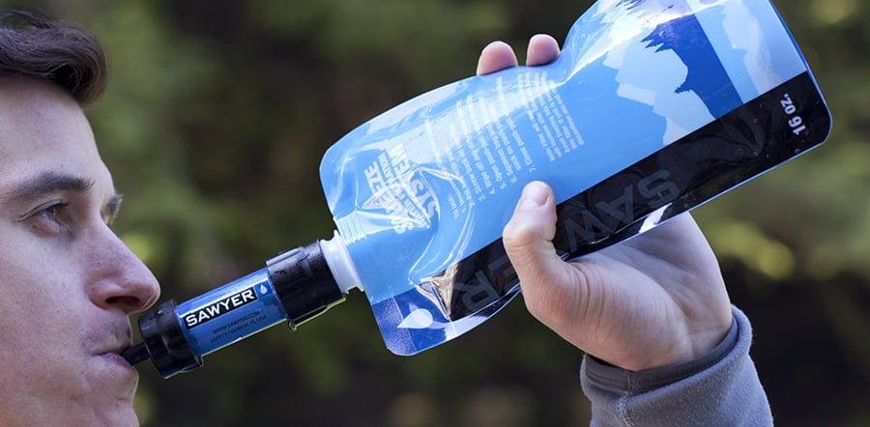
Water Treatment Methods
Squeeze Filters
This broad category is similar to bottle filters except that you’re filling a small reservoir, then squeezing water through the filtration element.
Pros:
Treatment is easy and water is quickly drinkable.
The element or cartridge is replaceable.
Some double as a gravity filter or straw-style filter.
On average, lighter, smaller and cost less than pump and gravity filters.
Cons:
Water quantity is limited by reservoir, flask or bottle size.
Field cleaning of the element is required.

Slide 14
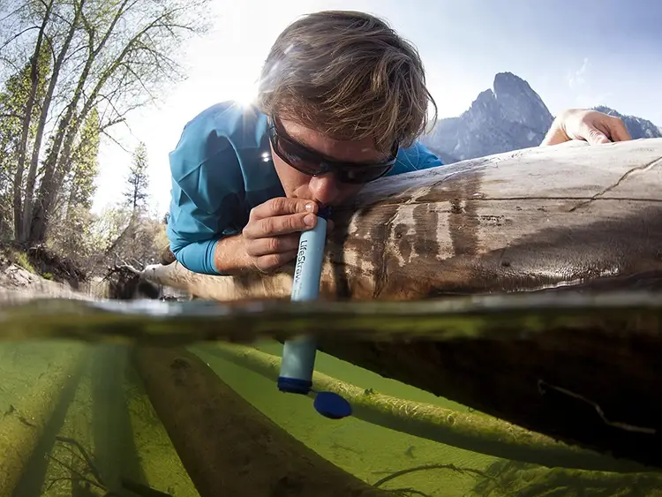
Water Treatment Methods
Straw-Style Filters
Providing water on demand, these cylinders have a built-in element that lets you slurp directly from the source.
Pros:
Treatment is easy and water is quickly drinkable.
On average, lighter and cost less than pump and gravity filters.
Cons:
Water is only available when you’re at a water source.
Generally only a 1-person treatment option.
Field cleaning of the element is required.
Not all models have replaceable elements.

Slide 15
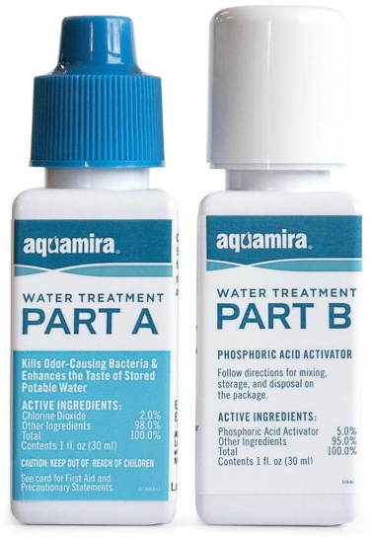
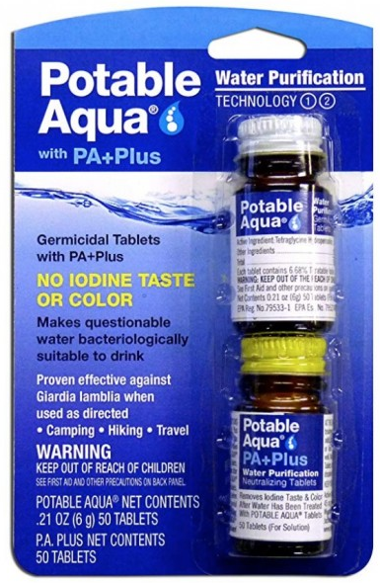
Water Treatment Methods
Chemicals
Effective against protozoa, bacteria and viruses, you simply add them to gathered water and wait. Products are typically iodine- or chlorine-based and available in drops, pills or gadgets that mix base ingredients.
Pros:
Easy to use.
Ultra-inexpensive, ultra-small and ultralight.
An excellent backup method to pack in case your main filter breaks.
Cons:
Wait time before drinking is 30 minutes to 4 hours, longer for icy cold water.
Iodine products impart a chemical taste—can be countered by taste-neutralizer tablets.
Iodine products aren’t effective against Cryptosporidium, though they work fine against other types of protozoa.
Iodine products can be a concern to pregnant women and people with a thyroid condition.

Slide 16
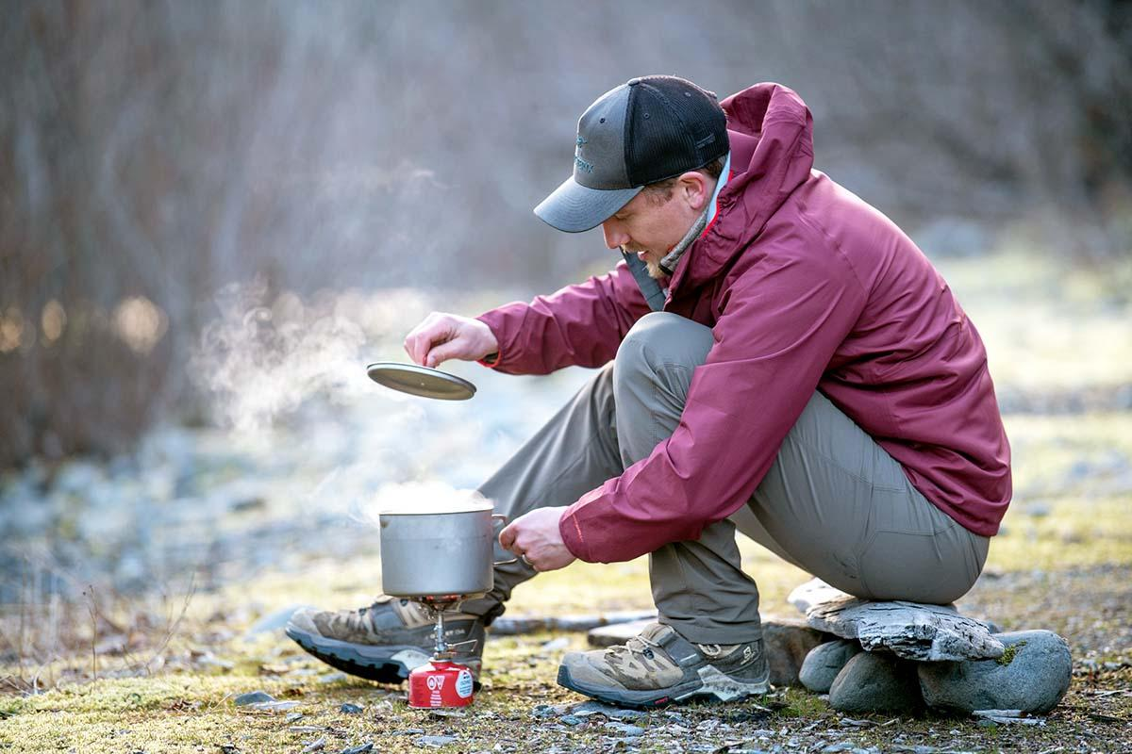
Water Treatment Methods
Boiling
Your stove, fuel and a pot are an effective treatment system to combat the full spectrum of biological pathogens. Bring water to a rolling boil for 1 minute; if you’re above 6,500 feet, boil it for 3 minutes.
Pros:
The only additional supply you need to pack along is extra fuel.
Murky water doesn’t impair effectiveness.
Serves as a readily available backup method in case your main filter breaks.
Cons:
Time and effort required to bring water to a boil.
Wait time for the water to cool.
If it’s your primary treatment method, you need to pack an extra fuel container.

Slide 17
Water Treatment Tips and Best Practices
Separate and clearly designate dirty and clean water containers.
Pay close attention to directions because every product has detailed steps to avoid cross contamination (introducing nontreated water into your treated water).
Seek out clean water because sediment impairs treatment effectiveness. If only murky sources are available, use a prefilter or allow sediment to settle from gathered water.
Keep your hands clean by packing hand sanitizer and using it often.
Keep camp, toilet and dishwashing areas at least 200 feet from any water source.
Freezing conditions require special consideration: Melting snow is your best bet. Filters that can freeze and crack can be stored overnight in your sleeping bag, though that won’t help if daytime temps remain below freezing, too. Batteries on UV pens won’t last as long, and many chemicals’ effectiveness diminishes in the cold (so read directions carefully for any you are considering).

Slide 18
Dishwashing
Backpacking Hygiene
Laundry
Human Waste
02
Sanitation

Slide 19
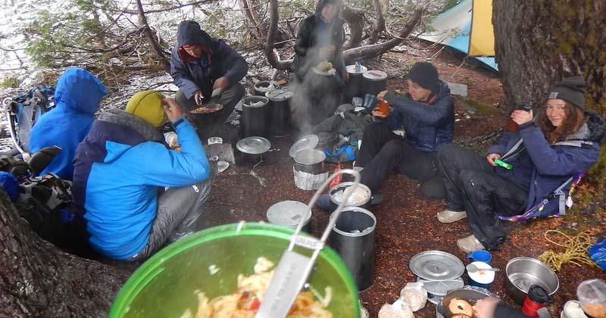
Dishwashing
It can be a real pain to do dishes in the wilderness, especially on those days when the weather leaves much to be desired.
Proper washing and rinsing will prevent diarrhea, dysentery and other ailments. Getting sick is never good, and stomach bugs will ruin a trip fast.
Dirty dishes can attract insects, small rodents and other animals (bears), plus dried food scraps will be harder to clean off.
Washing your backpacking dishes and cookware on the trail takes more than a few licks and a quick wipe. It takes soap, water and a strategy.

Slide 20
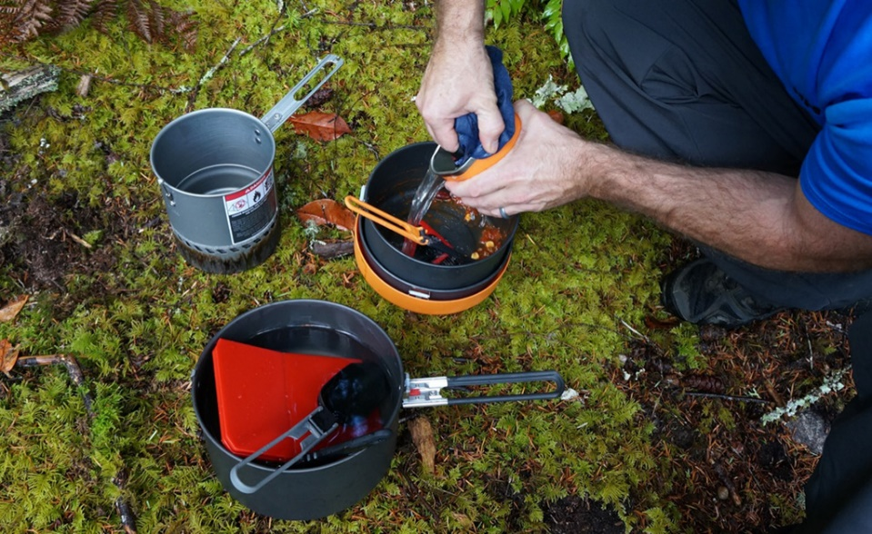
Steps For Easy Dishwashing
Heat extra water while cooking and set it aside for washing.
Hot soapy water dissolves the oil, grease and sticky food components clinging to your backpacking bowls, spoons and mugs.
It kills bacteria and viruses from saliva and dirty fingers.
It also leaves you with clean fingernails, a perk you shouldn't be too quick to dismiss as silly!
If you skip the soap and lick your dishes, I cringe in your direction.
Only the letter E stands between bowl and bowel. Coincidence? I think not!
Bacteria can double in number every 20 minutes - how long is it to your next bowl usage?
Start the cleaning by eating all your food and scooping out the rest before it dries.
Make your largest pot or bowl into your sink.

Slide 21
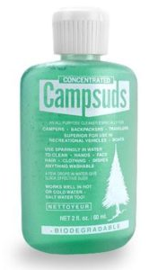
Steps For Easy Dishwashing
Use biodegradable soap. A small amount should go a long way.
Wash from cleanest to dirtiest. Usually cups, bowls, cutlery, and pots, in that order.
Rinse dishes, pots and utensils with a little filtered water.
Lest you be tempted to skip the "rinse off the soap" step, please let me remind you of the impact of soap suds on your GI tract.
Air dry the dishes.
Broadcast the dishwater over a wide area at least 200 feet from the nearest water source, campsite, or trail. Scattering dishwater in a sunny area will cause the water to evaporate quickly, causing minimal impact.
Wring out and hang your scrubber to dry.

Slide 22
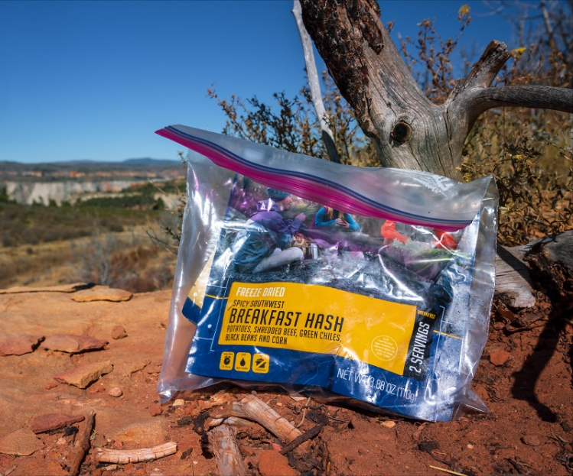
How to Deal with Food Scraps, the Leave No Trace Way
Leave No Trace is an overarching idea behind hiking in such a way that no other humans could tell that you ever hiked or camped in the area that you did, like a hiking ninja. Here’s how to do it:
​Properly plan your meals. Cooking the right amount of food makes the food disposal and dishwashing process much easier.
Bring less trash and packaging with you into the woods in the first place. Take your food and snacks out of the bulky plastic and cardboard packaging at home and repackage them into Ziploc baggies that can then be reused as trash bags on the trail.
Always pack out all trash and food scraps – Animals will be attracted to your trash and try to eat it long before it biodegrades. This is unhealthy for them and can cause the animals to learn to turn to humans for food – creating ‘nuisance animals’ who either need to be euthanized or relocated. If you use freezer bags to bring your food in, use them again to store your food waste and pack it out until you reach a place to dispose of trash properly. If the idea of stuffing freezer bags full of trash and food scraps into your pack doesn’t excite you, plan your meal portions better.

Slide 23
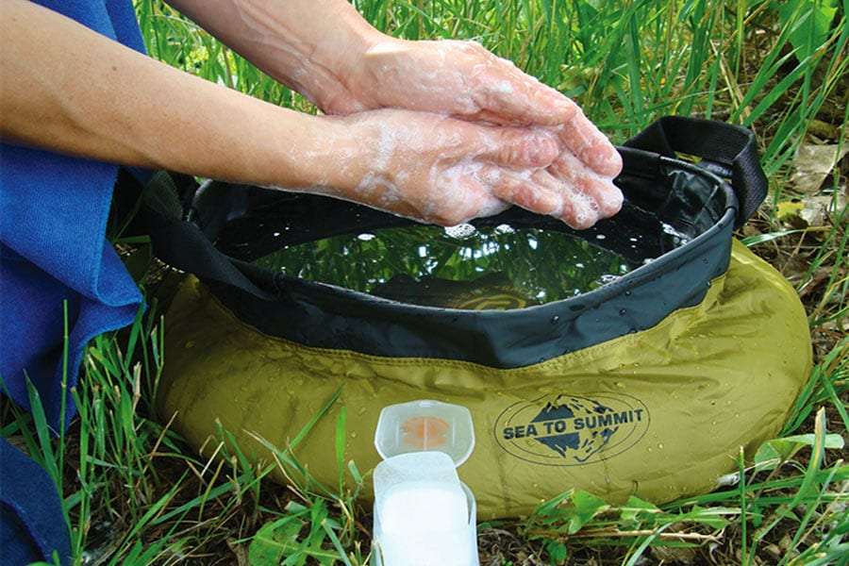
Backpacking Hygiene
Maintaining good personal hygiene while on the trail can be a bit tough at times due to a lack of running hot water and the luxury of a private area.
The following slides provide some overall useful tips for keeping up with hygiene and making sure your body is in top notch condition while spending extended time in the backcountry whether it be for a weekend camping trip, multi-week backpacking adventure, or long trail thru-hike.
Remember, do not bathe or do laundry in or near a stream. Instead, use biodegradable soap and a shower or wash bag at least 200 feet from the nearest water source, campsite, or trail.

Slide 24
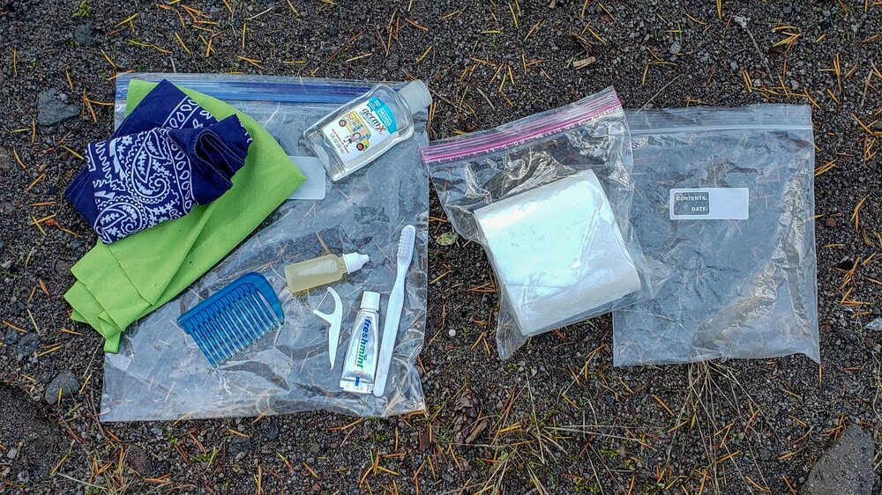
What Are Backpacking Hygiene Essentials?
Do Bring
Unscented, alcohol-based gel hand sanitizer
Biodegradable soap
Toothbrush
Toothpaste
Dental floss (doubles as string in a pinch)
Cotton bandana or washcloth
Unscented moist towelettes or baby wipes
Quick-dry microfiber pack towel
Toilet paper in its own plastic bag
A menstrual cup (if necessary) or feminine hygiene products and a sealable plastic bag to carry them out.
A sizeable plastic bag to do laundry in

Slide 25
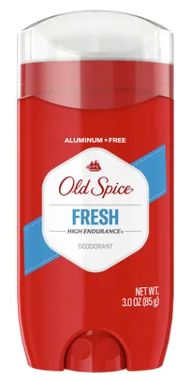
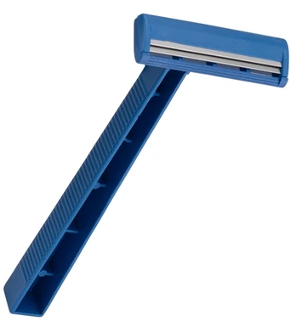
What Are Backpacking Hygiene Essentials?
Do Not Bring
Deodorant (smells attract woodland creatures)
Shampoo (bad for the environment)
Razors (embrace the beard, or let your legs go)
Mirrors (clunky and easily broken)
Non-biodegradable products (bad for the environment)
“Disposable” products that you’ll have to carry out (bulky and cumbersome)

Slide 26
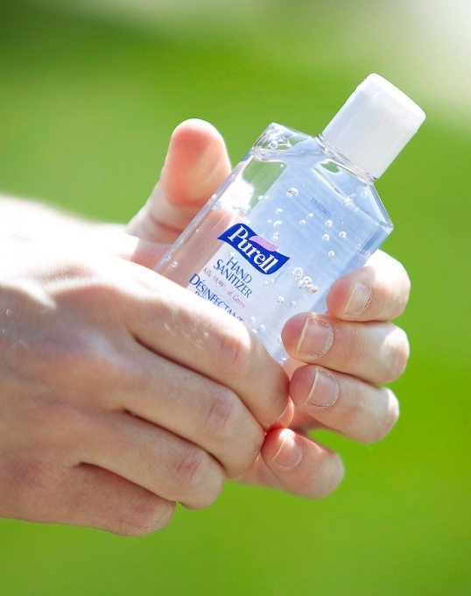
Hand Sanitizer Is a Backpacking Godsend
Hand sanitizer is a compact and lightweight way to kick germs’ butts.
Hikers should sanitize their hands whenever they go to the bathroom and before cooking or eating meals.
If you don’t, the germs on your fingers will end up in your eyes or mouth.
Hikers are quick to blame trail illnesses on contaminated drinking water, but hand-to-mouth infection is a frequent culprit too.
Because washing with soap and water isn’t always convenient or available, carry a bottle of alcohol-based hand sanitizer.
This clear gel contains a small concentration of ethyl alcohol that kills germs on contact.
Just add a dime-size drop to your palm, rub your hands together vigorously, and wait 20 to 30 seconds for the alcohol to evaporate.
Sanitizer can be used to disinfect eating utensils as well.

Slide 27
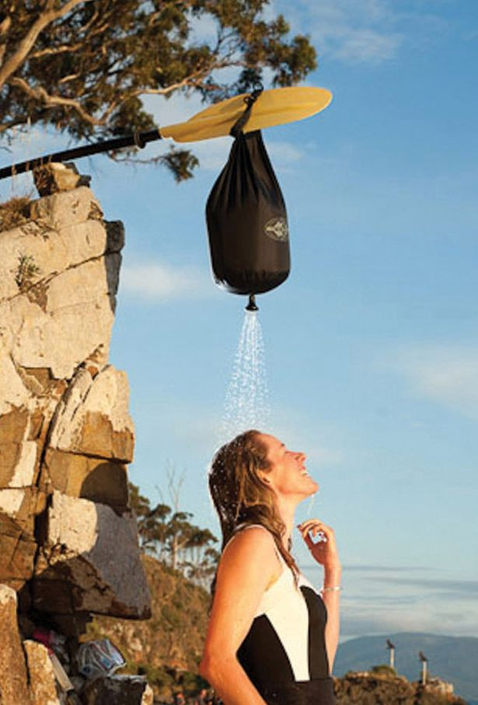
How Do I Shower (or Keep Clean) When I’m Backpacking?
To get clean after a sweaty day on the trail, you have three options.
Get in a Lake or River: Not only is a cool swim extremely refreshing, it also rids your body of sweat and dirt. Just be sure to swim away from where other hikers collect water, camp, or fish, and don’t use any soap.
Take a Trail Shower: Take a trail shower by stripping down and washing yourself with biodegradable soap, a sponge or bandana, and a couple of liters of water. Shower at least 200 feet from any lakes, streams, or ravines. You want to avoid fungus and chafing, so pay special attention to your face, underarms, groin, lower legs, and feet. Sea-to-Summit makes small pocket showers that can be filled with nearby water, hung, and a legitimate shower can be taken on a backpacking trip.
Spruce Up With a Sponge Bath: If it’s too cold or impractical to take a trail shower, try a sponge bath. Fill a backpacking water bucket, strip off your clothes, wet your bandana and add some biodegradable soap, then go to town. After soaping and scrubbing, rinse the bandana and begin wiping off the soap.
Whichever method you choose, dry yourself off with a lightweight, quick-drying microfiber towel.

Slide 28
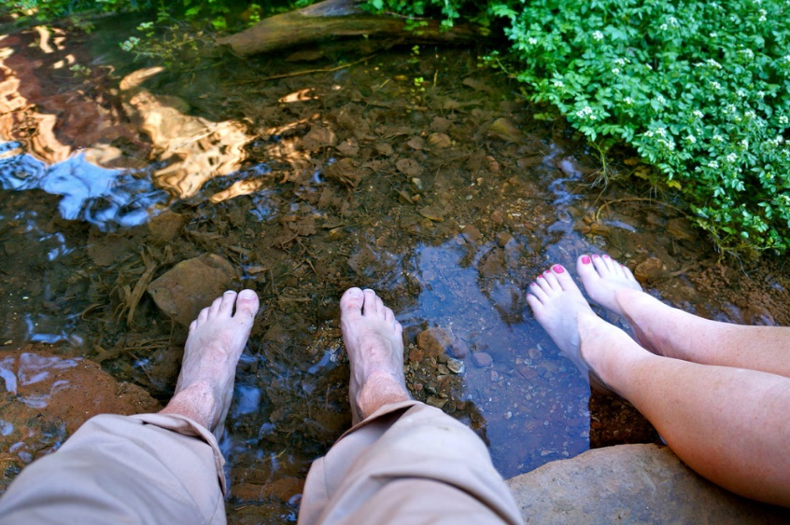
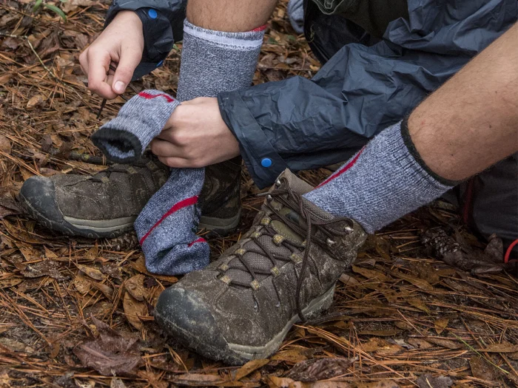
Take Proper Care of Your Feet
Your feet are the most important part of any hike you go on, so you want to keep them clean as possible so that you don’t catch something itchy or fungus-like.
Be sure that you change your socks frequently, wash your feet everyday, and remove your socks and shoes throughout the day to let them air out and breathe.

Slide 29
Change Your Clothes
Ideally, you want to carry extra underwear, shirts, and socks that you can switch between.
This means you can wash one set, let them dry, and switch over to the clean set the next day.
Make sure you are switching to clean clothes routinely.

Slide 30
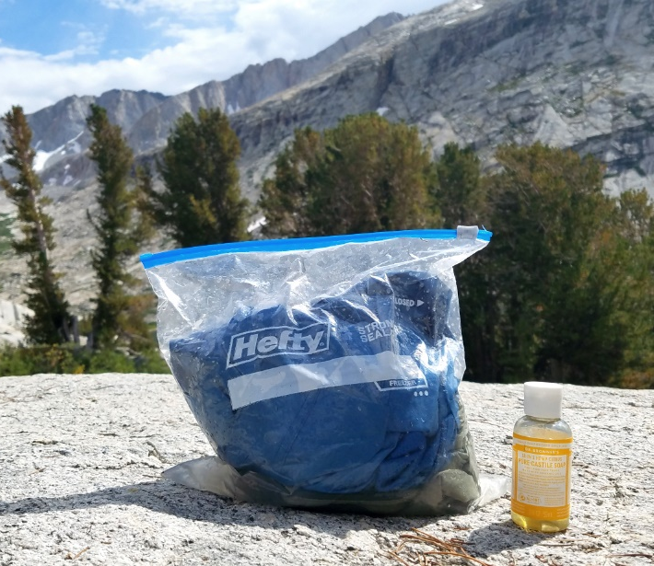
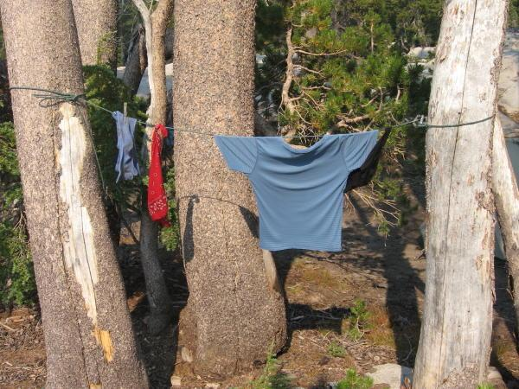
How To Do Your Laundry While Backpacking
Pack a 2 ½ gallon Ziploc bag.
Fill the bag half way with lukewarm water.
Add your clothing items and biodegradable soap, making sure that you leave enough room for the contents to move around.
This step is very important in order to clean your clothes thoroughly as possible.
Shake the bag vigorously, making sure that the contents are moving around for about 5 to 10 minutes.
Dispose of your used water at least 200 feet away from any water source.
Refill the bag with clean water and shake again.
Wring the clothing items out thoroughly and hang them somewhere to dry.
If you plan on hiking out, you can hang the wet clothing from the outside of your pack so that they dry while you hike.

Slide 31
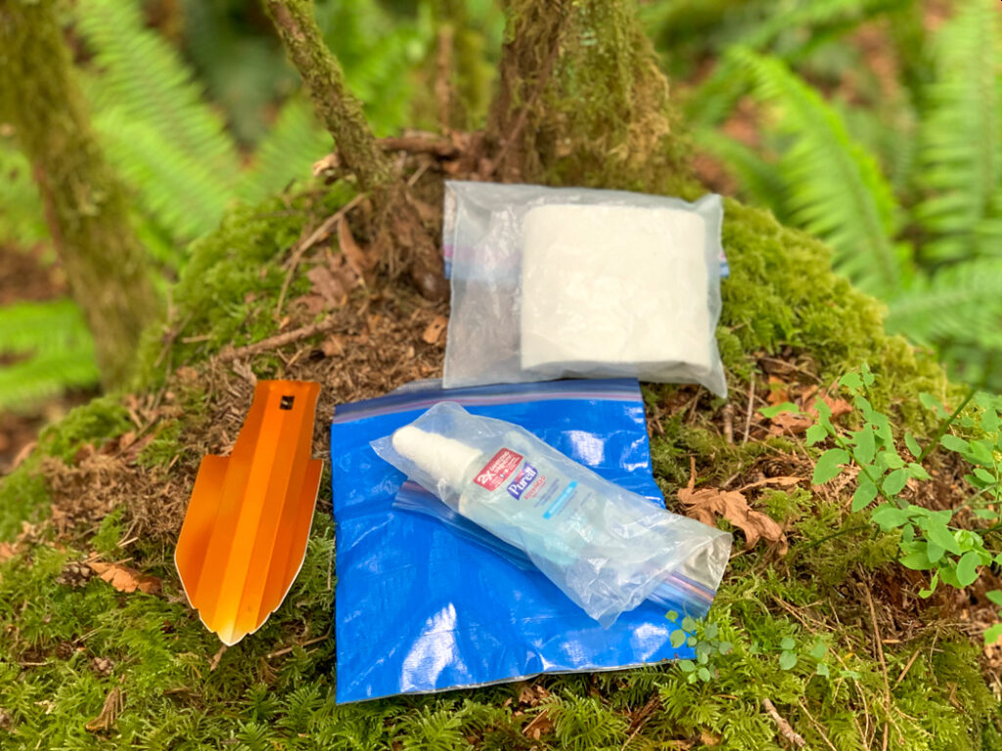
How To Deal With Your Period While Backpacking (For The Girls)
If you have your period while on trail, there are a few options to choose from.
The most eco-friendly option for dealing with periods on the trail is to use a menstrual cup, preferably the washable, silicone kind.
These cups must be emptied out properly and regularly.
Another option is to carry disposable products, such as tampons.
You will need to pack out the used ones when you’re done in the same manner you would pack out used toilet paper.

Slide 32
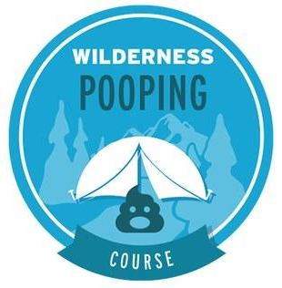
Human Waste (How to poop and pee in the woods!)
Proper disposal of human waste is important to avoid pollution of water sources, avoid the negative implications of someone else finding it, minimize the possibility of spreading disease, and maximize the rate of decomposition.
If an outhouse or bathroom is available, use it.
In most backcountry locations, burying human feces in the correct manner is the most effective method to meet these criteria.
Solid human waste must be packed out from some places, such as river canyons or corridors.
Land management agencies can advise you of specific rules for the area you plan to visit.

Slide 33
How to Pee in the Woods
Choose a place that’s well away from your trail or campsite. A group may choose to designate more than one location.
When choosing your specific spot, keep the following in mind depending on where you are:
Small bodies of water: Never go directly into a small pond, stream or lake. Always move 200 feet (about 70 steps) away from a water source.
Large bodies of water: If you’re in a rafting group camping along a very large river, Leave No Trace recommends peeing directly in the water; the river volume will dilute it, and the camping area avoids getting over-saturated.
Alpine areas: Up high in mountain goat territory, peeing on a rock surface is recommended. Goats and other animals are attracted to the salts in urine, and may dig up fragile vegetation to get the salt.

Slide 34
How to Poop in the Woods
Before you head to your outdoor rest stop, make sure you have the supplies you need with you and know the proper techniques to follow.
Supplies: In addition to the basics—toilet paper and hand sanitizer—you’ll want to bring along the following as needed:
Sealable plastic bag: The preferred practice now is to pack out your used toilet paper (and even if it's not required, it's still the best practice for lowering your impact on the land).
Roll of dog poop bags: The kind you use to clean up after your pet when on a walk.
Camp trowel: Many are very lightweight and can be helpful for digging a cat hole.

Slide 35
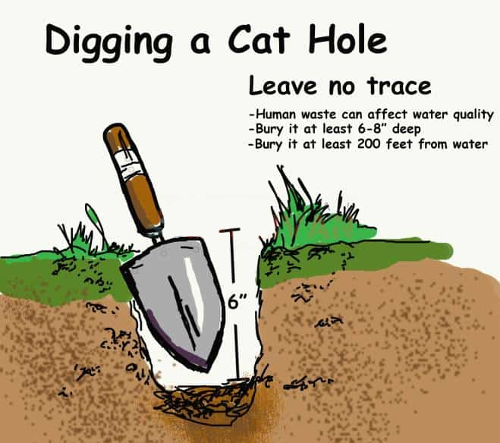
How to Poop in the Woods
Find an appropriate spot:
Carry your supplies 200 feet (70 steps) from a trail, campsite or water source. Choose underbrush for privacy if you like, and notice your surroundings to make sure you can find your way back to your camp or trail.
If possible, find loose, rich soil and a sunny site. Both of these conditions help decompose waste more quickly. Use a trowel, stick, rock or boot heel to make a hole about 4 inches wide and 6 to 8 inches deep.
If the ground is too hard or rocky to dig, try lifting a rock and use that spot. Replace the rock when you’re done. Or carry your waste out in a bag.

Slide 36
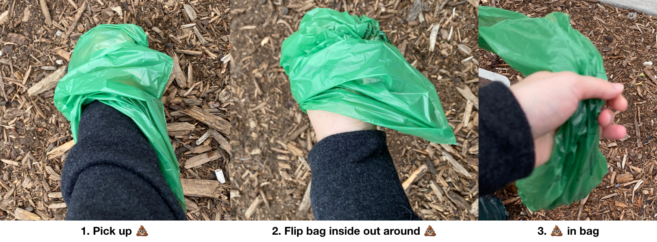
How to Poop in the Woods
Pick up toilet paper
Flip bag inside out around toilet paper
Toilet paper in bag
Managing toilet paper:
Use toilet paper sparingly and use only plain, white, nonperfumed brands.
Place used TP in a dog poop bag, squeeze the air out and tie it closed, and then put the wag bag in a Ziploc bag to pack out. (Places where burying your TP is allowed are becoming scarce—only do it if your cathole is sufficiently deep and you're absolutely certain land managers say that it's acceptable practice.)
Never burn used toilet paper as used toilet paper does not burn well (I wonder why?) and you increase the danger of starting a wildfire.
Pre-moistened wipes can be nice to use on occasion, but don’t drop them in the hole; they need to be packed out in your waste bag (as do menstrual supplies).

Slide 37
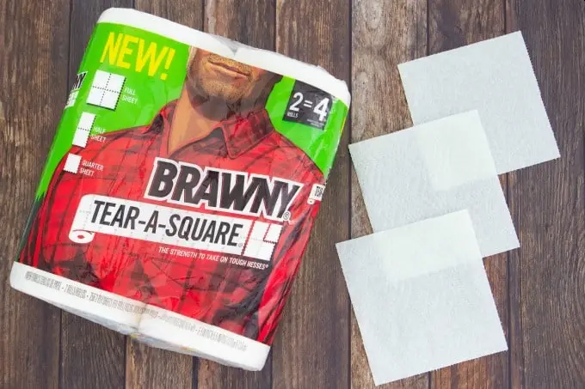
How to Poop in the Woods (with Paper Towels)
The best toilet paper for backpacking may actually be paper towels.
Regular toilet paper just doesn't stand up to the humidity and shreds too easily leaving Klingons (not the Star Trek variety).
Brawny paper towels are great to use because they now come in quarter sheets.
If using other brands, at least find one that comes in half sheets and follow the procedure below:
In packing toiletries for a trip, tear off five half sheets for each day.
Cut each half sheet in half again, producing ten quarter sheets for each day.
Pack ten quarter sheets in a quart Ziploc bag along with dog poop bags (the bags people use to put pet feces in) and individually wrapped antibacterial moist wipes such as “Wet Ones” (unscented to avoid attracting bears).
Prepare a quart bag for each day to be spent in the backcountry along with one extra.
Place these prepared quart bags along with a gallon Ziploc bag inside of a second gallon Ziploc bag.
The extra gallon bag is to hold the wag bags containing the used toilet paper.
Don’t forget to include a small bottle of hand sanitizer.

Slide 38
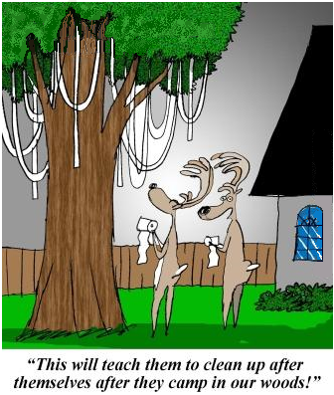
How to Poop in the Woods (with Paper Towels)
When nature calls in the backcountry, dig a cathole in an appropriate site and make your fecal deposit in the hole.
Clean yourself with the contents of one of the quart Ziploc bags.
Paper towels are biodegradable, but don't bury them in a cat hole or drop them in a composting privy.
Pack out the used towels and Wet Ones in a dog poop bag sealed inside of the quart Ziploc bag.
Place the quart bag in the separate gallon Ziploc bag (you should only need one for a seven-day trip).
Finally, cover and disguise the contents of the cathole and use the hand sanitizer to thoroughly clean your hands.
The most common cause of diarrhea in the backcountry is poor hand sanitation, not contaminated drinking water or what was ate.

Slide 39
How to Poop in the Woods
The moist wipes serve two functions.
They contain aloe which can be soothing when necessary and they can help ensure that your butt crack is clean.
Monkey butt (diaper rash) can become very painful if you are hiking long distances over multiple days.
The best cure is prevention.
If that fails, break out the medicated Gold Bond and use liberally (if you are tough enough).

Slide 40
Questions?
Terry McKibben
Troop 344/9344
Pemberville, OH
troop344leaders@gmail.com

